Slide 1
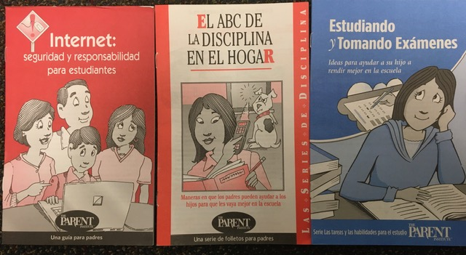
AVAILABLE RESOURCES FOR PARENTS

