Slide 1
Autism Spectrum Disorder Professional Learning Series Part 3
Created and Presented by: M-SCS Health Services Program Advisors
Timika Sholar, Nicole Hilliard, Shanel Carson, LaTasha Jones, Michaela Myers, and Veronica Roberts

Slide 2
Smaller Title or Accent Image Here

Slide 3
LEARNING OBJECTIVES
Smaller Title or Accent Image Here
Tips for Talking with Parents about Developmental Concerns
Supporting Parents with Information About Their Rights and Responsibilities
S-TEAM Process (SST Process)
What to Do if a Parent has an Evaluation from an Outside
Provider Agency
Autism Resources

Slide 4
A Review…..What is Autism?
A bio-neurological developmental disability that generally appears before the age of 3
Impacts the normal development of the brain in the areas of social interaction, communication skills, and cognitive function and can cause significant social, communication, and behavioral challenges.
Typical difficulties are seen in the areas of verbal/non-verbal communication, social interactions/communications, and leisure/play activities
Individuals with autism often suffer from numerous co-morbid medical conditions which may include allergies, anxiety, adhd, asthma, epilepsy, digestive disorders, persistent viral infections, feeding disorders, sensory integration dysfunction, sleeping disorders, and more
Is an individualized disability and can vary greatly from person to person
(no two people with autism are alike)
Children with autism do progress – early intervention is key
Is treatable and not a hopeless condition
Smaller Title or Accent Image Here
https://nationalautismassociation.org/ and www.cdc.gov

Slide 5
Tips for Talking with Parents about Developmental Concerns

Slide 6
Initial Conversations
Discuss development regularly, not only at times of concern
Share Resources
(milestone checklists, Milestone Moments booklet, CDC Milestone Tracker app)
Use good listening skills
www.cdc.gov/ActEarly

Slide 7
cdc.gov Training Module #4 Watch Me! Learn the Signs. Act Early Conversation about a typically developing child "Active Listening: No Concerns"

Slide 8
When You Need to Share
Concerns with a Parent
Share/Highlight the child’s strengths first
Be well prepared to express your concerns (do not diagnose or speak negatively about the student)
Encourage the parent to share concerns with the student’s PCP
Follow-up with the family in a few weeks
Be mindful of cultural differences
www.cdc.gov/ActEarly

Slide 9
cdc.gov Training Module #4 Watch Me! Learn the Signs. Act Early Conversation about a non-typical developing child "Active Listening: Concerns"

Slide 10
cdc.gov Training Module #4 Watch Me! Learn the Signs. Act Early Conversation about a non-typical developing child "Putting the Milestones into Practice: Jacob and Tyler, a Case Study"

Slide 11
When Parents Disagree with Your Concerns
OR
Doctors Want to Wait/Don't See What You See

Slide 12
Examples of Statements You Can Express
REMEMBER TO NEVER DIAGNOSE A CHILD…..
Sometimes children behave differently at home and school so I'm only able to share what I've witnessed in the classroom. We can refer your child to our school district’s Local Education Agency to discuss concerns further/request an evaluation or we can continue to monitor and have a follow-up discussion in a few weeks to see how you feel.
I understand that you are upset, but I also want the best for your child so it's important for me to share what I have observed. We can move forward however you feel is best.
I understand the Doctor prefers to wait and it's true all children develop at their own pace, but if you're willing, there are alternate avenues we can take such as getting a second opinion or calling our district’s Local Education Agency to make sure there are no legitimate concerns because early intervention is key.
www.cdc.gov/ActEarly

Slide 13
Recommendations You Can Offer Parents
Ask the PCP about completing Developmental Screenings
Ask the PCP for a referral to a Specialist
Get an evaluation completed by an outside provider (2nd Opinion)
Contact the assigned HSA for additional guidance

Slide 14
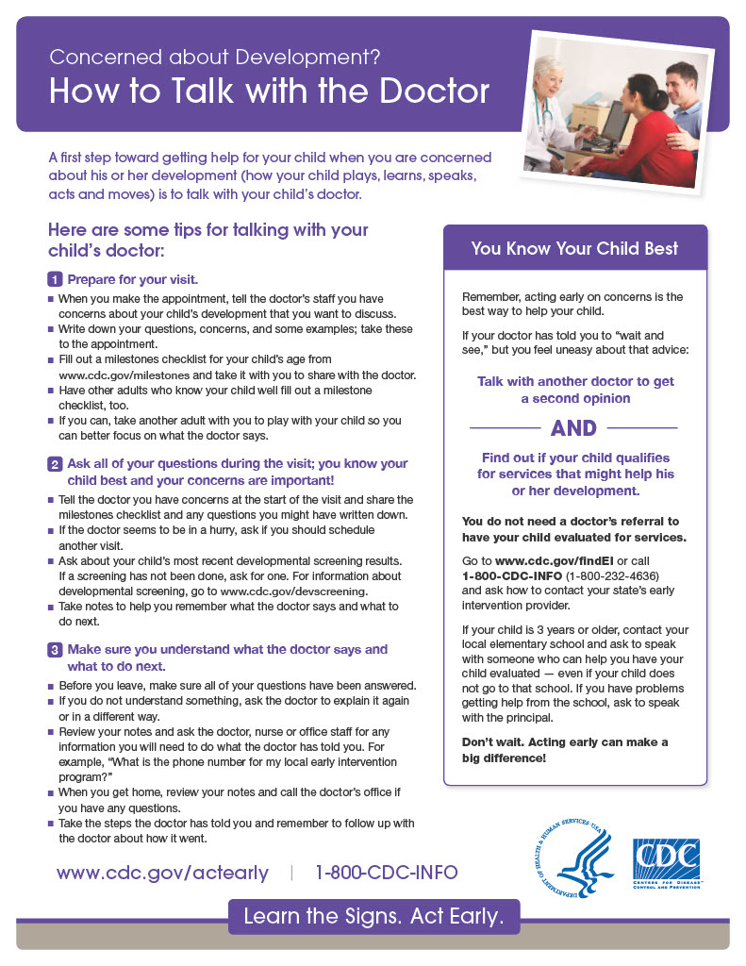
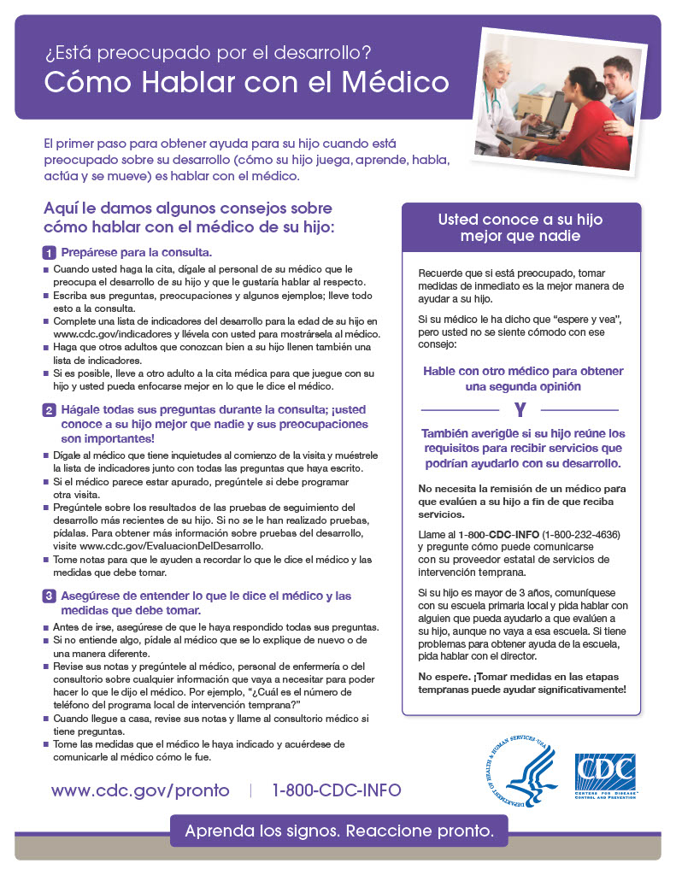
Tip Sheet

Slide 15
Supporting Parents with Their Rights and Responsibilities
Remember whenever a disability is SUSPECTED, the student is IMMEDIATELY protected by the Individual’s with Disability’s Education Act (IDEA) and the TN Rule 0520-01-09. In addition, parents are given the right to participate in their child’s education.
Purpose of the IDEA
to ensure that all children with disabilities have available to them a free appropriate public education that emphasizes special education and related services designed to meet their unique needs and prepare them for further education, employment, and independent living;
to ensure that the rights of children with disabilities and parents of such children are protected;
to assist States, localities, educational service agencies, and Federal agencies to provide for the education of all children with disabilities;
to assist States in the implementation of a statewide, comprehensive, coordinated, multidisciplinary, interagency system of early intervention services for infants and toddlers with disabilities and their families;
to ensure that educators and parents have the necessary tools to improve educational results for children with disabilities by supporting system improvement activities; coordinated research and personnel preparation; coordinated technical assistance, dissemination, and support; and technology development and media services;
to assess, and ensure the effectiveness of, efforts to educate children with disabilities.
https://sites.ed.gov/idea/
Notes:
Smith Last Slide

Slide 16
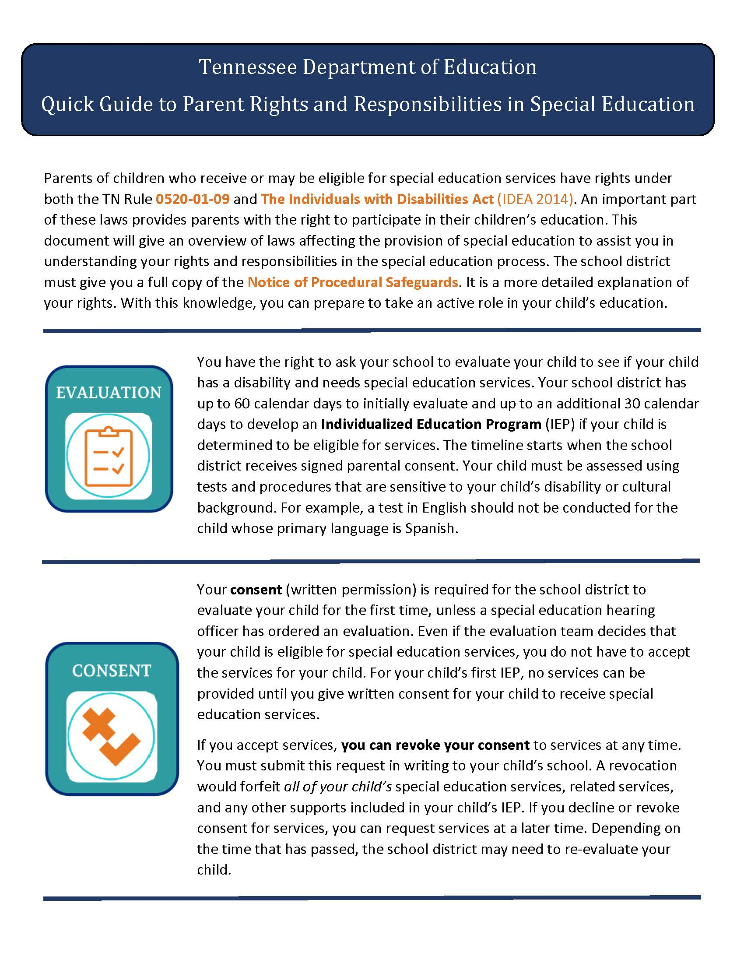
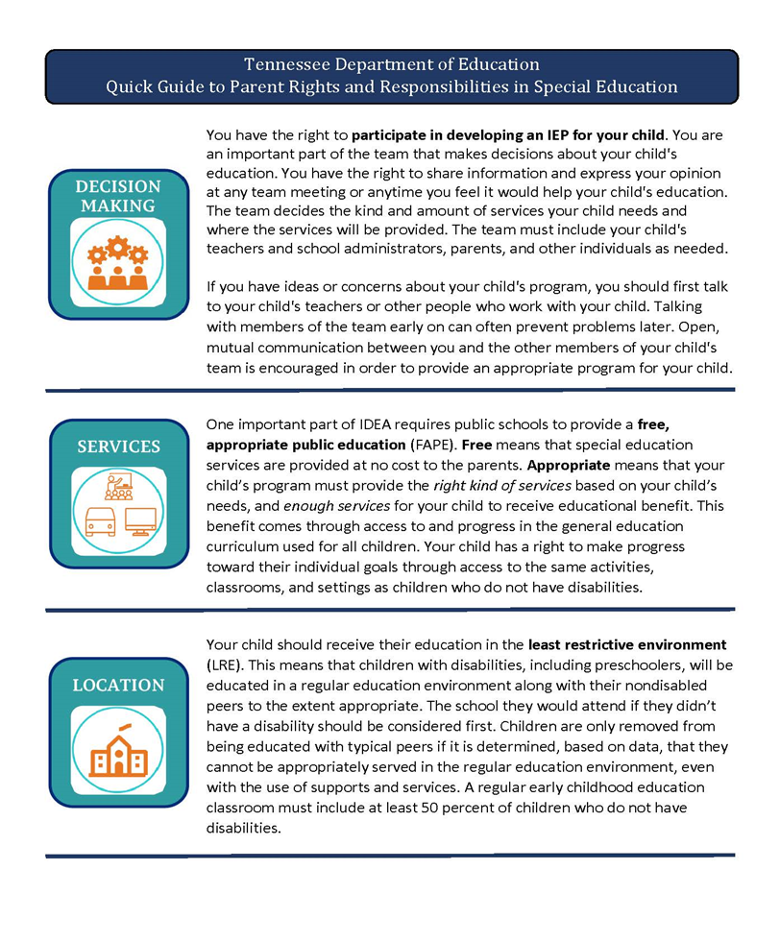
TN DOE QUICK GUIDE TO PARENT RIGHTS AND RESPONSIBILITIES IN SPECIAL EDUCATION

Slide 17
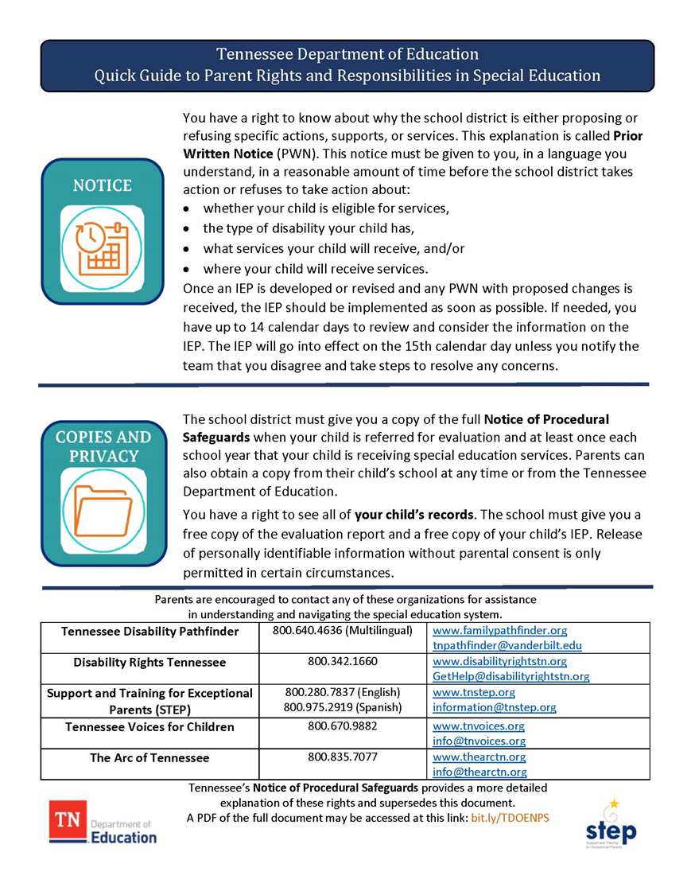

Slide 18
S-TEAM/SST PROCESS
Referral to Student Support Team
If additional student concerns are noted, the student will be referred to the Student Support Team (SST) to discuss the need for further testing. If agreed upon by the SST Team members, the child will be referred to the Local Education Agency (LEA) for further evaluation. School-Based Sites: The FES will contact the School Counselor or S-Team Chairperson to initiate the process. Center-Based Sites: The FES will compile the necessary referral packet documentation (listed below). The referral packet is then given to the HSA to process with Colonial. Community Partner Sites: The FES will assist the parent in scheduling an appointment with the LEA and continue to follow-up with the Parent throughout the process. The FES will also notify the HSA of the referral and provide updates throughout the process.
Notes:
Contrary Pattern: where they ask for something, then say no when you give it to them

Slide 19
The following items must be included in the referral packet:
Copy of vision screening results (must state “Passed” status)
Copy of hearing screening results (must state “Passed” status)
Copy of speech screening results/referral packet
FBA/BIP (if applicable)
Copy of any evaluations from outside agencies
Copies of all Student Support documents
The Head Start Referral for Further Evaluation Form (Center-Based Sites)
Brigance Screener
***Additional documents may be required by the Local Education Agency (LEA)***

Slide 20
WHAT TO DO WITH OUTSIDE EVALUATIONS
If a parent has an evaluation from an outside provider, the evaluation will need to be submitted to the LEA (Local Education Agency) via the parent or the assigned site HSA. Within our school district, the LEA is Colonial Hearing, Speech, and Vision Center.
COLONIAL HEARING, SPEECH & VISION CENTER
Offers FREE hearing evaluations and vision screenings to all SCS students, age 3 – 22. This includes Pre-K speech/language and developmental testing.
AVAILABLE SCREENING SERVICES:
Audiological Therapy
Diagnostic Testing
Hearing Impaired
Interpreting for Deaf Students
OT/PT
Special Education Preschool
Speech Language Therapy
Vision
CONTACT FOR AN APPOINTMENT: (901) 416-5206 | 4774 SEA ISLE RD.

Slide 21
Smaller Title or Accent Image Here
RESOURCES
Notes:
https://www.youtube.com/watch?v=-9UtEaEoAiU

Slide 22
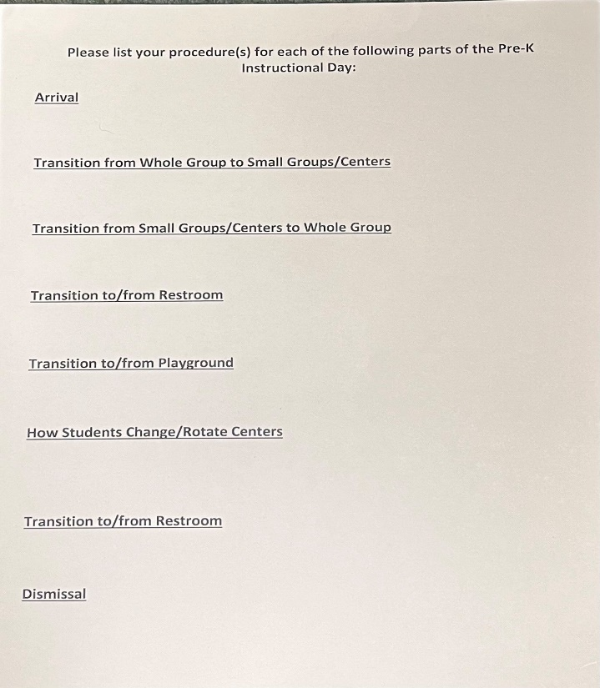
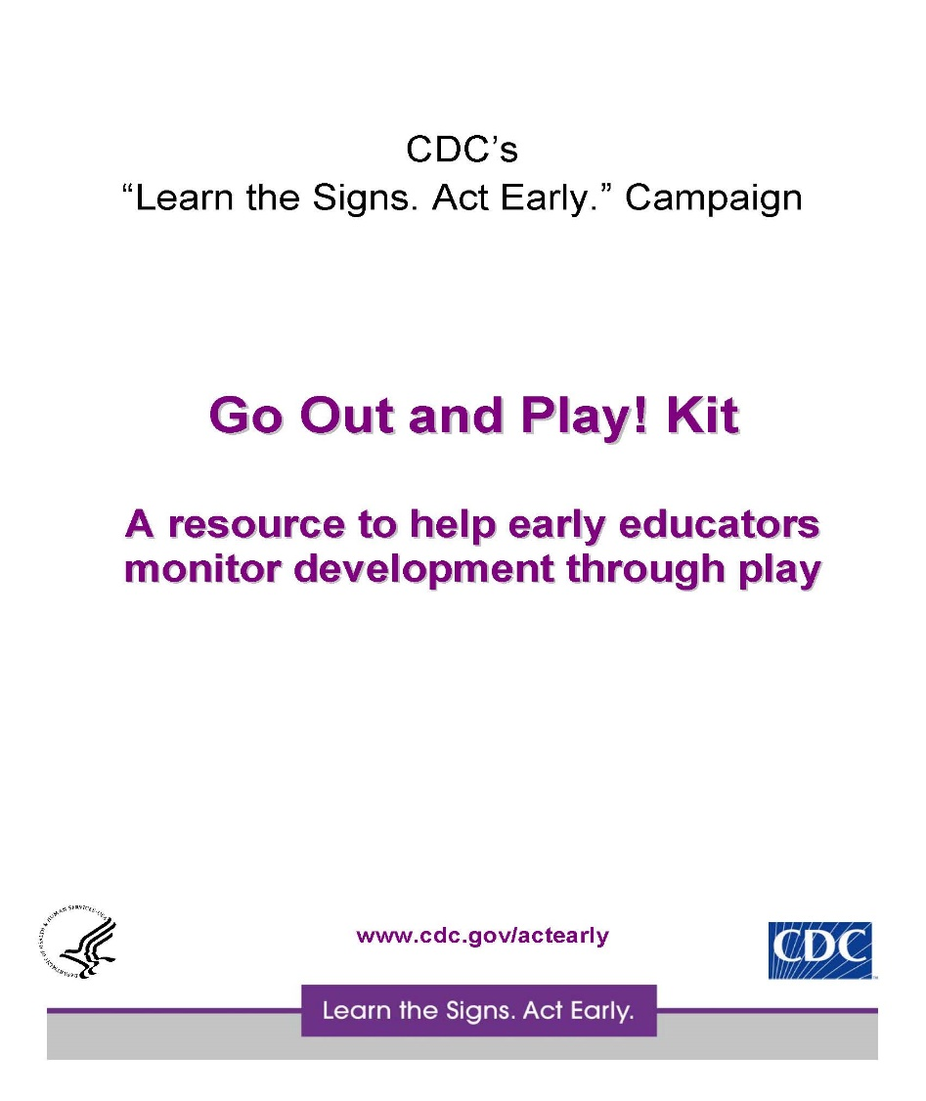
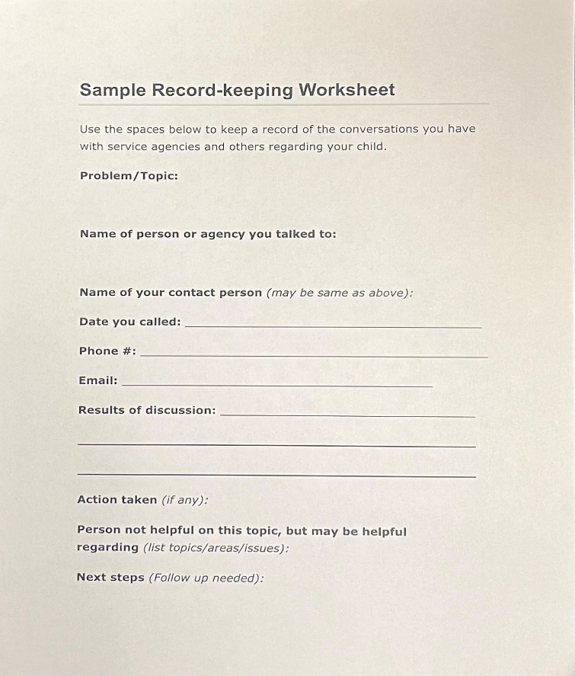
Sample Tools
Smaller Title or Accent Image Here
Notes:
What are some things you do in your classroom to help with Hyposensitivity?

Slide 23
Children’s Books About Autism
Armond Goes to a Party: A Book About Asperger’s and Friendship
My Brother Charlie by Holly Robinson Peete and Ryan Elizabeth Peete
Never Touch a Monster
Touch! My Big Touch-and-Feel Word Book
Touch and Explore the Ocean
Little Monkey Calms Down
This is Me! I am who I’m meant to be!
Headphones: A Book for Children with Autism & Sensory Disorders
When Things Get Too Loud
Silly Sea Creatures
Poke-A-Dot 10 Little Monkeys
Catty the Cat, Green vs. Red Choices
See, Touch, Feel: A First Sensory Book
Touch and Trace Farm
Point to Happy
The Color Monster
Off to School!
My Awesome AUTISM
My First Book of Emotions for Toddlers

Slide 24
ABA Therapy Resources
Behavior Services of the Mid-South: 901.248.0595 / https://www.behaviorservicesmidsouth.com
Autism Centers of TN: 901-567-5361 / contactus@autismcenterstn.com
Team Autism Memphis: .901.337.7524 / https://www.teamautism.org/
Hopebridge Autism Therapy: 855.324.0885 / https://www.hopebridge.com/
Infinite Changes and ABA Therapy & Autism Services: 901.221.7458 / https://www.infinitechangesaba.com/
Transformations Autism Treatment Center: 901.231.1931 / www.transformingautism.com
ABA Development: 901.634.8005 / www.abadevelopment01@gmail.com
Specialized Learning Center: 901.634.5729 / mwilkins@memphis.edu
Harwood Center: 901.584.8281 / https://harwoodcenter.org/
Behavioral Science Consulting: 901.276.9606 / http://bscmemphis.com/
Pinnacle Autism Therapy: 1.866.342.8847 / https://pinnacleautismtherapy.com/
Notes:
What are some things you do in your classroom to help with Hypersensitivity?

Slide 25
Resources
NATIONAL
Autism Speaks Website: https://www.autismspeaks.org/
National Autism Association: https://nationalautismassociation.org/
Autism Society: https://www.autism-society.org
LOCAL FUN
Chuck E. Cheese Sensory Sunday
First Sunday of each month from 9:00 AM to 11:00 AM

Slide 26
Other Community Resources
ABA Development
Specialized Learning Center
Lebonheur
UT Boling Center
Wholistic HC
Knowles M.D. Neurodevelopmental Center
Behavioral Health & Assessment
University of Memphis Psychological Services
Christian Psychological Center
Germantown Psychological Associates
Vogelfanger & Struble Clinic
Katherine Powers, Ph. D., BCBA-D

Slide 27
HEALTH SERVICES TEAM CONTACT INFO
Timika Sholar, HSA: sholarts@scsk12.org
Debany Corral, BS: corralozaetad@scsk12.org
Nicole Hilliard, HSA: hilliardn2@scsk12.org
Capria Tyson, BS: tysoncm@scsk12.org
Shanel Carson, HSA: carsons@scsk12.org
Shalah Pate, BS: pates@scsk12.org
Michaela Myers, HSA: myersmd1@scsk12.org
Maya Smith, BS: smithm12@scsk12.org
Veronica Roberts, HSA: robertsv@scsk12.org
Pamela Boyce, BS: boycepc@scsk12.org
Latasha Smith, HSA: bentonjonesle@scsk12.org
Keva Smith, BS: smithky@scsk12.org
LEADERSHIP TEAM
Divalyn Gordon, Executive Director
Detris Crane, Ed.D. Head Start Director
Tujuana Wallace, Comprehensive Services/ERSEA Manager

Slide 28
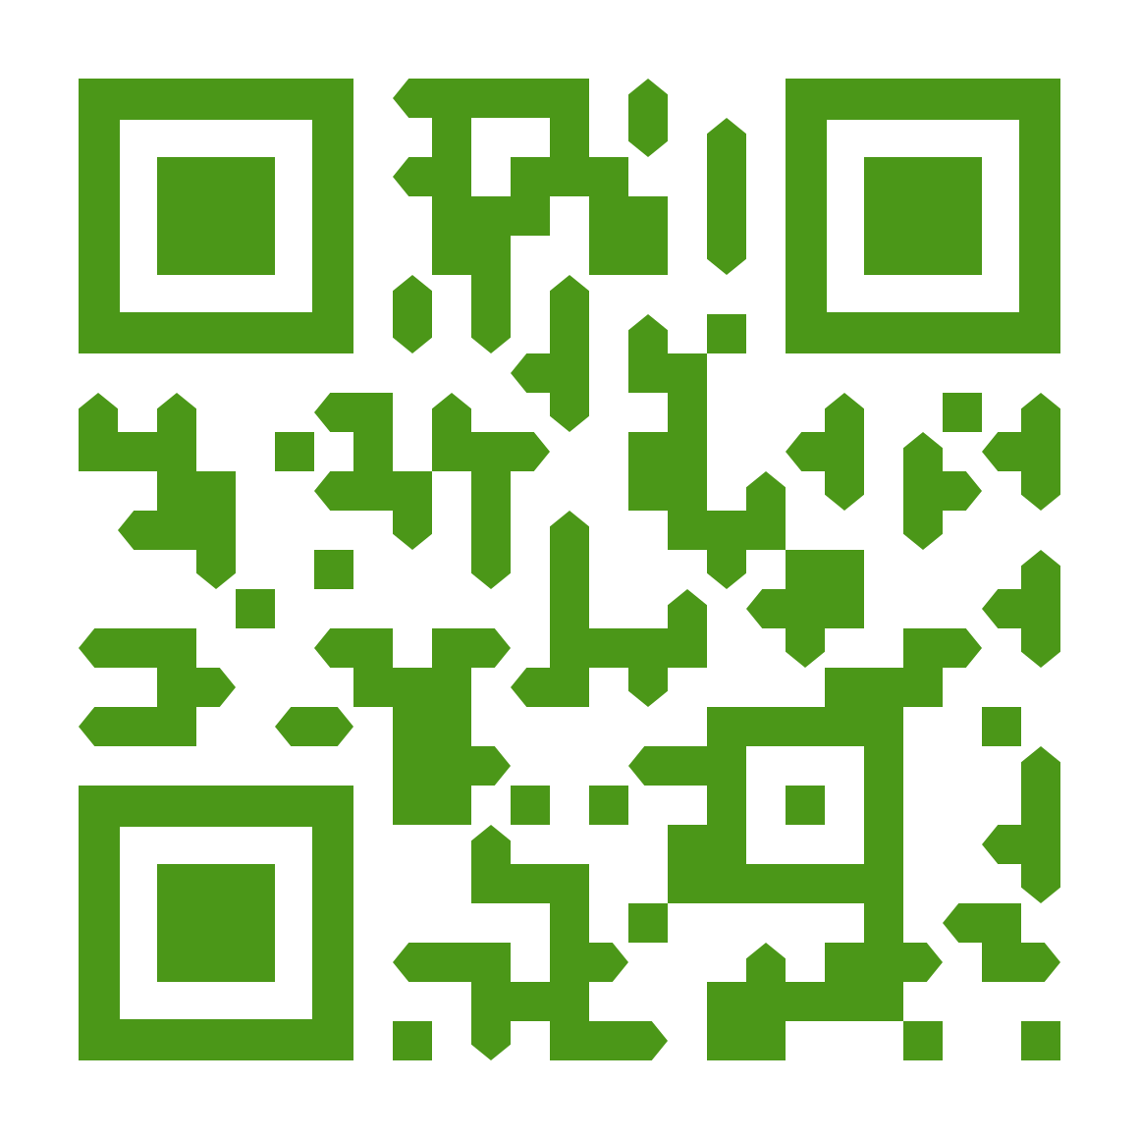
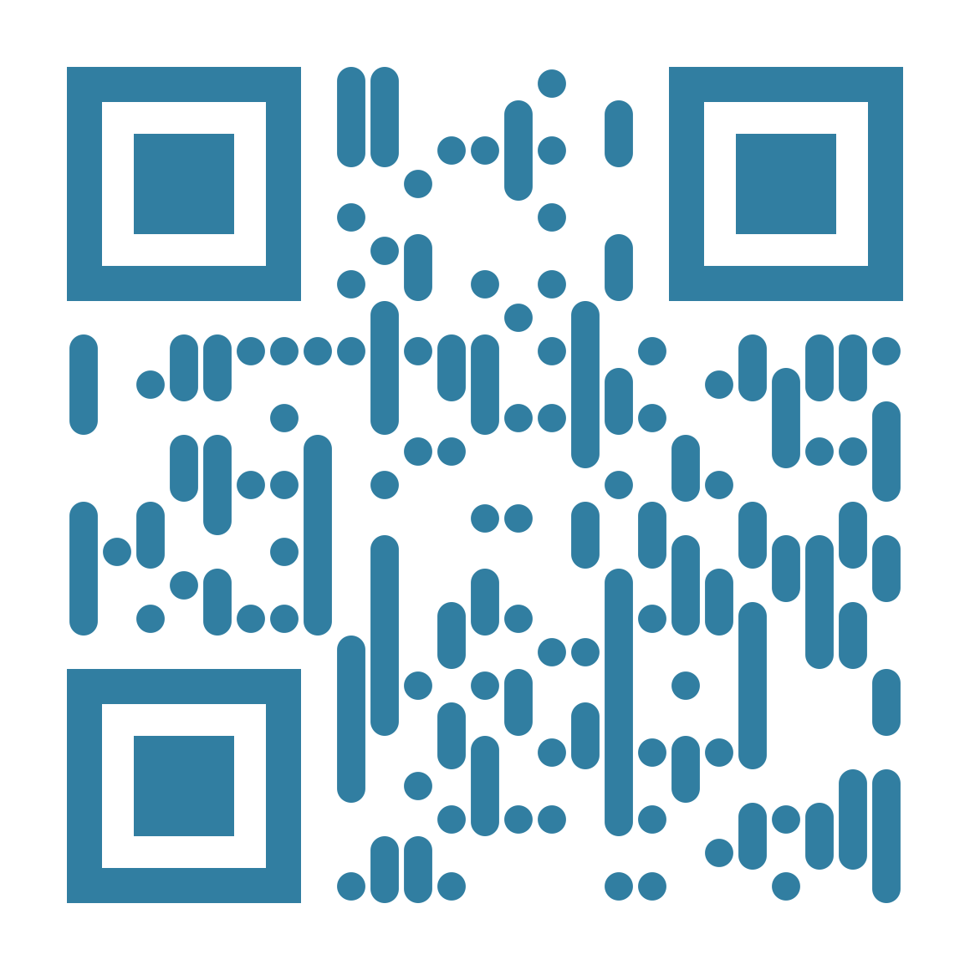
Thanks for Attending!
Attendance Link
bit.ly/23maratt
Feedback Link
bit.ly/23marsurv

