Slide 1
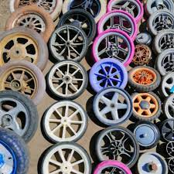
The Most Important Thing About Wheels!
By Allison Barton

Slide 2
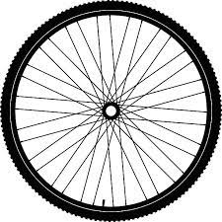
The most important thing about wheels is that they are circles that can turn on an axle.

Slide 3
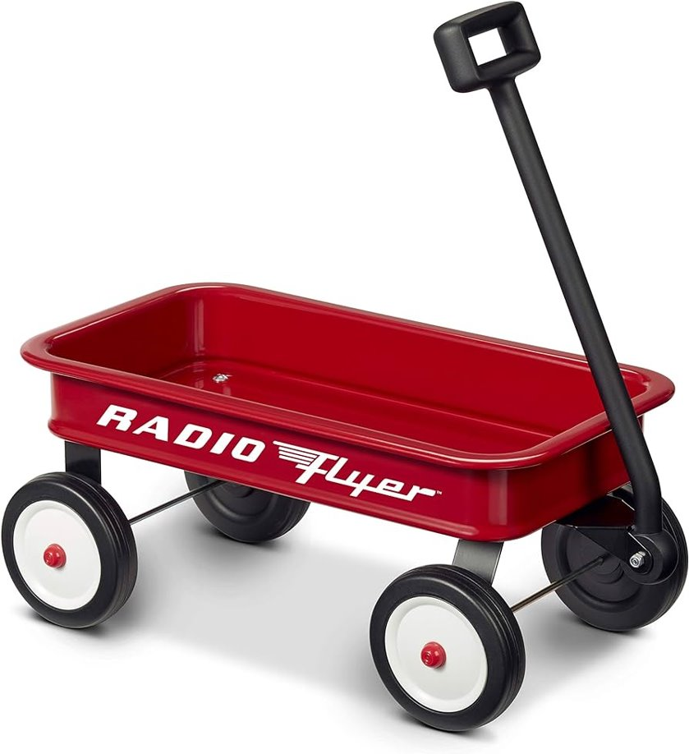
An axel is a rod, or a stick, that sticks in the middle of a wheel. The most important thing about wheels is that they are circles that can turn on an axle.

Slide 4
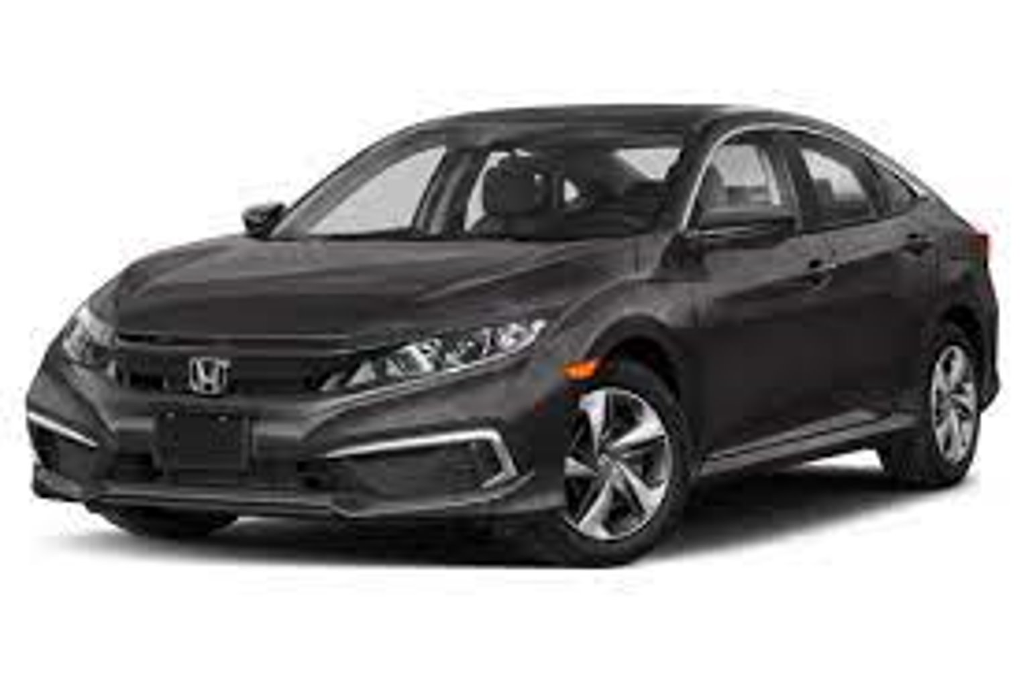
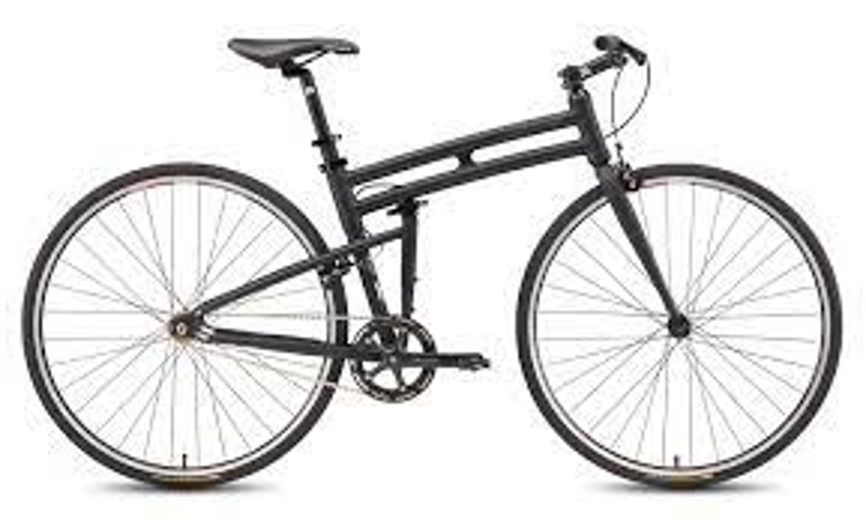
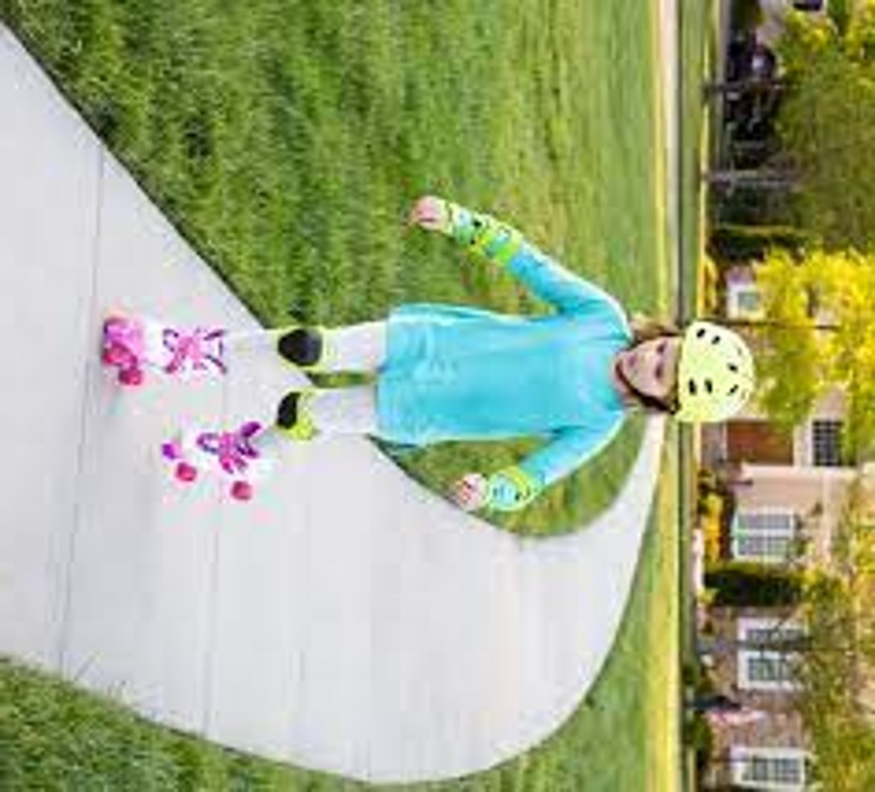
Wheels are used to take us places. The most important thing about wheels is that they are circles that can turn on an axle.

Slide 5
Wheels are used to help us carry heavy things. The most important thing about wheels is that they are circles that can turn on an axle.

Slide 6
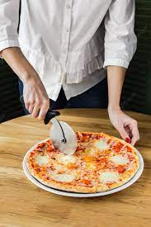
Wheels can be big or small. The most important thing about wheels is that they are circles that can turn on an axle.

Slide 7
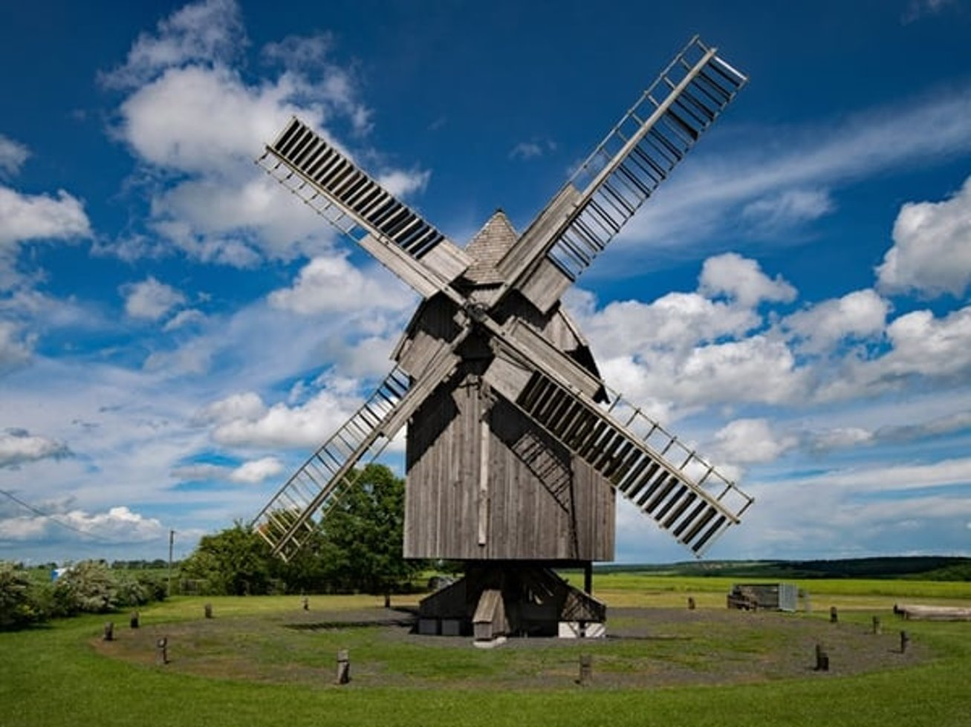
Wheels can spin, turn, or roll. The most important thing about wheels is that they are circles that can turn on an axle.

Slide 8
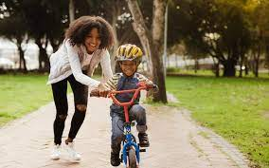
We use wheels every day. The most important thing about wheels is that they are circles that can turn on an axle.

