Slide 1
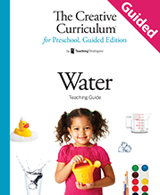
Question of the Day

Slide 2
Exploring the Topic

Slide 3
What does
water feel like?

Slide 4
How did you use
water at home this morning?

Slide 5
How do you use water to brush your teeth?

Slide 6
Where do you wash your hands?

Slide 7
How many steps does it take to walk to the sink from the large-group area?

Slide 8
Investigation
#1

Slide 9
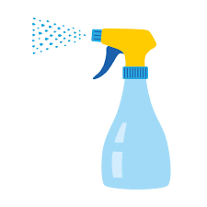
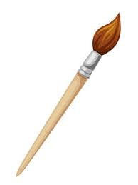
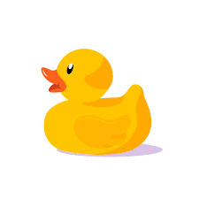
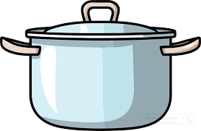
What do you use these for?

Slide 10
What is something that gets your hands dirty?

Slide 11
How many times can you jump up and down?

Slide 12
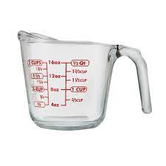
What type of cup is this??

Slide 13
How do you like to play with water?

Slide 14
Investigation
#2

Slide 15
Do you like to paint?

Slide 16
Is ice a liquid?

Slide 17
What happens to water when it gets very cold?

Slide 18
What happened to the water bottles in our experiement?

Slide 19
Investigation
#3

Slide 20
When do you drink water?

Slide 21
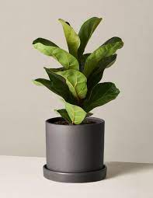
How do you take care of plants?

Slide 22
What do you think we will see on our site visit today?

Slide 23
How does water help us?

Slide 24
Celebrating Learning

Slide 25
What would you like to show our guests tomorrow at the celebration?

Slide 26
How do you feel about your families coming to visit today?

