Slide 1
De-escalation Techniques
Presented By Behavioral Specialist, Division of Early Childhood

Slide 2
To provide teachers and support staff with organized strategies and recommendations when faced with challenging behaviors in the classroom.
Objective

Slide 3
Defining De-Escalation
De-escalation is one technique that can be used when confronted with violent or aggressive behaviors. De-escalation means “transferring your sense of calm and genuine interest to what the “student” wants to tell you by using respectful, clear, limit setting [boundaries].”

Slide 4
WHO ?
For this presentation, the desired focus are teachers and additional school staff, parents and any individuals that encounter specific problematic behaviors when supporting the students that we serve.

Slide 5
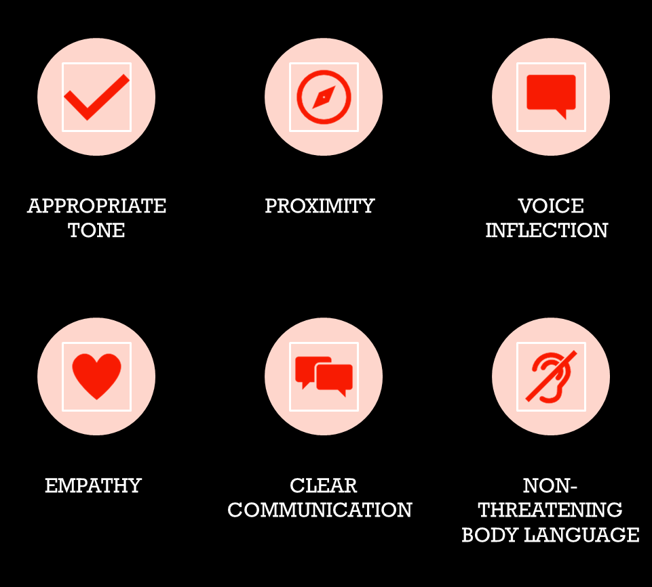
WHAT is needed when implementing some of these skills ?

Slide 6
Before the behavior occurs
During the behavior
After the behavior
WHEN ?

Slide 7
WHERE ?
RED FLAG BEHAVIORS
Removing the child or audience to ensure a safe environment for all parties.
To properly report ALL safety concerns and incidents to ensure that everyone is covered.
Please do not take any eye raising occurrences lightly!!

Slide 8
WHY?
By integrating de-escalation strategies and function-based support strategies, educators may be able to meet the youth where they are in a more proactive and comprehensive manner.

Slide 9
HOW ?

Slide 10
“Challenging Behavior”
is defined as “any repeated pattern of behavior...that interferes with or is at risk of interfering with the child's optimal learning or engagement in pro-social interactions with others”

Slide 11
Withdrawn behaviors such as shyness, rocking, staring, anxiety, school phobia, truancy, social isolation or hand flapping.
Disruptive behaviors such as physical and verbal aggression, being out-of-seat, calling out in class, tantrums, swearing, screaming or refusing to follow instructions.
Violent and/or unsafe behaviors such as head banging, kicking, biting, punching, fighting, running away, smashing equipment or furniture/fixtures.
Inappropriate social behaviors such as inappropriate conversations, stealing, being over-affectionate, inappropriate touching or masturbation.
Challenging
Behaviors
Include

Slide 12
Known influences on student behavior
There are many potential influences on student behavior, and many factors that can lead to behaviors that are challenging for schools to deal with. These may include:
biophysical factors such as medical conditions or disabilities
psychological factors including emotional trauma or lack of social skills
behavioral/social factors including where a student’s problem behavior has been learned through reinforcement, consequences or adaptation to social practices (a student with a learning difficulty repeatedly misbehaves knowing that he/she will be removed from the class, and this will avoid his/her learning difficulty being exposed)
historical community factors including for students whose family member/s had difficult, sometimes traumatic, experiences of school and government agencies
cultural factors
student group dynamics such as bullying and teasing, cliques or student apathy or hostility
environmental factors such as the level of classroom noise or classroom seating arrangements
classroom organization issues such as inconsistent routines, inadequate materials or obliviousness to cultural differences
teacher behavior for example boring or disorganized lessons, over-reaction to misbehavior or over-reliance on punishment.
In many cases, there is no single “cause” of challenging behavior, but it is the result of several factors operating in combination.

Slide 15
The following tips — published by the Crisis Prevention Institute and the Western Journal of Emergency Medicine — may provide a useful starting point for the de-escalation process. (2-3) https://youtu.be/R2PSExM-NhU https://youtu.be/DCN4qX6t7FQ https://youtu.be/Py2T-Gsqq7s

Slide 16
Questions ???
Pamela Boyce, boycepc@scsk12.org Debany Corral, corralozaetad@scsk12.org
Shalah Pate, pates@scsk12.org Keva Smith, smithky@scsk12.org
Maya Smith, smithm12@scsk12.org Capria Tyson, tysoncm@scsk12.org

