Slide 1
Question of the Day

Slide 2
Exploring the Topic

Slide 3
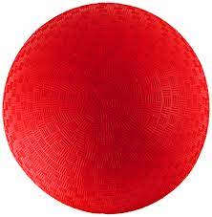
Do you know what this is?

Slide 4
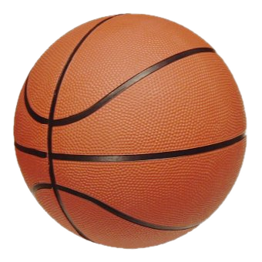
What kind of ball is this?

Slide 5
How do you play with this ball?

Slide 6
What do we want to find out about balls?

Slide 7
Investigation
#1

Slide 8
What is your favorite ball in the collection?

Slide 9
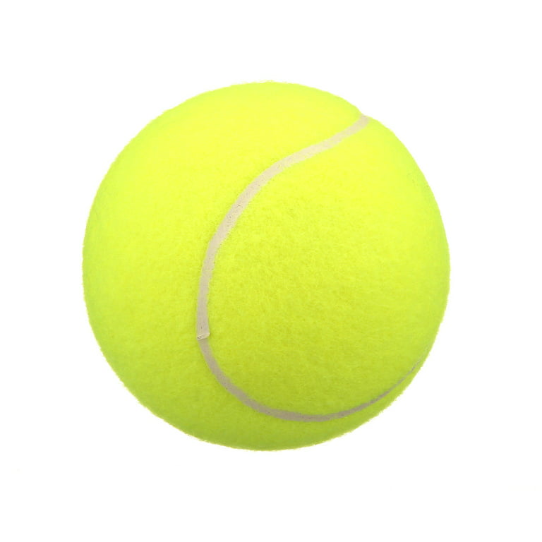
Which ball is bigger?

Slide 10
What is this ball made of?

Slide 11
What do you think is inside this ball?

Slide 12
Investigation
#2

Slide 13
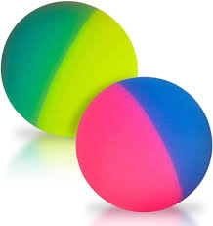
What can you do with this ball?

Slide 14
Does this ball bounce?

Slide 15
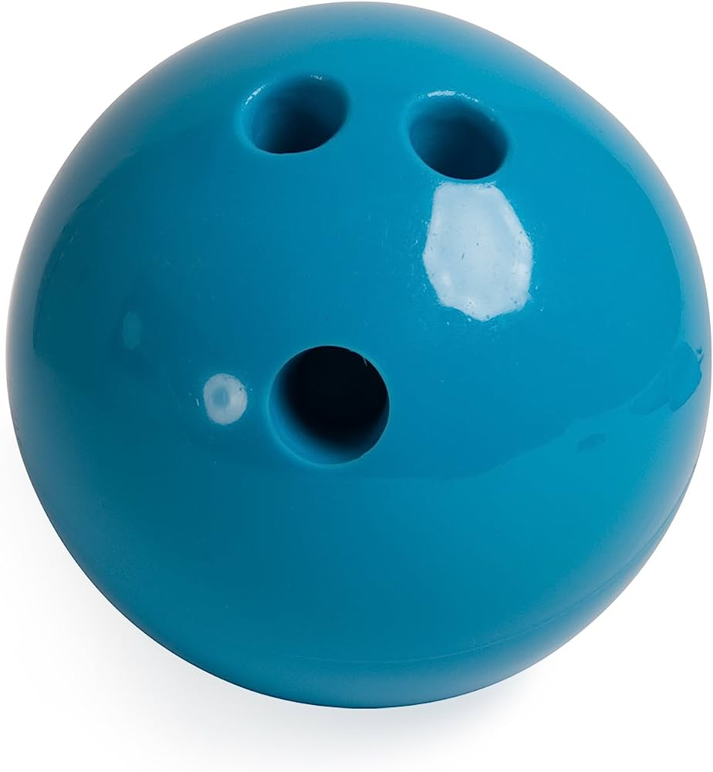
Which ball is heavier?

Slide 16
Investigation
#3

Slide 17
Does this ball roll?

Slide 18
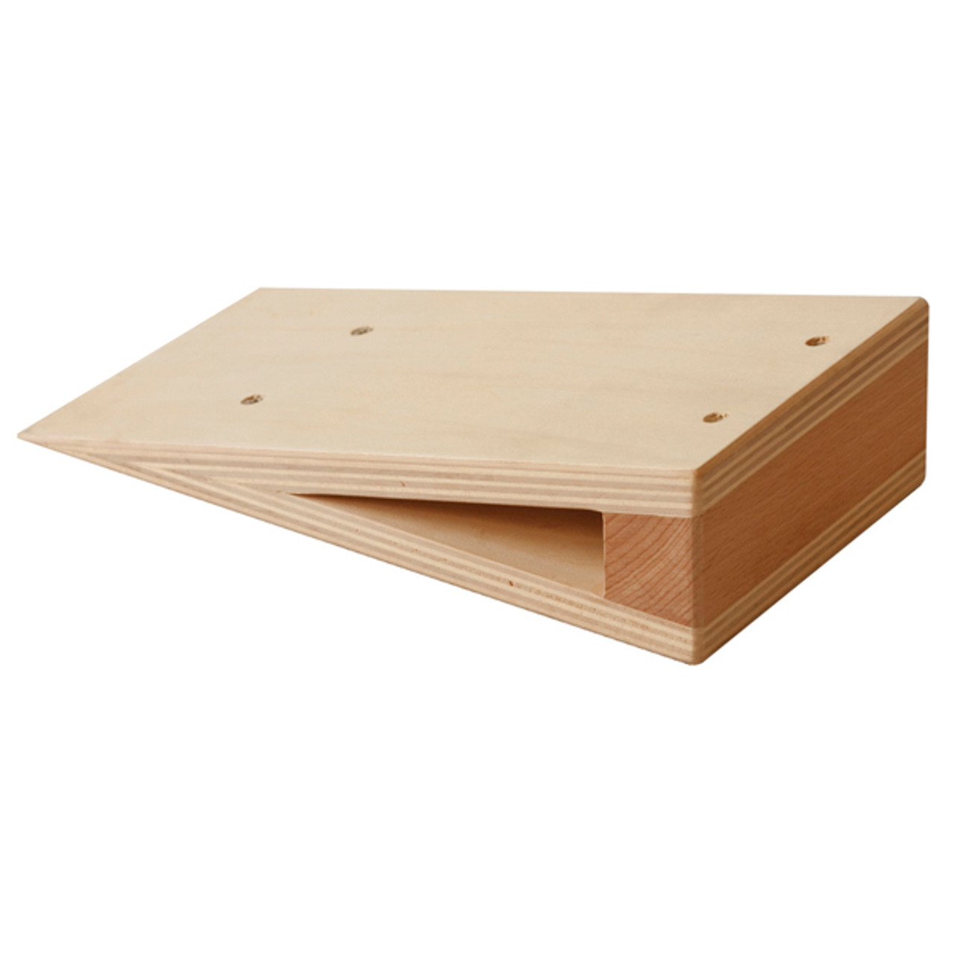
How can you roll a ball on this?

Slide 19
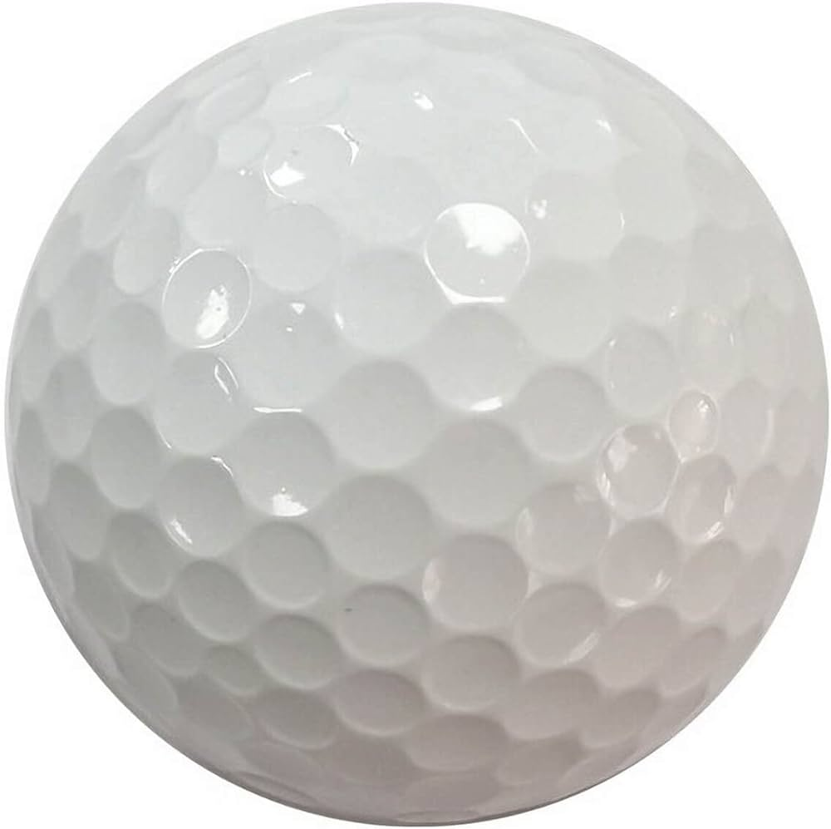
How far can this ball roll?

Slide 20
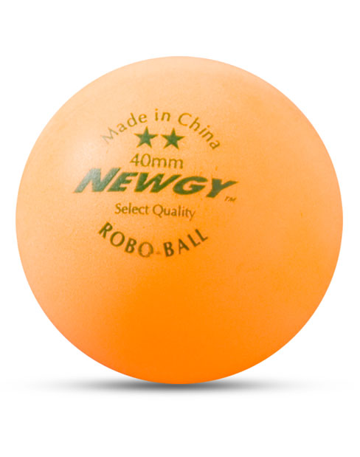
What happens when youi blow on this ball?

Slide 21
Investigation
#4

Slide 22
How can you use this ball?

Slide 23
What sport do you like to play?

Slide 24
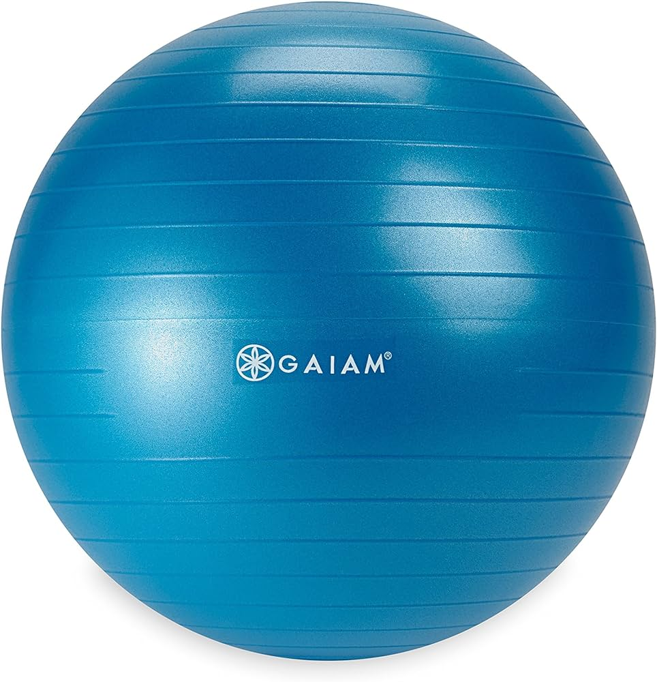
How do people use this ball?

Slide 25
Celebrating Learning

Slide 26
What would you like to show our guests tomorrow at the celebration?

Slide 27
What is something you learned during our study of balls?

