Slide 1
Question of the Day

Slide 2
Exploring the Topic

Slide 3
Did you see a tree on the way to school today?

Slide 4
Are there trees next to our playground?

Slide 5
Can you count how many trees you see?

Slide 6
What do you want to learn about trees?

Slide 7
Investigation
#1

Slide 8
What parts are missing on this tree?

Slide 9
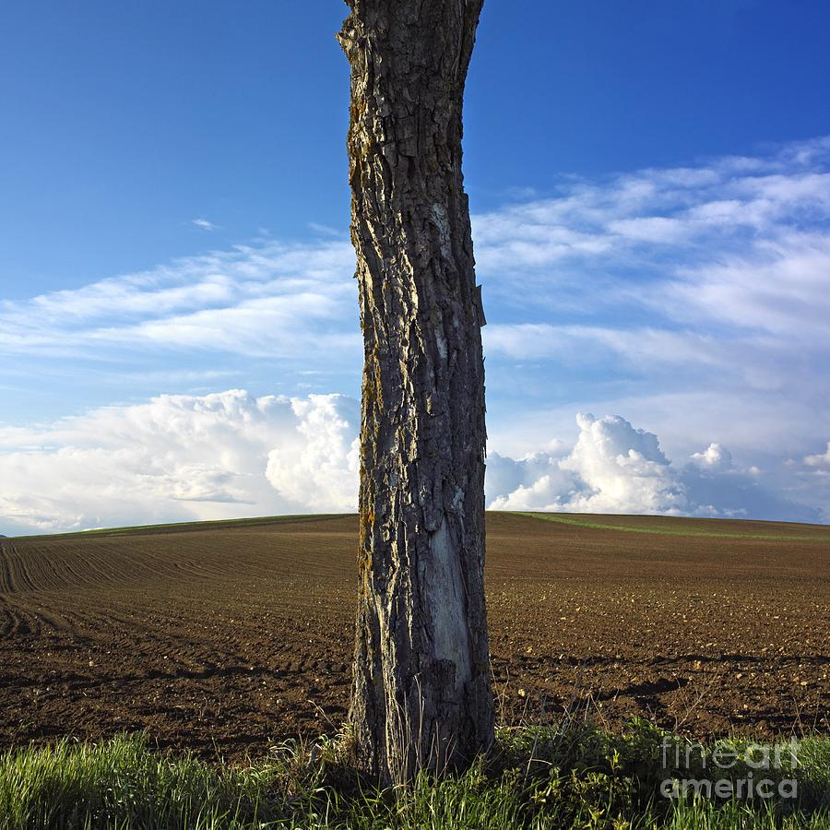
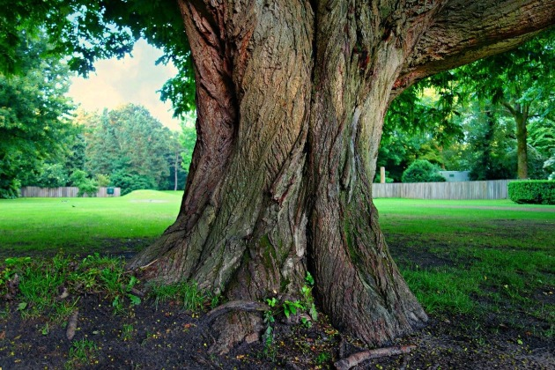
Which tree has a bigger trunk?

Slide 10
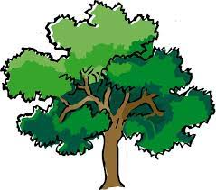
Where are the branches on this tree?

Slide 11
Can you name this part of a tree?

Slide 12
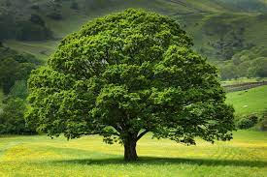
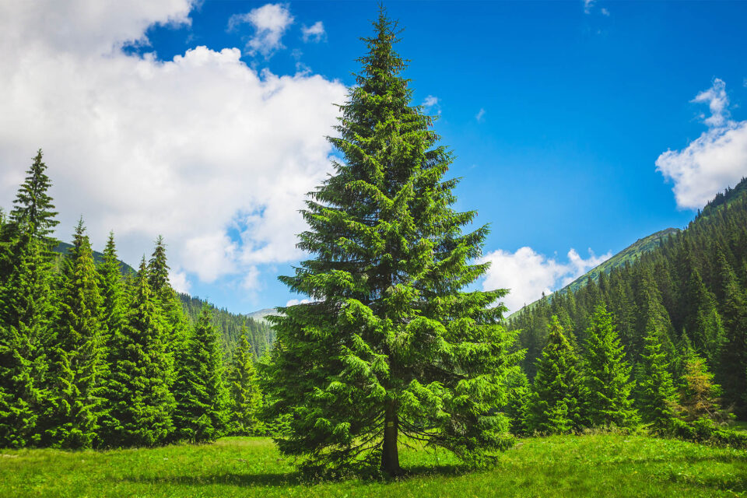
What type of tree would you like to make?

Slide 13
Investigation
#2

Slide 14
How tall where you were when you were a baby?

Slide 15
How do water and food help us grow?

Slide 16
What questions would you like to ask our visitor?

Slide 17
Investigation
#3

Slide 18
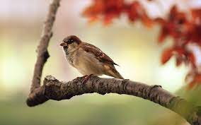
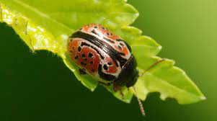
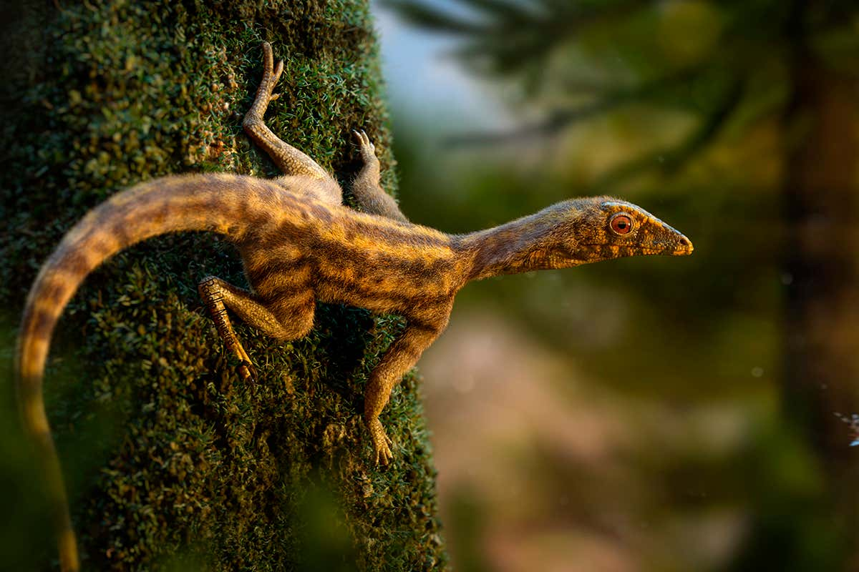
What do you see in these photos?

Slide 19
Does this animal
live in a tree?

Slide 20
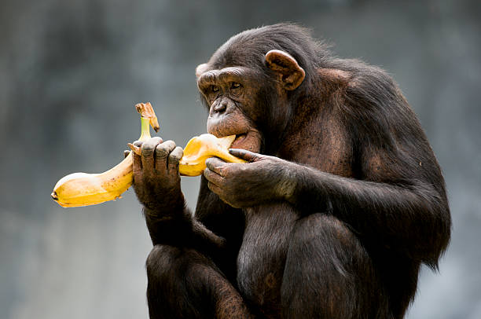
What is the monkey eating?

Slide 21
Investigation
#4

Slide 22
Are tree branches
easy to break?

Slide 23
What would you like to ask our visitor?

Slide 24
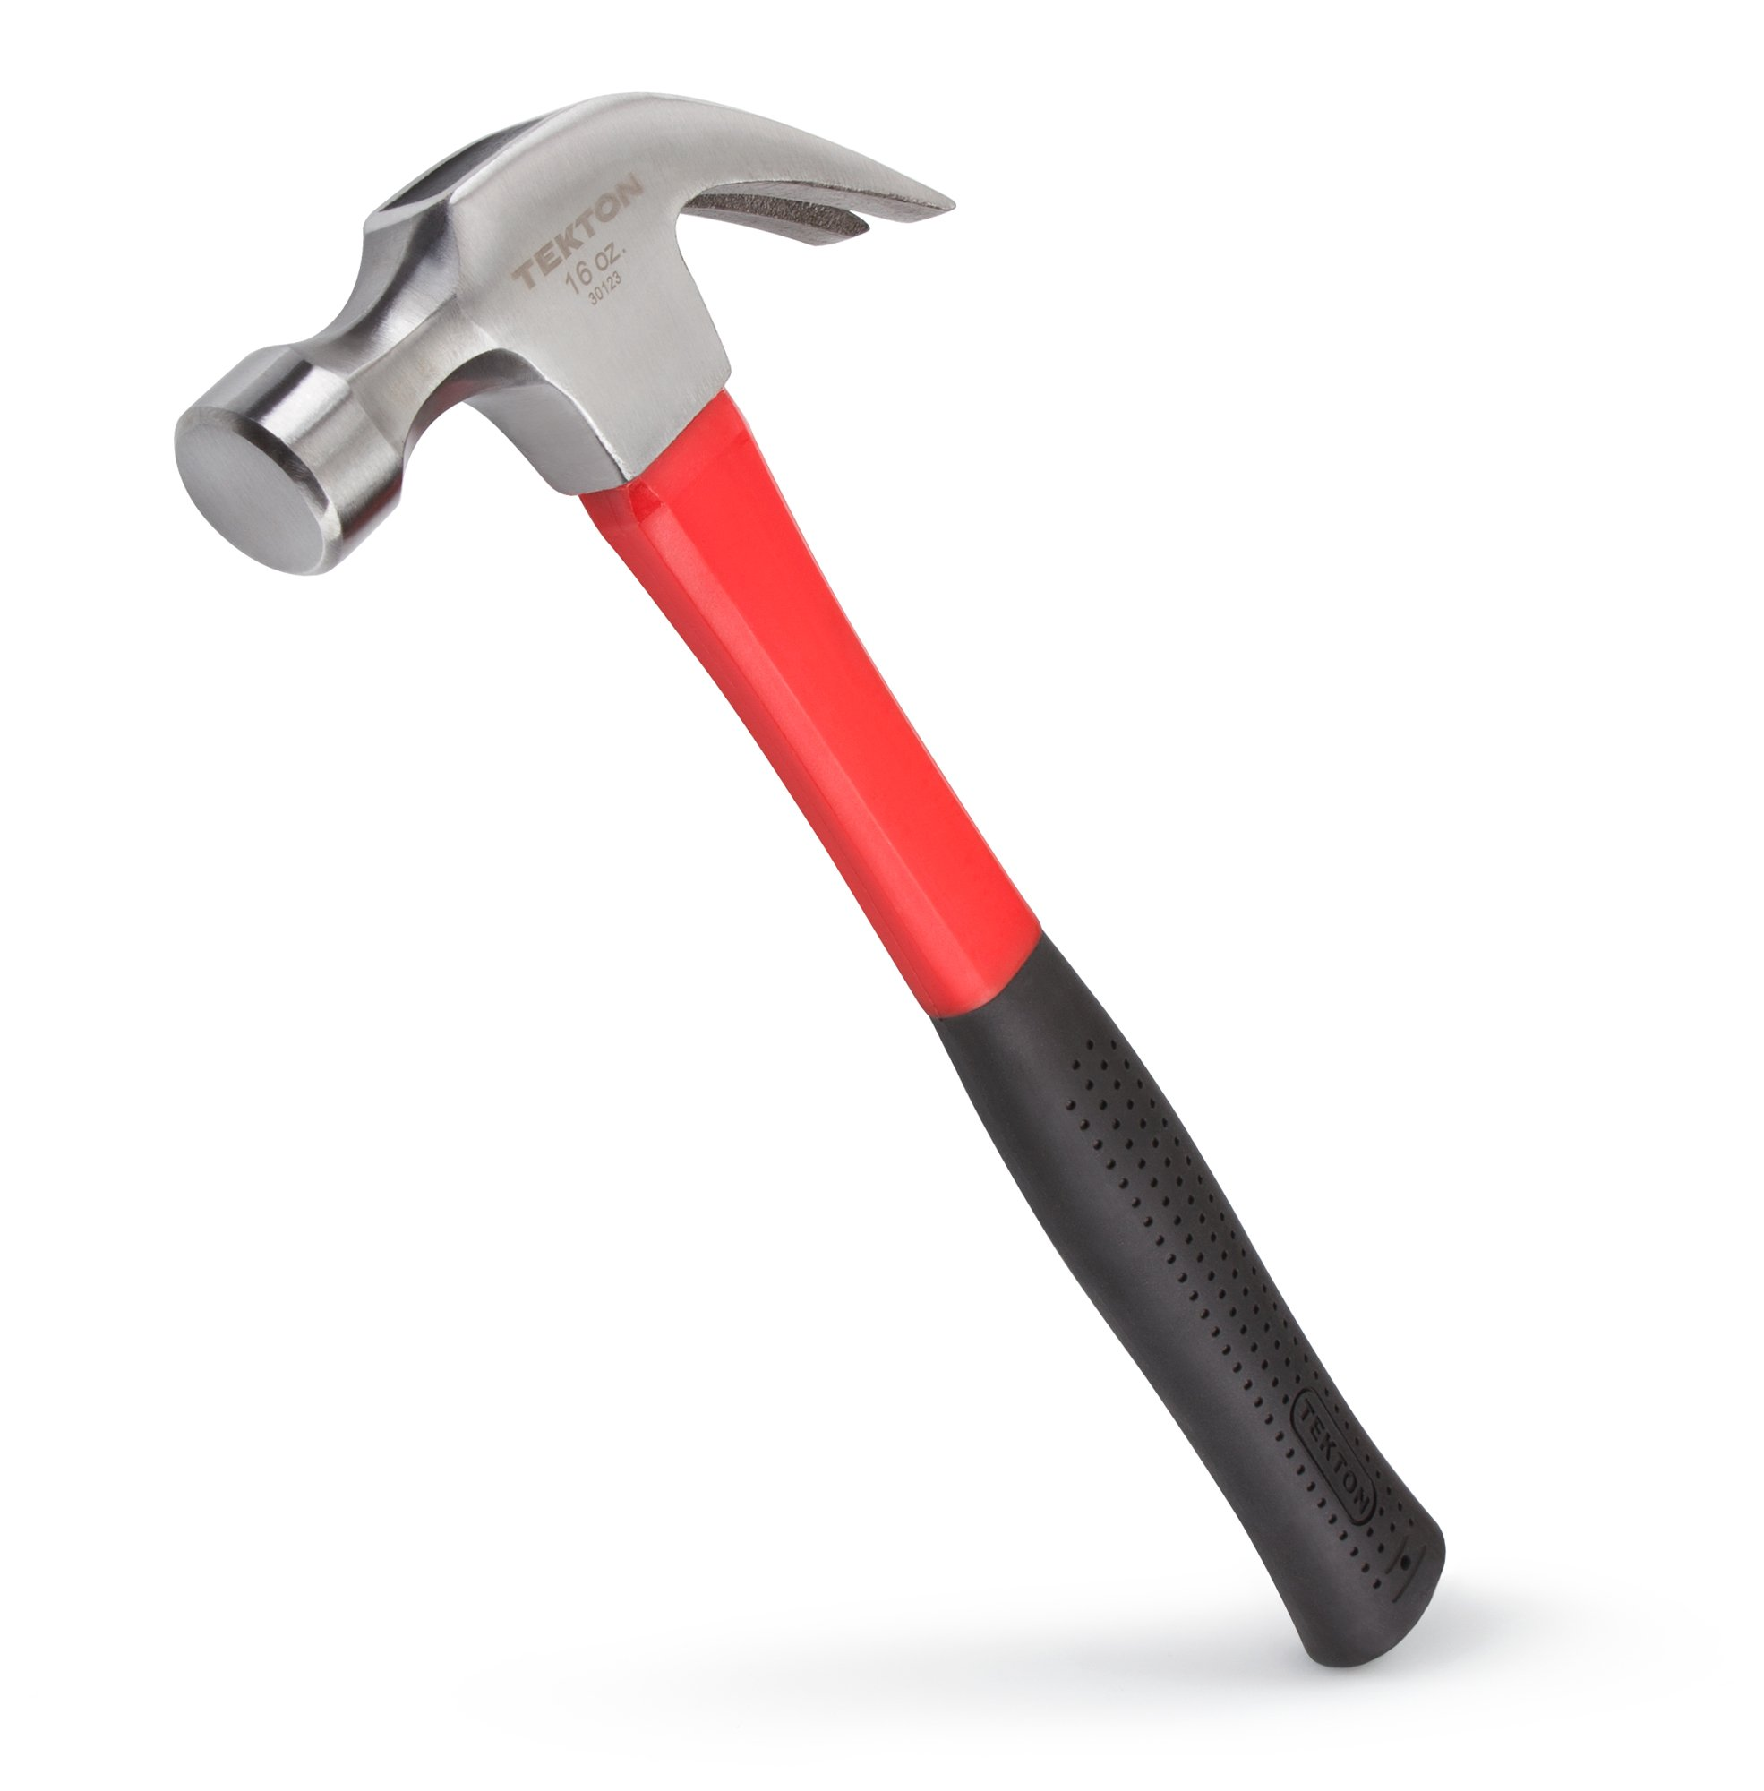
What do we use
this tool for?

Slide 25
Celebrating Learning

Slide 26
What would you like to share with guests at the celebration?

Slide 27
What is something you learned about trees?

