Slide 1
Dexter
K-8
Annual
Title I
Parent Meeting
Friday
September 30, 2022
8:45 A.M.
Mr. Patrick Certion, Principal
Assistant Principals
Ms. K. Davis, Primary
Ms. L. Hicks, Intermediate
Ms. T. Stinson, Intermedite
PLC Coaches
Ms. R. Billingsley
Ms. K. Johnson
Interventionist
Ms. M. Shockey
Together, we MUST BELIEVE,
Together, we
WILL ACHIEVE.
Togerther, we ARE
REIMAGINING 901.

Slide 2
Annual Title I Parent Meeting
September 30, 2022
8:45 a.m.
Welcome……………………………………….Mr. Patrick Certion, Principal
Title I Presentation………….……….……….Ms. Rebecca Billingsley, PLC Coach
• Policies for Family Engagement (SCS and School Plan)
• Reporting Pupil Progress
• Parent– Teacher Conferences
• Parental Involvement Requirements
• Availability of Parent Training
• Opportunities for Additional Parent Meetings
• District/School Progress/AYP Status
• School Improvement Plan
• Teacher Qualifications
• Parent’s Right to Know
• Notice of Title I School Status
• School/Parent Compact
• Student Code of Conduct
Dexter School Counseling Services………………Ms. Sherman and Ms. Cole
Closing Remarks………………………………..Mr. Patrick Certion, Principal

Slide 3
What Is Title I?
Title I of the Elementary and Secondary Education Act of 1965 (20 U.S.C. 6301 et seq.) is amended to read as follows:
TITLE I — What is the Purpose?
The purpose of Title I, Part A program is to provide federal dollars to supplement educational opportunities for students who attend schools with high numbers or percentages of children from low-income families and are most at risk of failing to meet the state’s challenging academic achievement standards. Title I, Part A funds are to be used to provide all students significant opportunity to receive a fair, equitable, and high-quality education and to close educational achievement gaps.
(US Department of Education)

Slide 4
A Title I school has qualified to receive
schoolwide federal funding under this act.
The Title I program serves millions of children in elementary and secondary schools each year.
Memphis-Shelby County Schools has roughly 190 schools operating under the Title I program.

Slide 5
To be a “Schoolwide” Title 1 School
The school must have a free/reduced lunch count of at least 40%.
The school must collect and analyze data that effects student achievement.
The school must develop a comprehensive site plan and annually review the effectiveness of the plan.

Slide 6
The school uses Title I funds to upgrade the entire educational program of the school.
Title I funds are used to serve all children in order to raise academic achievement.
Title I funds will be used to provide additional assistance to all students who experience difficulties in meeting the State’s performance targets.

Slide 7
How our School Spends Title 1 Money
Instructional resources for teachers
Resources for students
Personnel
Parental Involvement Activities
Parent Communication
Extended Learning Opportunities for students

Slide 8
Title 1 Gives Parents the Right to Know
The school’s status according to the ESSA standards
A teacher’s professional qualifications, licensure, or certification
A paraprofessional’s qualifications
Academic services available for your child
That YOU can help by becoming involved in your child’s education

Slide 9
Dexter K-8
School Improvement Plan
The School Improvement Plan, (SIP), is a working document that serves as a guide to improve student achievement and increase parental involvement.
Parents, school and district staff and community volunteers serve on this committee.

Slide 10
Policies for Parental Involvement Family Engagement
Purpose: To build a long range program of collaboration between the school and parents that will effectively support the school’s vision of providing a high quality education for all students.
Goal: To prepare parents with the knowledge of the skills and information needed to help their children be successful in school.

Slide 11
What is Parental Involvement?
Room Parent
Becoming involved in the PTA
Test Proctor
Ground Duty in the morning or afternoons
Ensuring your child attends school daily
Volunteering for fieldtrips
Hall Monitor
Reading to your child’s class
Attending meetings at the school
Donating clothing to the school your child can no longer wear
Celebrating special occasions with your child at school (birthdays, Read Across America, etc.)

Slide 12
Dexter Parent and Family Engagement Plan
School has a special responsibility to our parents and the community by providing opportunities for you to get involved and share the responsibility of promoting success in our children.
To ensure that our parents participate in the development and implementation of the school’s program, Dexter Elementary will do the following:
Develop jointly with parents a written school level family engagement plan and parent-school compact showing how parents, school, and students share responsibilities.
A copy of the Dexter Family Engagement Plan can be located in the back of the Dexter Student Handbook and on our school website.

Slide 13
DEXTER’s Parent and Family Engagement Plan
Parents play an important role in the success of the children. Our parents can fulfill this by:
Attending meetings, programs, workshops, and other school activities.
Participating in school sponsored parent-teacher conferences.
Serving on a committee and participating in the decision-making process.
Responding to memos, surveys, and questionnaires expressing ideas and concerns.
Serving as a volunteer at the school.
Ensuring that your child studies at home and completes homework assignments.
Voicing concerns and providing feedback at parent meetings.

Slide 14
School/Parent/Student Compact
Purpose: The compact is designed to put emphasis on the shared responsibility of parents and schools for the high performance of children.
Designed: The compact has outlined how parents, the entire school staff, and students will share responsibility for improved student achievement.
A copy of the compact can be found at the back of the Dexter Student Handbook.

Slide 15
Reporting Students Progress
The teachers of Dexter K-8 communicate students progress in several ways:
- Intervention Reports:
RTI2 Updates, Iready
-Mastery Connect Data
-TCAP Reports
- Progress Reports (quarterly)
- Report Cards – quarterly
- Phone Calls to parents
- Wednesday Folders
- Homework Folders
- Parent Teacher Conferences

Slide 16
Parent-Teacher Conferences
Shelby County Schools has scheduled two dates this school year for parent-teacher conferences.
1st Semester
Thursday, September 8, 2022 4:00-7:00 p.m.
2nd Semester
Tuesday, February 16, 2023 4:00-7:00 p.m.
Additional Conferences can be scheduled during planning time, as needed, with your child’s teacher.

Slide 17
Opportunities for Parental Involvement-School Level
2022-2023 School Year
Meet the Teacher /Open House, September 2022
Title I Annual Meetings, A.M. and P.M. Fall and Spring Semesters
Serve on the SIP Team
Dexter Curriculum Nights – Fall 2022 and Spring 2023
Read for the Record—Fall 2022
Fall Family Reading and Math Night, Fall 2022
PTA Activities….TBA
TCAP Parent Meeting – TBA
School Calendars will be sent home at the beginning of each month with important meeting dates.

Slide 18
MSCS Website Curriculum & Instruction (scsk12.org)

Slide 19
Thanks for joining us to show your
DEXTER PRIDE!
We really appreciate your continued support,
hard work and dedication to Dexter .
Together, we MUST BELIEVE,
Together, we WILL
ACHIEVE.
Together, we ARE
REIMAGINING 901.

Slide 20
Dexter K-8 School Counseling Services
Mr. Certion, Principal
Ms. Davis, AP
Ms. Hicks, AP
Mrs. Stinson, AP
Mrs. Billingsley and Miss Johnson PLCs
Ms. Cole, PK, KK-1st PSC
Mrs. Sherman, PK, 2nd-3rd PSC
Ms. N. Johnson, 4th-5th PSC
Mrs. Jamison, 6th-7th PSC
Ms. Brooks, 7th-8th PSC

Slide 21
Objective
To provide an overview of Counseling Services, as it will be implemented in the school setting.
Counseling Referral
DCS reporting
RTI2-B
504
SEL
SST Process
This Photo by Unknown author is licensed under CC BY-SA.

Slide 22
Counseling Referral
The School Counseling Referral will be found on Dexter's website.
The referral can be filled out by parents, teachers, and students

Slide 23
DCS Reporting: SCS Policy# 7005
T.C.A. 37-1-605(d)(1) TN Child Abuse law
Everyone is a mandated reporter!
Failure to report is a Class A misdemeanor. Fine for “failure to report” is not to exceed $2,500
24/7 DCS Contact Information: Child Abuse Hotline-1-877-237-0004
Child Abuse Hotline School K-12 line: 1-855-209-4226
Child Abuse Reporting and Tracking site-apps.tn.gov/carat/
Any person who has knowledge of or is called upon to render aid to any child who is suffering from or has sustained any wound, injury, disability, or physical or mental condition shall report such harm immediately if the harm is of such a nature as to reasonably indicate that it has been caused by brutality, abuse or neglect or that, on the basis of available information, reasonably appears to have been caused by brutality, abuse or neglect.
Any such person with knowledge of the type of harm described above shall report it, by telephone or otherwise, to the:
Department of Children and Human Services; or
Sheriff of the county where the child resides; or
Chief law enforcement official of the municipality where the child resides.
**Note: After filing a report, alert the Coordinator and Co-Coordinator

Slide 24
RTI2-B: Response to Intervention to Behavior
RTI2-B is a framework for prevention and intervention within an integrated, three- tiered approach. Tier 1 focuses on the behavioral and social needs of all students across the school environment. Tier 2 involves delivering more targeted interventions for those students that don’t respond to Tier 1 supports. Tier 3 includes individualized interventions for students that do not respond to Tier 1 or Tier 2.
Students are taught school wide expectations, and students will be able to practice these expectations through the use of our acknowledgement system.
Goal of RTI2-B: Improve school culture and climate
Website with virtual incentive ideas: https://www.pbisrewards.com/blog/pbis-incentives-distance-learning/

Slide 25
Section 504
SCS follows District/State policies and procedures
IDEA is monitored and enforced by the state
Section 504 is monitored and enforced by OCR
Who is Eligible for 504? Section 504 defines a person with a disability as anyone who:
Has a mental or physical impairment which substantially limits one or more major life activities
Has current medical record of such impairment
Section 504 of the Rehabilitation Act of 1973 is a national law that protects qualified individuals from discrimination based on their disability. The nondiscrimination requirements of the law apply to employers and organizations that receive financial assistance from any Federal department or agency.

Slide 26
Section 504
Child Find Law is a legal requirement that schools find all children who have disabilities and who may be entitled to special education services. Identifying these kids is an important first step toward getting them the help they need to succeed in school.
Child Find covers every child from birth through age 21.
The school must evaluate any child that it knows, or suspects may have a disability.
What is your responsibility as a teacher?
Thoroughly complete the Teacher Input and Observation forms. Make sure you add a justification for every accommodation and return in a designated time.
Document and report all suspected medical or behavior related impairments.
Implement all classroom accommodations as indicated on the Accommodations at a Glance form.
In meetings, always be objective and not subjective-stick to the facts.
Please notify Counselor of any significant changes in the student’s classroom performance.
This Photo by Unknown Author is licensed under CC BY

Slide 27
Social-Emotional Learning (SEL)
The Five Core Social-Emotional Competencies
Self-awareness
Self-management
Social awareness
Relationship management
Responsible decision making

Slide 28
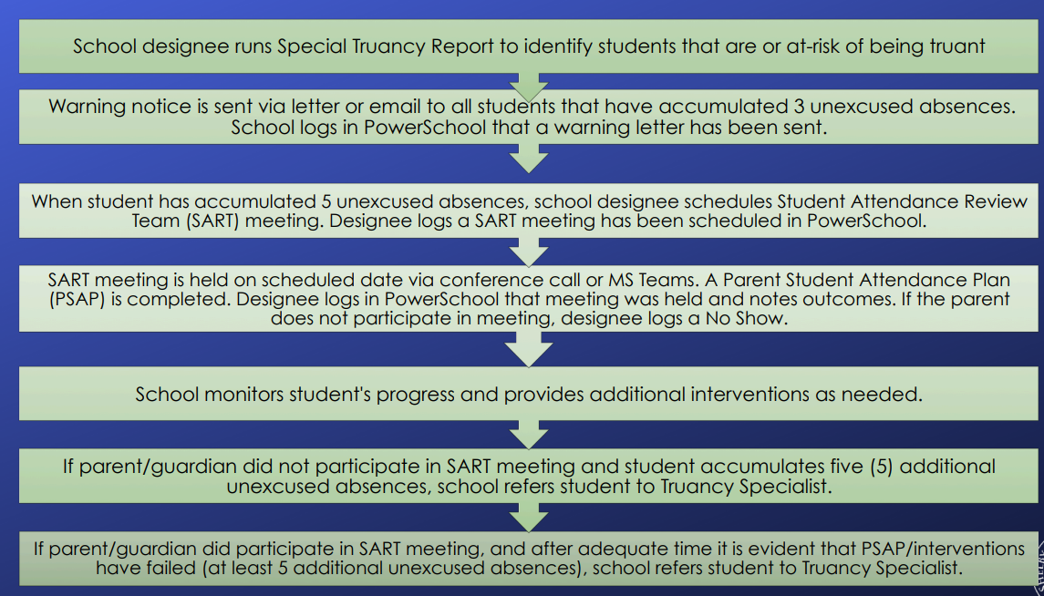
STUDENT ATTENDANCE REVIEW TEAM PROCESS (SART PROCESS)

Slide 29
Student Support Team (SST) Process
Purpose:
Who Can Refer:
Review student progress, intervention or service provided prior to referral
Determine Action Plan
Determine need for Specialized Services (SS) and identify appropriate referral path to address student needs
Parent or Community Stakeholder
Teacher, School Staff or District Staff
Self Referral by student
Other District Processes
RTI-A Team
RTI-B Tier 1 & 2 Team

Slide 30
Thank You!
Questions or Comments??

