Slide 1
TN Foundational Literacy
November 4-8, 2024

Slide 2
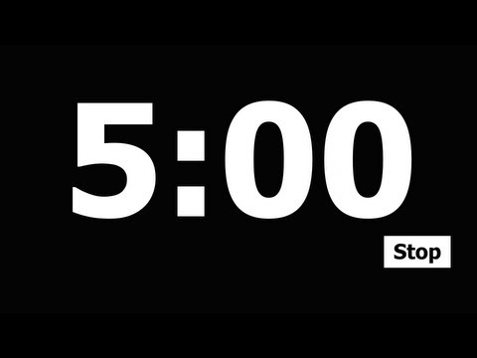
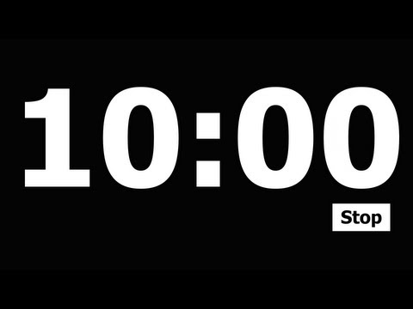
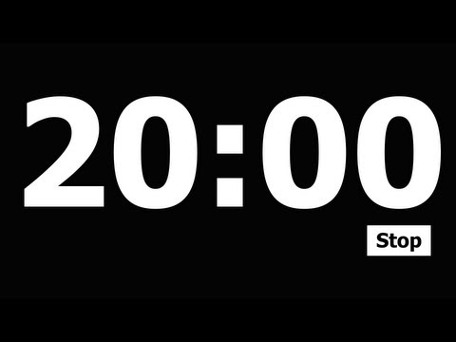
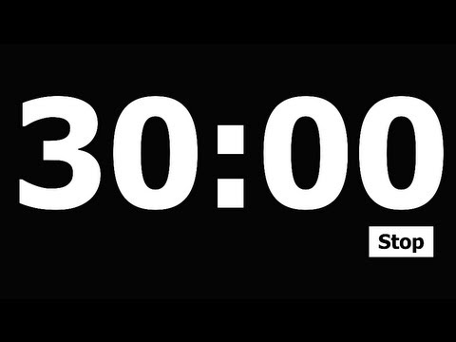
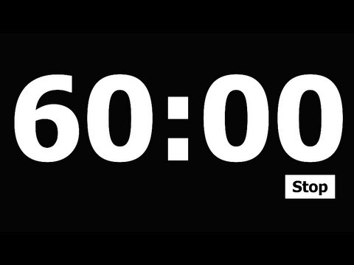
TODAY IS:
Add a timer
Focus Board
Monday
November 4, 2024
Color and Shape
green cone
Letter Bundle
Number
0
zero
Bb
Ff
Dd
Gg
Aa
Sight Words:
it
he
have
Daily
Affirmation
“I am special”

Slide 3
Add a timer
Let’s Learn to Read!
Today’s Lesson
TN Sounds First Vol. 1
Week 8
Day 1
Rhyme Time!
Syllables: Break it Up!
Snatch the Sound
like, bike
bake, lake
dog, log
best, rest
some, come
plastic
orchard
person
picture
over
mash, mush
punch, pinch
clinch, clutch
bath, both

Slide 4
Add a timer
Let’s Learn to Read!
Today’s Lesson
TN Sounds First Vol. 1
Week 8
Day 1
Snatch the Sound
Silly Sentence
mash, mush
punch, pinch
clinch, clutch
bath, both
Gerry the goat grazed on green grass.

Slide 5
TODAY IS:
Add a timer
Focus Board
Tuesday
November 5, 2024
Color and Shape
green cone
Letter Bundle
Number
0
zero
Bb
Ff
Dd
Gg
Aa
Sight Words:
it
he
have
Daily
Affirmation
“I am special”

Slide 6
Add a timer
Let’s Learn to Read!
Today’s Lesson
TN Sounds First Vol. 1
Week 8
Day 2
Rhyme Time!
Syllables: Break it Up!
Snatch the Sound
door, floor
fox, socks
gawn, lawn
knee, tree,
dove, glove
meow
ocean
captain
ostrich
older
went, want
mind, mend
fish, fash*
pat, pot

Slide 7
Add a timer
Let’s Learn to Read!
Today’s Lesson
TN Sounds First Vol. 1
Week 8
Day 2
Snatch the Sound
Silly Sentence
went, want
mind, mend
fish, fash*
pat, pot
Henry heard a herd of hippos.

Slide 8
TODAY IS:
Add a timer
Focus Board
Wednesday
November 6, 2024
Color and Shape
green cone
Letter Bundle
Number
0
zero
Bb
Ff
Dd
Gg
Aa
Sight Words:
it
he
have
Daily
Affirmation
“I am special”

Slide 9
Add a timer
Let’s Learn to Read!
Today’s Lesson
TN Sounds First Vol. 1
Week 8
Day 3
Rhyme Time!
Syllables: Break it Up!
Snatch the Sound
true, blue
dream, cream
child, wild
tent, dent
Chad, sad
invent
morning
lady
cactus
perfect
bag, big
far, for
bop, bip
dad, did

Slide 10
Add a timer
Let’s Learn to Read!
Today’s Lesson
TN Sounds First Vol. 1
Week 8
Day 3
Snatch the Sound
Silly Sentence
bag, big
far, for
bop, bip
dad, did
Seals saw seagulls flying over the sea.

Slide 11
TODAY IS:
Add a timer
Focus Board
Thursday
November 7, 2024
Color and Shape
green cone
Letter Bundle
Number
0
zero
Bb
Ff
Dd
Gg
Aa
Sight Words:
it
he
have
Daily
Affirmation
“I am special”

Slide 12
Add a timer
Let’s Learn to Read!
Today’s Lesson
TN Sounds First Vol. 1
Week 8
Day 4
Rhyme Time!
Syllables: Break it Up!
Snatch the Sound
lid, kid
toad, road
tar, bar
floor, store
beg, egg
panther
picnic
hamster
sister
garden
grip, gap
flap, flip
got, get
foam, fame

Slide 13
Add a timer
Let’s Learn to Read!
Today’s Lesson
TN Sounds First Vol. 1
Week 8
Day 4
Snatch the Sound
Silly Sentence
grip, gap
flap, flip
got, get
foam, fame
Fearless Freddy went fishing with a fork.

Slide 14
TODAY IS:
Add a timer
Focus Board
Friday
November 8, 2024
Color and Shape
green cone
Letter Bundle
Number
0
zero
Bb
Ff
Dd
Gg
Aa
Sight Words:
it
he
have
Daily
Affirmation
“I am special”

Slide 15
Add a timer
Let’s Learn to Read!
Today’s Lesson
TN Sounds First Vol. 1
Week 8
Day 5
Rhyme Time!
Syllables: Break it Up!
Snatch the Sound
bun, done
lug, rug
brave, cave
did, kid
class, grass
carpet
menu
fancy
poster
nickel
watch, witch
sit, sat
win, won
red, rid

Slide 16
Add a timer
Let’s Learn to Read!
Today’s Lesson
TN Sounds First Vol. 1
Week 8
Day 5
Snatch the Sound
Silly Sentence
watch, witch
sit, sat
win, won
red, rid
Wilma wants watermelon while watching whales.

