Slide 2
Agenda
• Meet the Teacher
• Norms
• Class Schedule
• Class Expectations
• Boost
• Grading
Wednesday Folders
• Questions

Slide 3
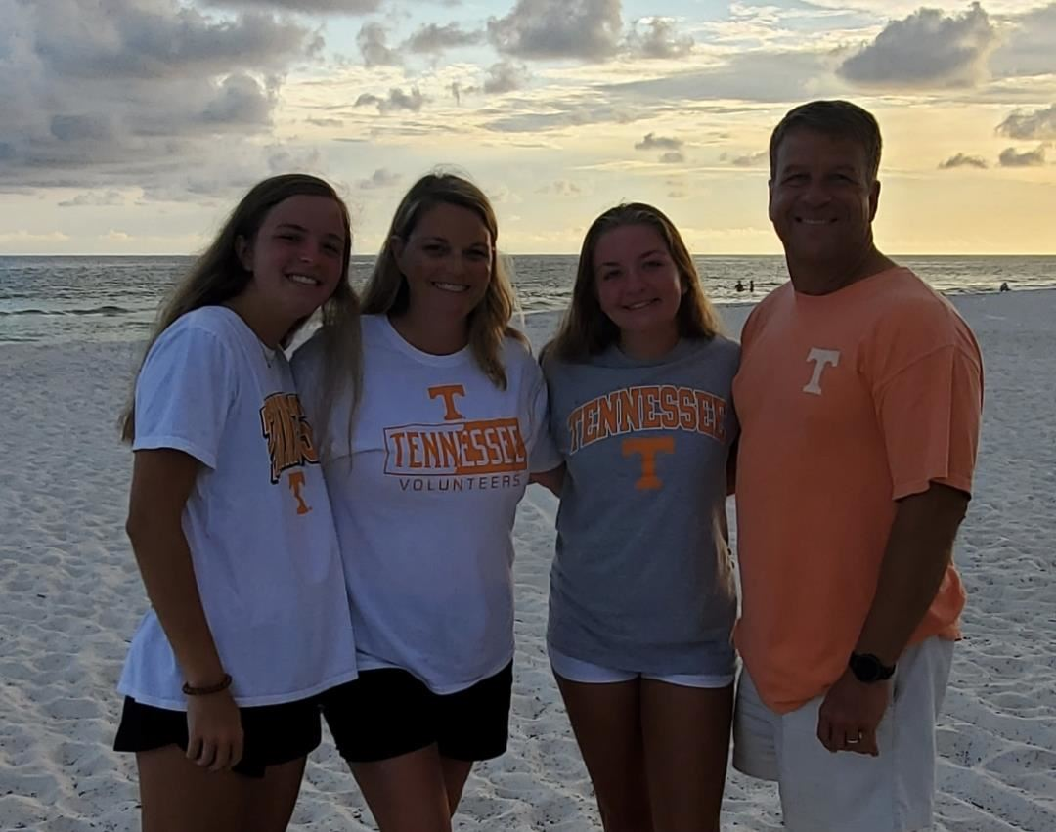
Mrs. Tricia Totty
Best Email Address:
tottytr@scsk12.org
Science and Social Studies

Slide 4
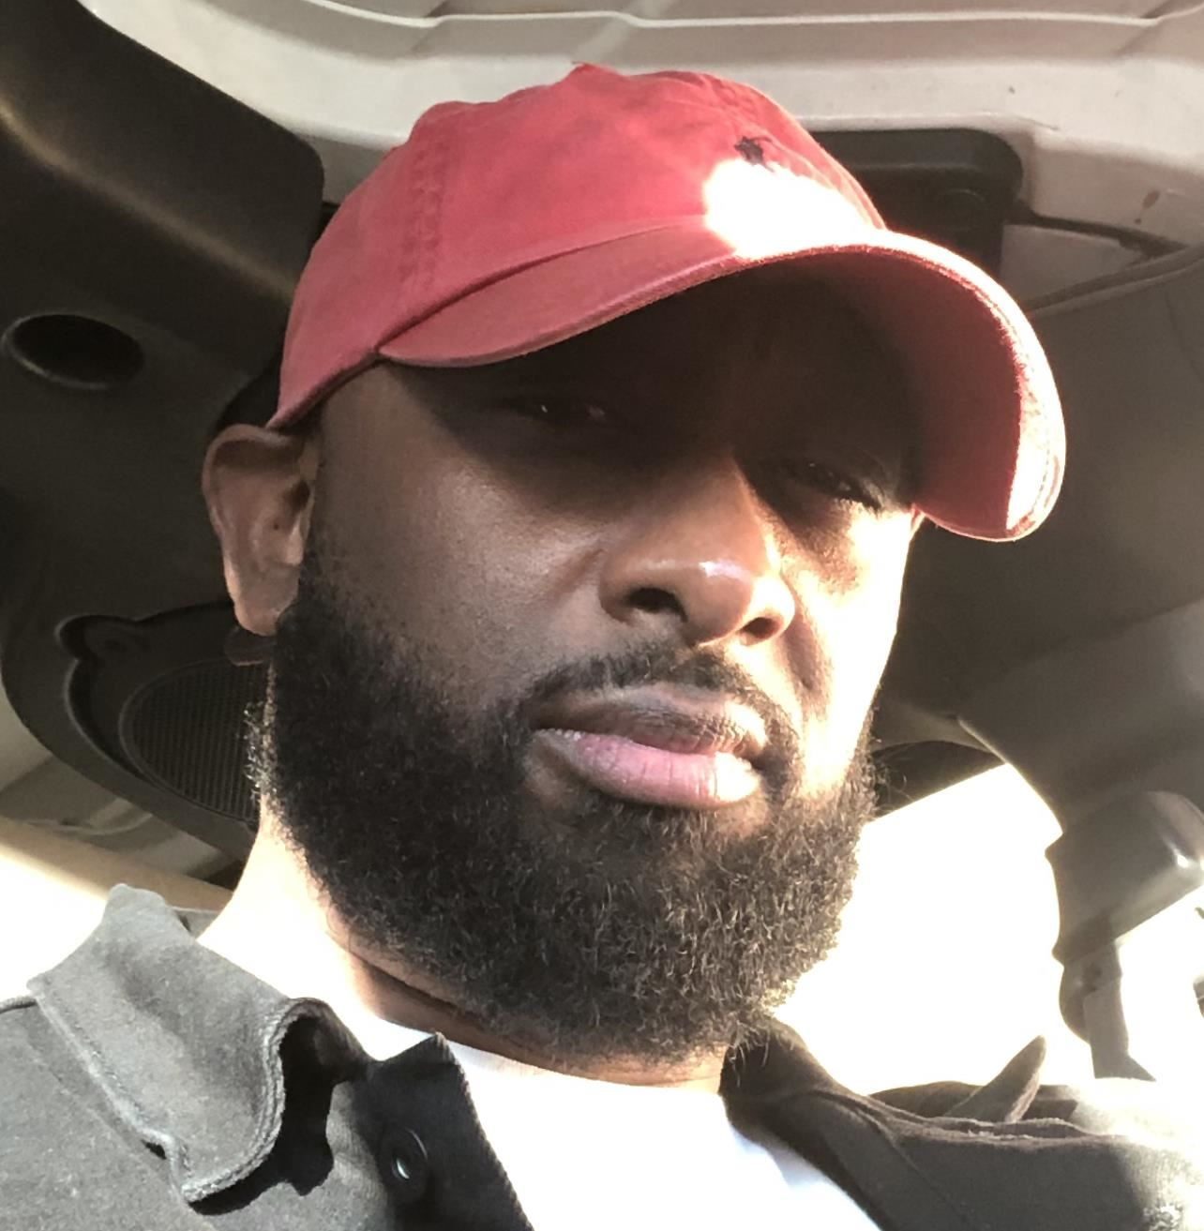
Mr. James Wardlow
Best Email Address:
wardlowj@scsk12.org
English Language Arts

Slide 5
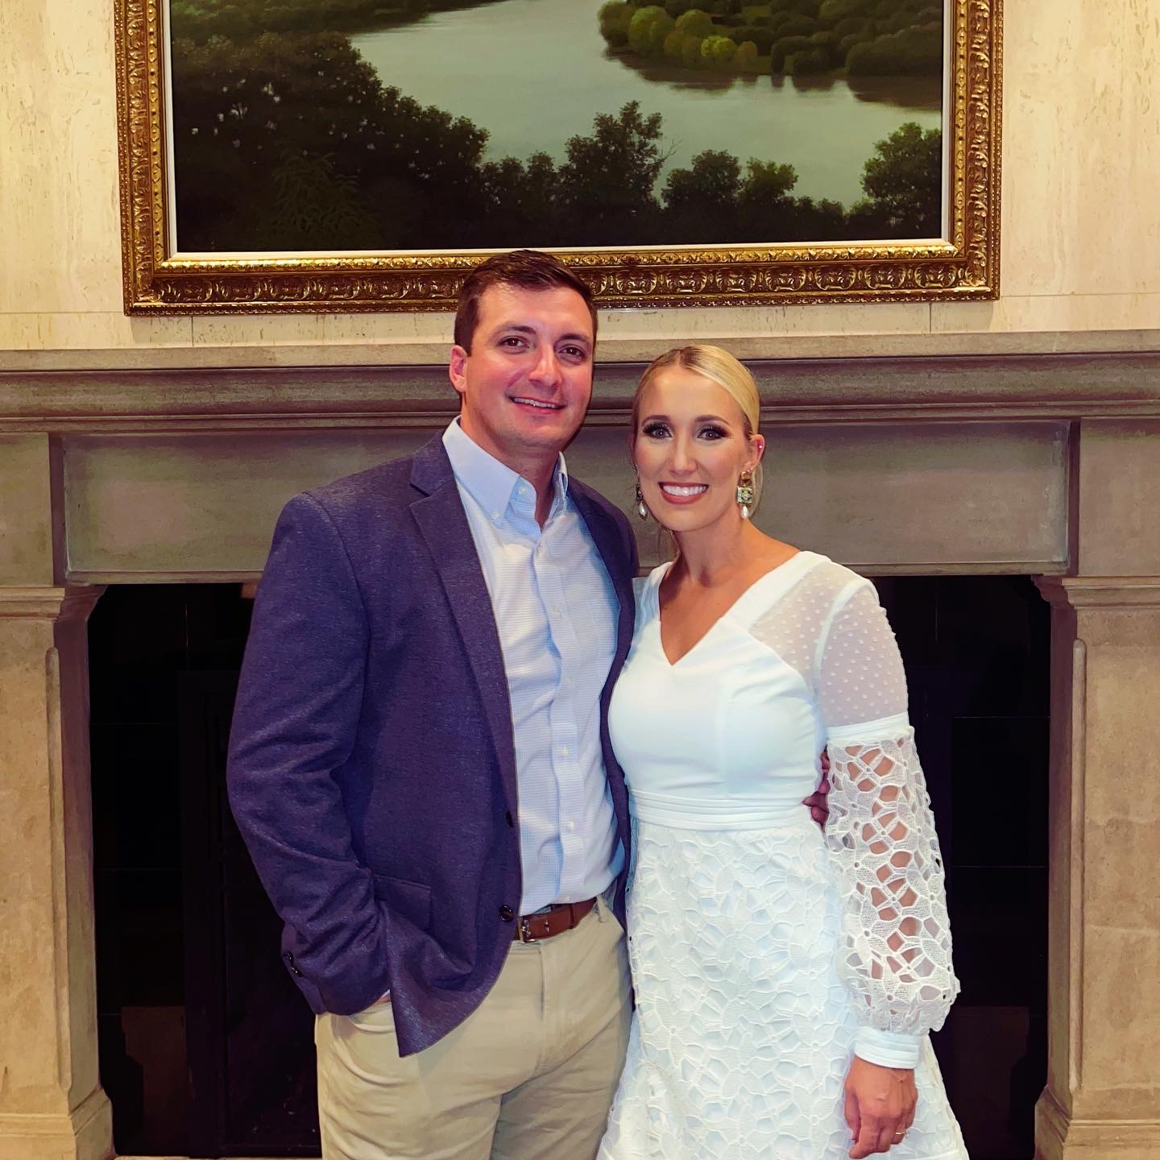
Ms. Cox
Best Email Address:
coxk1@scsk12.org
Math

Slide 6
Binders
This is a great place for students to keep everything organized. Please be sure students have their binders at school every day!
agenda book
homework
pencil pouch
study guides
blank paper
assignments
passwords-log in information
class schedule

Slide 7
5th Grade
8:00-8:30 | Do Now
8:30-9:20 | Encore
9:20-10:05 | Boost*
10:05-11:35 | Block 1
11:40-12:15 | Lunch
12:15 – 1:45 | Block 2
1:45 – 3:15 | Block 3
3:15 | Dismissal

Slide 8
Boost
This is a 45 minute period during which your child will receive differentiated instruction.
It is designed to create growth for all students.
Students will rotate between teachers to receive intervention or enrichment in ELA or Math.

Slide 9
Grading Scale
A- 90-100 Test grades count 45%
B- 80-89 Daily Grades count 40 %
C- 70-79 Homework –5 %
D- 60-69 Projects—5%
F- Below 60 Participation 5%

Slide 10
HOMEWORK
Monday: Sci / SS
Tuesday: Math
Wednesday: ELA
Thursday: Study for weekly tests
**If classwork isn't completed, it may be assigned for homework.

Slide 11
Positive attitude
Come to class prepared
Character pledge
Fabulous Four
• A- Act safely
• B- Be responsible and respectful
• C- Care for yourself, others and the environment
• D- Do your best at all times!

Slide 12
Wednesday Folders
Wednesday folders will go home weekly. Please sign each week. You may also login to Power School often to check your child’s grades.

Slide 13
Weekly Conduct
E = excellent
G = good
S = satisfactory
N = needs improvement
U = unsatisfactory

Slide 14
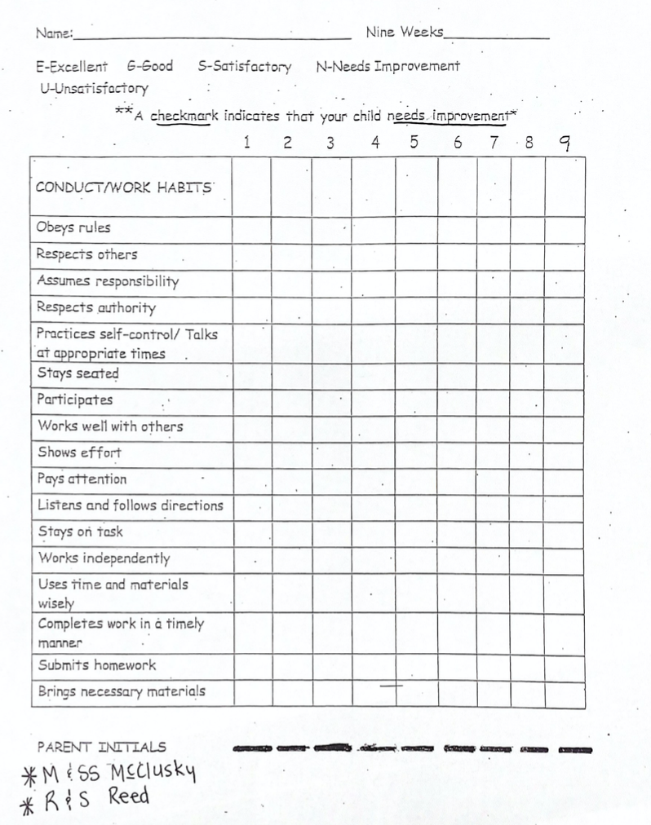
Wednesday Folders
Conduct /Behavior

Slide 15
All students will need to bring their devices and chargers to school everyday.
*Please charge devices nightly!

Slide 16
We will provide a weekly update on the Richland website. Click on your homeroom teachers page and you can view our combined weekly update.

Slide 17
We will be taking 3 I-ready test throughout the school year.
TNREADY will be given at the end of April.

Slide 18
9/8: Parent/Teacher Conference 4:00 – 7:00
2/16: Parent/Teacher Conference 4:00 – 7:00
You will be able to sign up through
Sign Up Genius.
**Conferences can be scheduled as needed through the year. Contact the teacher directly to schedule.

Slide 19
We will have two field trips this year. One in town and one out of town. Chaperones for the out-of-town trip must have a current 2022, level 3 background check.

Slide 20
Each class will need two parents to be room parents.
Duties:
Parents will help with class parties and activities throughout the year.
Note went home yesterday.

Slide 21
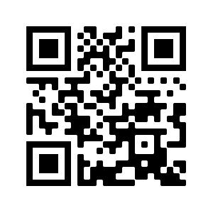
Remind App for
Mrs. Totty
Text @gg9beg to 81010
or scan the QR code.

Slide 22
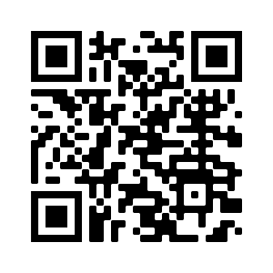
Remind App for
Mr. Wardlow
Text @501wa to 81010
or scan the QR code.

Slide 23
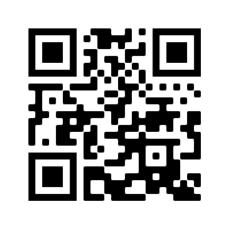
Remind App for
Ms. Cox
Text @503cox to 81010
or scan the QR code.

Slide 24
