Slide 1
TN Foundational Literacy
September 23-27, 2024

Slide 2
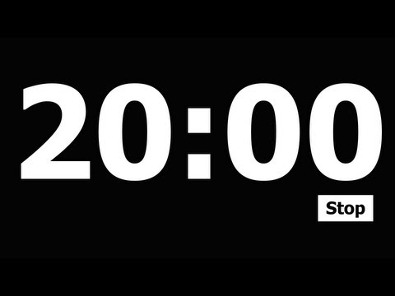
TODAY IS:
Add a timer
Focus Board
Monday
September 23, 2024
Letter Bundle
Color and Shape
white square
Tt
Vv
Ww
Xx
Yy
Uu
Sight Words:
Number
6
six
see
too
white
Daily
Affirmation
“I can do whatever I put my mind to.”

Slide 3
Add a timer
Let’s Learn to Read!
Today’s Lesson
TN Sounds First Vol. 1
Week 3
Day 1
Rhyme Time!
Break it Up!
Snatch the Sound
log, bog
sat, mat
jet, met
sight, night
hum, gum
milkshake
clothesline
bedroom
watermelon
tadpole
mom
wide
hat

Slide 4
Add a timer
Let’s Learn to Read!
Today’s Lesson
TN Sounds First Vol. 1
Week 3
Day 1
Snatch the Sound
Silly Sentence
mom
wide
hat
Fred’s friends fried Fritos.

Slide 5
TODAY IS:
Add a timer
Focus Board
Tuesday
September 24, 2024
Letter Bundle
Color and Shape
white square
Tt
Vv
Ww
Xx
Yy
Uu
Sight Words:
Number
6
six
see
too
white
Daily
Affirmation
“I can do whatever I put my mind to.”

Slide 6
Add a timer
Let’s Learn to Read!
Today’s Lesson
TN Sounds First Vol. 1
Week 3
Day 2
Rhyme Time!
Break it Up!
Snatch the Sound
trip, lip
ramp, camp
fish, dish
jump, bump
coat, boat
sidewalk
snowman
leapfrog
cartwheel sandwich
bird
sat
leg

Slide 7
Add a timer
Let’s Learn to Read!
Today’s Lesson
TN Sounds First Vol. 1
Week 4
Day 2
Snatch the Sound
Silly Sentence
bird
sat
leg
Quincy can quilt quickly.

Slide 8
TODAY IS:
Add a timer
Focus Board
Wednesday
September 25, 2024
Letter Bundle
Color and Shape
white square
Tt
Vv
Ww
Xx
Yy
Uu
Sight Words:
Number
6
six
see
too
white
Daily
Affirmation
“I can do whatever I put my mind to.”

Slide 9
Add a timer
Let’s Learn to Read!
Today’s Lesson
TN Sounds First Vol. 1
Week 3
Day 3
Rhyme Time!
Break it Up!
Snatch the Sound
rake, snake
sat, chat
book, cook
treat, sweet
drink, pink
forehead
softball
indoors
hilltop
grapefruit
cab
loud
honk

Slide 10
Add a timer
Let’s Learn to Read!
Today’s Lesson
TN Sounds First Vol. 1
Week 3
Day 3
Snatch the Sound
Silly Sentence
cab
loud
honk
Peter knows practice makes perfect.

Slide 11
TODAY IS:
Add a timer
Focus Board
Thursday
September 26, 2024
Letter Bundle
Color and Shape
white square
Tt
Vv
Ww
Xx
Yy
Uu
Sight Words:
Number
6
six
see
too
white
Daily
Affirmation
“I can do whatever I put my mind to.”

Slide 12
Add a timer
Let’s Learn to Read!
Today’s Lesson
TN Sounds First Vol. 1
Week 3
Day 4
Rhyme Time!
Break it Up!
Snatch the Sound
queen, mean
please, sneeze
paste, taste
four, door
goose, moose
outside
midnight
aircraft
icebox
spacecraft
can
fish
bait

Slide 13
Add a timer
Let’s Learn to Read!
Today’s Lesson
TN Sounds First Vol. 1
Week 3
Day 4
Snatch the Sound
Silly Sentence
can
fish
bait
I see two tasty tacos for lunch.

Slide 14
TODAY IS:
Add a timer
Focus Board
Friday
September 27, 2024
Letter Bundle
Color and Shape
white square
Tt
Vv
Ww
Xx
Yy
Uu
Sight Words:
Number
6
six
see
too
white
Daily
Affirmation
“I can do whatever I put my mind to.”

Slide 15
Add a timer
Let’s Learn to Read!
Today’s Lesson
TN Sounds First Vol. 1
Week 3
Day 5
Rhyme Time!
Break it Up!
Snatch the Sound
yell, bell
right, bright
duck, truck
flock, block
game, same
background
playpen
outgrow
necktie
bulldog
kid
sad
end

Slide 16
Add a timer
Let’s Learn to Read!
Today’s Lesson
TN Sounds First Vol. 1
Week 3
Day 5
Snatch the Sound
Silly Sentence
kid
sad
end
I smell pineapple pepperoni pizza.

