Slide 1
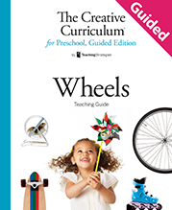
Question of the Day

Slide 2
Exploring the Topic

Slide 3
Can you roll this?

Slide 4
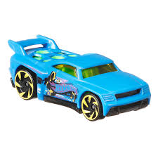
Where can I find this toy?

Slide 5
What have you seen with wheels this morning?

Slide 6
What kind of wheel
can you draw?

Slide 7
Do you know what this is?

Slide 8
Investigation
#1

Slide 9
How did you get
to school today?

Slide 10
What wheels did you see after school yesterday?

Slide 11
What is your favorite instrument in the music and movement area?

Slide 12
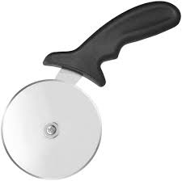
What do you use this for?

Slide 13
Investigation
#2

Slide 14
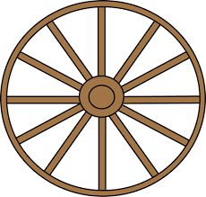
How can you
make this move?

Slide 15
What do you think we will see on our site visit today?

Slide 16
Can you make a wheel with this?

Slide 17
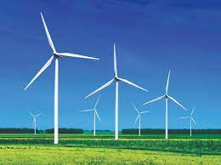
How do you think this object moves?

Slide 18
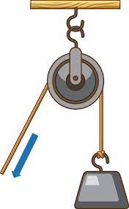
Where do you see a wheel in this picture?

Slide 19
Investigation
#3

Slide 20
Which wheel is the biggest?

Slide 21
Which one of these can you roll the fastest?

Slide 22
How many jumping jacks can you do?

Slide 23
How can you pick
up these books?

Slide 24
Celebrating Learning

Slide 25
Can you find something in the classroom that starts with the letter Ww?

Slide 26
What would you like to share with our visitors today?

