Slide 1
Annual Title I Parent Meeting
August 27, 28 2024, 10:00 a.m./ 5:00 p.m.
Nicholas Dominguez, Principal
Shela Ashford, Anthony Bowen, and Jennifer Jackson, Assistant Principals
Lokita Glover, Title 1 PLC Coach
Jamie Hargett, RTI Interventionist
Beth James and Melanie Harrison, Professional School Counselors

Slide 2
Agenda
Welcome Nicholas Dominguez, Principal
Title 1 Information for Parents Lokita Glover, PLC Coach
Notice of Title I School Status
Policies for Family Engagement
Reporting Pupil Progress
Parent-Teacher Conferences
Parental Involvement Requirements
Availability of Parent Training
Status School Improvement Plan/ District-School Status
Opportunities for Additional Parent Meetings
Teacher Qualifications
Parent’s Right to Know
School/Parent Compact
Student Code of Conduct
Curriculum Information
Closing Remarks

Slide 3
Welcome
We are a Title 1 School!!
The Purpose of Title1 is to provide all children significant opportunities to receive a fair, equitable, and high-quality education, and to close educational achievement gaps. School-wide programs use their funds to improve the entire program of the school so that all students are impacted.
Title 1 Provides:
Supplement not Supplant
Programs, materials, supplies
Technology (Promethean Boards, DocuCams, Computers)
Staff ( Teacher Assistants, Additional Guidance Counselors, Teachers)
Parent and Family Engagement events
Notes:
The purpose of the Title I, Part A program is to provide federal dollars to supplement educational opportunities for students who attend schools with high numbers or percentages of children from low-income families and are most at risk of failing to meet the state’s challenging academic achievement standards. Title I, Part A funds are to be used to provide all students significant opportunity to receive a fair, equitable, and high-quality education, and to close educational achievement gaps.

Slide 4
Policies for Family Engagement
Shelby County Schools’ Family Engagement Policy #4.502 speaks to the following goals:
To provide meaningful two-way communication
To provide meaningful and varied participation by families to support student achievement
To eliminate or reduce barriers to greater family participation
To provide training opportunities and informational seminars for families

Slide 5
Family Engagement Plan
Macon-Hall Elementary encourages parental involvement in the educational process. Therefore, we worked jointly with parents and community partners to establish expectations for parental involvement at our school.
Parental Commitment
MHE will promote student success by providing opportunities and encouraging parents to actively participate in the educational process. Parents will:
Collaborate to revise the School/ Parent Compact and the Family Engagement Plan.
Join and support the PTO by participating in their sponsored events and activities.
Respond to surveys and questionnaires expressing their concerns and offer suggestions to improve parent interactions.
﻿﻿ Use their talents and resources to enhance the instructional program.
﻿﻿ Attend the Annual Title 1 meeting, Curriculum night, Family Data Night, and monthly parent workshops.
﻿﻿. Become advocates and supporters of MHE.
Title 1 /Federal Programs Commitment
MHE faulty, staff, administrators, and parents will meet all Title 1 requirements by implementing the following protocols:
﻿ Advise all MHE parents and community members of our participation in Title 1 state and federal programs.
Provide parents with a copy of the Family Engagement Plan, the School Compact and the MSCS Family Engagement Policy.
Encourage parents to observe and volunteer in the school's programs and classrooms.
Provide parents with progress reports and updated information on our school's achievement.
Communicate consistently with parents through weekly newsletters, monthly calendars, Wednesday folders, progress reports and teacher/parent conferences.

Slide 6
Reporting Student Progress
Macon Hall Elementary reports student progress in the following ways:
Mid nine-week progress report- Dates: September 4, November 13, February 5, and April 16
Report cards every nine weeks- October 23, January 15, March 26, and May 30
Parent-Teacher Conferences : Scheduled when necessary and district-wide
September 5 (4:30 -7 pm); February 13 (4-7 pm)
Phone calls/ emails
Communication Apps (Class Dojo)
Agendas and Weekly Thursday Folders
-

Slide 7
School Improvement Plan- School Status
The School Improvement Plan is a written document that shows:
School demographics
Teacher Demographics
School Test Scores (District CFA’s Iready Benchmarks, TCAP)
Chronic absenteeism
Goals for improving academic achievement in reading, math, early literacy, and chronic absenteeism
Action plans to improve in areas that need to be strengthened
-

Slide 8
District/School Progress AYP Status:
Data from 2023-24
Macon Hall’s Performance Scorecard Rating: Not Available yet
To Improve We Are:
Implementing the Reading Wonder’s, IReady, and the new Envision Math Curriculum with fidelity
Tracking Reading/Math Data and Reteaching non-mastered standards/objectives
Professional Development geared towards improving literacy and numeracy
Departmentalization in Grades 2-5
Response to Intervention-
Tracking absenteeism rates for frequent truant students
-

Slide 9
Opportunities for Parent Engagement:
Grandparent’s Day September 11( A-L) September 12( M-Z)
Family literacy Nights: Spooktacular October 24 5-7 pm
Family Literacy Trainings: October 3, January 16, March 6
Assisting with creating the Family Engagement Plan and School Compact May 2025
Notes:
Family literacy book trainings will start next month and meet every 6 weeks to discuss ways to increase your student’s literacy skills. Each family will also receive a set of books for home activities. Only K-3

Slide 10
Parent’s Right to know/ Teacher Qualifications
All parents have the right to request the following:
A teacher’s professional qualifications, licensure, grade(s) certification, waivers
A teacher’s baccalaureate and/or graduate degree, fields of endorsement, previous teaching experience
A paraprofessional’s qualifications
An annual notice of Student Education Records Privacy and notice for disclosure of School Directory Information
An assurance that their child’s name, address and telephone listing not be released to military recruiters
All parents will receive information on the following:
Their child’s level of achievement on each of the state’s academic assessments
Notification of right to transfer their child to another school in the district if the student becomes the victim of a violent crime or is assigned to an unsafe school
District Family Involvement Policy and School Parent Involvement Policy
Their right to public school choice, Supplemental Educational Services and more effective involvement if their child’s school is identified for school improvement

Slide 11
School/Parent Compact
PARENT/GUARDIAN AGREEMENT
I want my child to achieve; therefore, I will encourage him/her by doing the following:
See that my child gets to school on time prepared to participate
Support the school in its efforts to maintain proper discipline
Establish a quiet area and time for homework
Communicate with teachers about my child’s academic progress and behavior
TEACHER/SCHOOL AGREEMENT
Provide high-quality curriculum and instruction
Conduct parent/teacher conferences
Provide parents with frequent reports on their student’s progress
Provide parents with reasonable access to staff
Provide parents opportunities to volunteer and participate in their student’s class ( when possible)

Slide 12
Student Code of Conduct
Macon- Hall Elementary Student Code of Conduct:
I am Safe, Responsible and Respectful.
I have Integrity.
All classroom, hallway, cafeteria, bathroom expectations posted throughout the school.
Available on SCS website
Speaks to the shared responsibility of children’s conduct
Gives notice of infractions as well as strategies and/or disciplinary measures for levels of offenses.

Slide 13
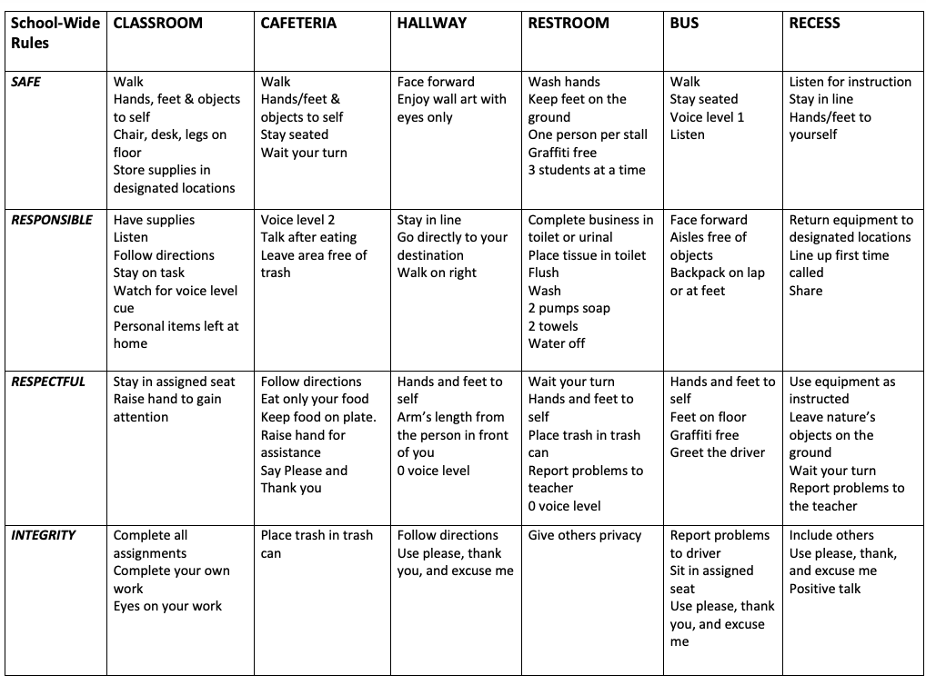
Student Code of Conduct

Slide 14
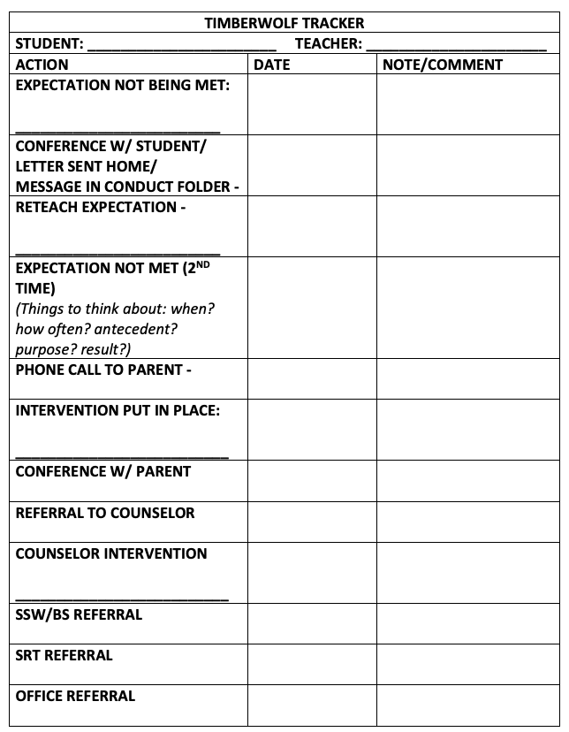
Progressive Discipline Policy

Slide 15
Conclusion
PLEASE check our website for a copy of the Parent Engagement form, the School/Parent Compact and The MH Parent Handbook.
Please give us feedback on any updates or changes that you deem necessary on either contract
Thank you for your time and commitment to MHE
Closing Remarks
Questions
Notes:
You will also receive a paper copy for signatures to be returned to school

Slide 16
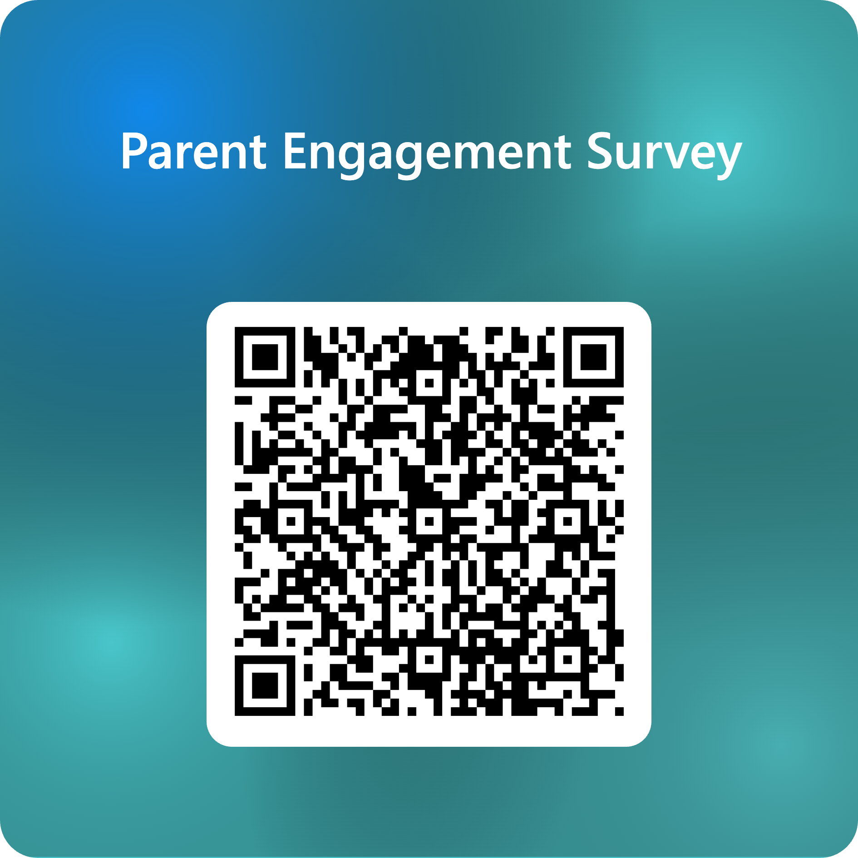
Parent Engagement Survey
Notes:
You will also receive a paper copy for signatures to be returned to school

