Slide 1
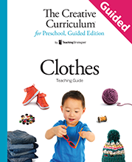
Question of the Day

Slide 2
Exploring the Topic

Slide 3
What clothes are you wearing today?

Slide 4
Can I wear pants
on my head?

Slide 5
What color shirt are you wearing today?

Slide 6
Investigation
#1

Slide 7
What is the name of this clothing item?

Slide 8
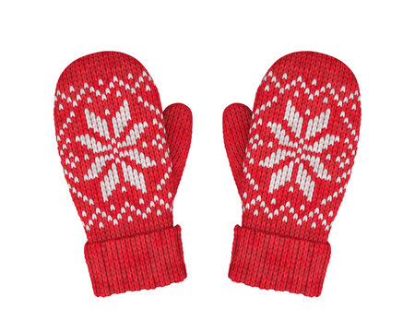
What are these?

Slide 9
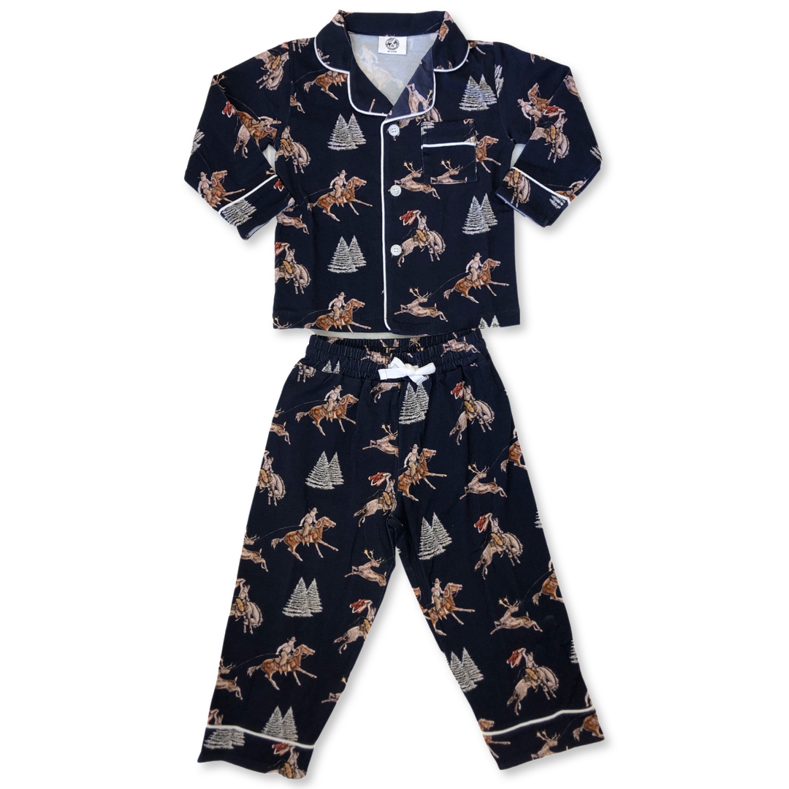
When do you wear this?

Slide 10
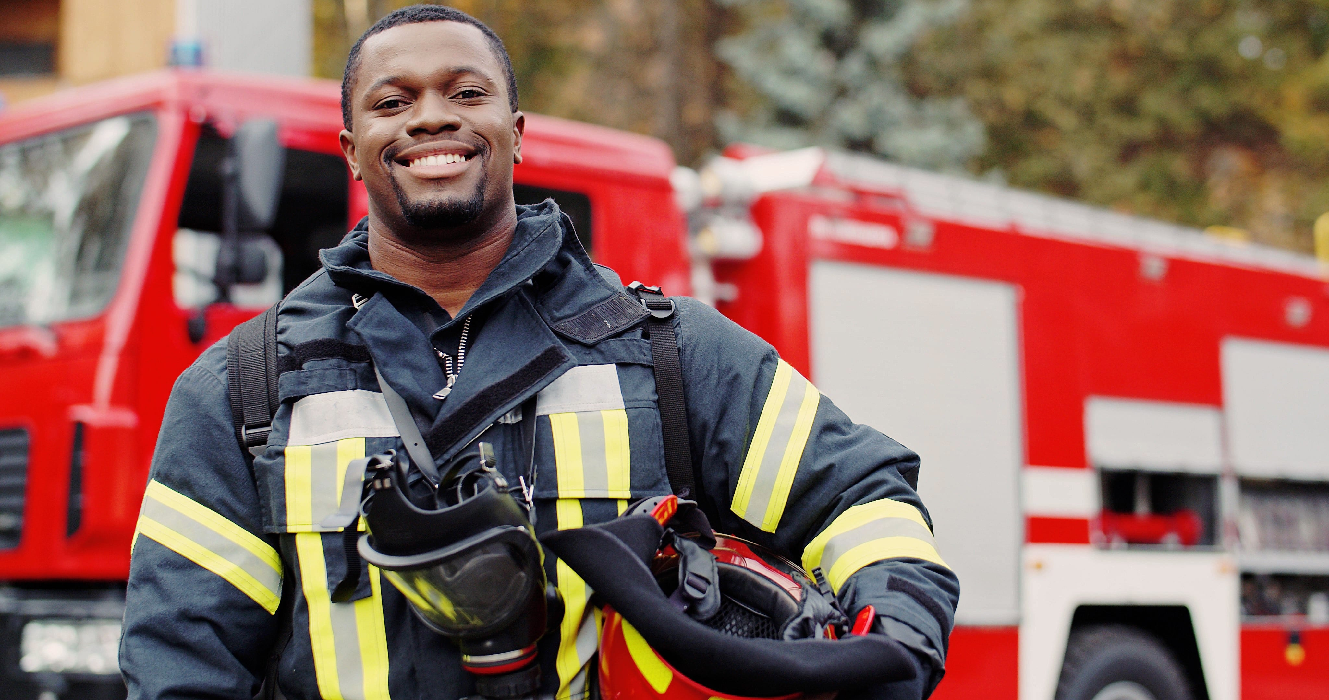
What type of clothing is this person wearing?

Slide 11
Investigation
#2

Slide 12
What happens to clothes when they get dirty?

Slide 13
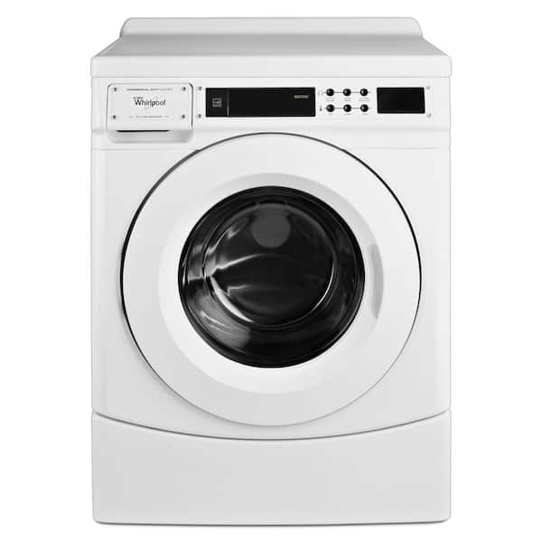
What is this called?

Slide 14
What happens to clothes after they are washed?

Slide 15
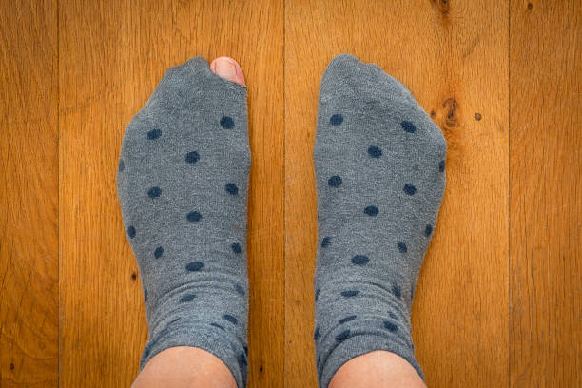
What happened to this sock?

Slide 16
Investigation
#3

Slide 17
Where do you get your clothes?

Slide 18
What questions would you like to ask our visitor?

Slide 19
What do you do with clothes that you do not wear anymore?

Slide 20
Investigation
#4

Slide 21
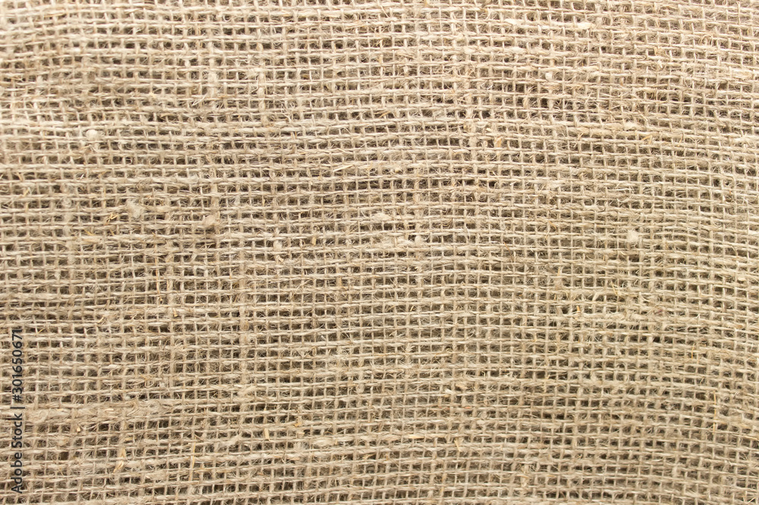
What do you notice about this piece of fabric?

Slide 22
Do you have a picture or pattern on your shirt?

Slide 23
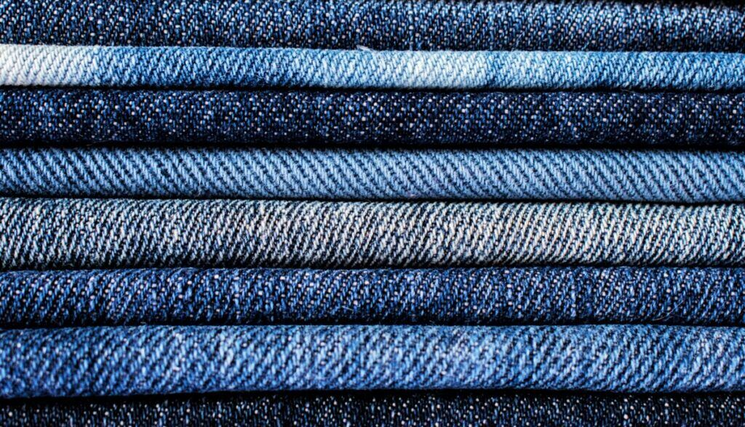
Where have you seen this fabic?

Slide 24
Do you have a button on your clothes today?

Slide 25
Celebrating Learning

Slide 26
What song should we play at the fashion show?

Slide 27
How are you going to walk down the runway?

