Slide 1
The Coaching Corner:
Strategies for Introducing and Exploring
Letter Bundles
Monday, January 29, 2024
Presented by:
Latanya Craig
Teleka Trezevant

Slide 2
Session Norms
Be engaged.
Be solutions-orientated.
Be open-minded.
Be student- focused.
Utilize this time to effectively plan for high quality instruction.

Slide 3
Today’s Agenda
Teaching the Alphabet
Approach
Rationale
Strategies & Practice

Slide 4
Outcomes
As a result of today’s session, you will be able to:
Understand and explain the letter bundle approach.
Utilize strategies to integrate letter instruction throughout the day.

Slide 5
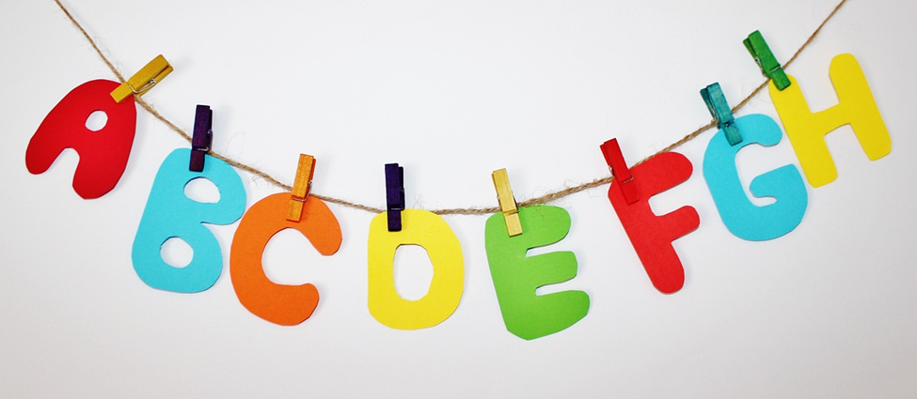
Alphabet Knowledge
Alphabet knowledge is the foundation for a child’s ability to read and write the English language and is critical for academic development. Alphabet knowledge involves recognizing letters, saying their name, associating the name with corresponding sounds and, to some extend, writing on paper or other material.

Slide 6
Alphabet Knowledge
Teaching alphabet knowledge to children can be complicated. There are:
26 letter names
52 letter forms
44 letter sounds
Experts recommend that letters and sounds should be taught together. Lowercase and uppercase forms that look similar (Oo, Ss, etc.) should also be taught together. Additionally, handwriting should be taught simultaneously.

Slide 7
Letter of the Week Approach
The Approach
Children learn one letter per week.
All letters are introduced after 26 weeks (typically end of 3rd 9 weeks at the earliest).
The Reality
Children don’t “magically” learn their letters after 26 weeks, nor do they automatically master letters in the order they are introduced.

Slide 8
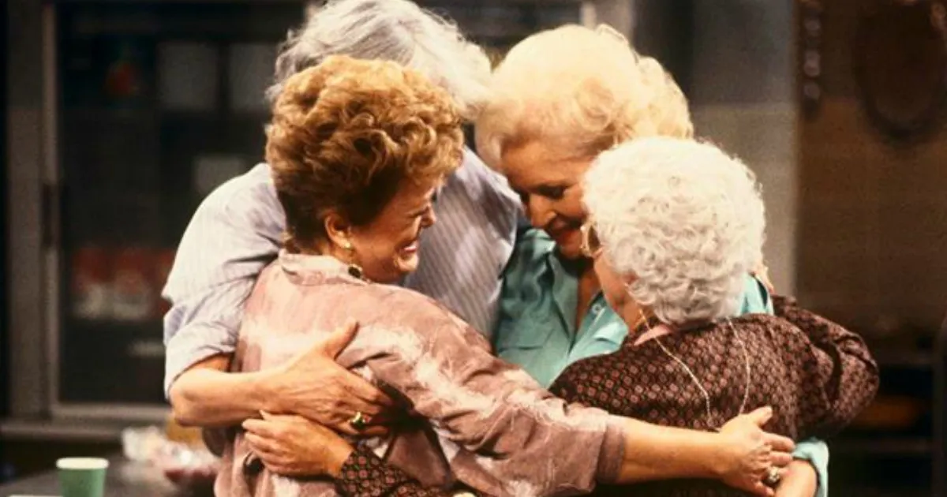
What Would You Discuss?

Slide 9
Letter Bundle Rationale
Scientifically based method (Reading Horizons)
Aligns with MSCS Kindergarten instruction
Introduces all letters within first 10 weeks of school
Includes a vowel with each group
Promotes repetitive practice/engagement
Designed for exposure rather than immediate mastery

Slide 10
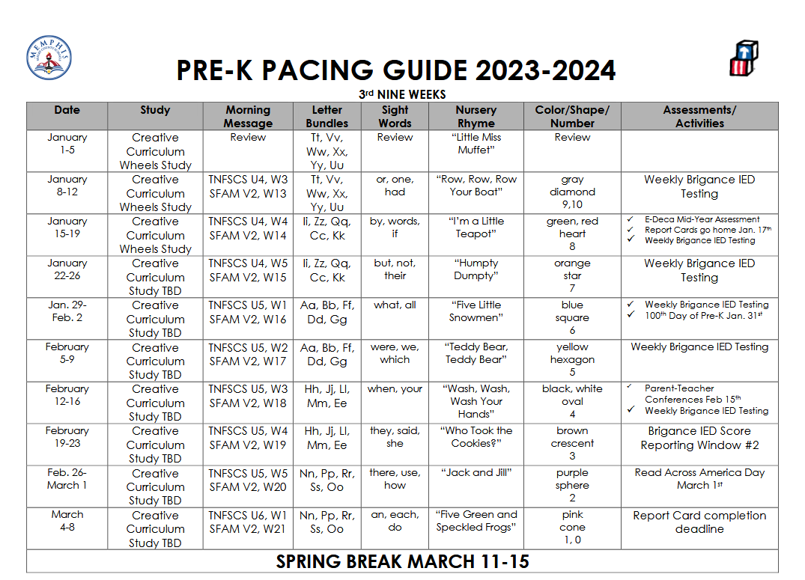
Letter Bundle Rationale
What is our letter bundle for this week?

Slide 11
Strategies and
Best Practices

Slide 12
Creative Curriculum Letter Knowledge Strategies
Display the alphabet.
Read alphabet books and add them to the library and other interest areas.
Sing the alphabet song and other songs with letter names.
Individualize alphabet instruction, especially during small-group time.

Slide 13
Creative Curriculum Letter Knowledge Strategies
Encourage sensory exploration of the alphabet.
Provide ample time, materials, and space for children to write throughout the day.
Use children’s names to help them learn alphabet letters and sounds.
Model writing during daily shared writing experiences.

Slide 14
Creative Curriculum Letter Knowledge Strategies
Children learn from repeated exposure over time and they learn at their own pace. It doesn’t always happen in a straight line as we want it to. These are some other strategies that can be used:
• repeated and varied exposure and practice • drawing attention to the print in the classroom • reading and writing the morning message • class letters, predictable charts • self-initiated writing • student-made books • class books such as The Letter-Shape Book • songs, poems, and games

Slide 15
Working with Letter Bundles in Morning Meeting/Message

Slide 16
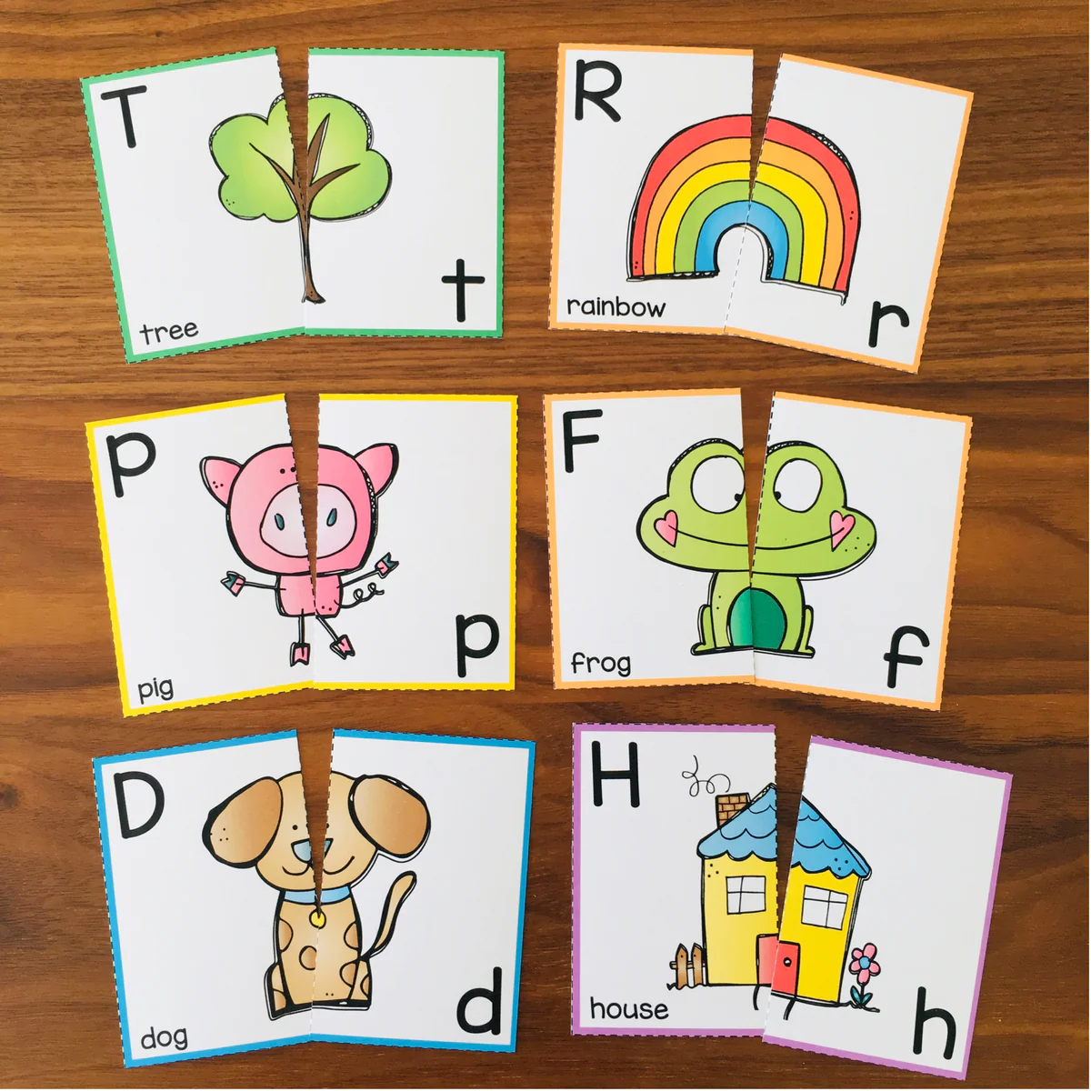
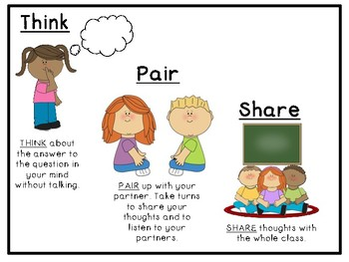
Letter Bundles in the Morning Meeting

Slide 17
Letter Bundles in the Morning Message
Ending Sound
Initial Sound
Goo_ morning _oys and _irls,
Today is Thursday, _ebruary 1, 2024.
The weather looks _____ and feels _______.
We have been in school ____ d_ys.
We will focus on the letters Ff, Bb, Dd, Aa, and Gg.
Medial sound

Slide 18
Letter Bundles in the Morning Message
Rhyming
Extend this activity.
Students can create words that rhyme that begin with a specific letter. Ex. “Tell me a word that rhymes with red that begins with B, D, F, or G.”

Slide 19
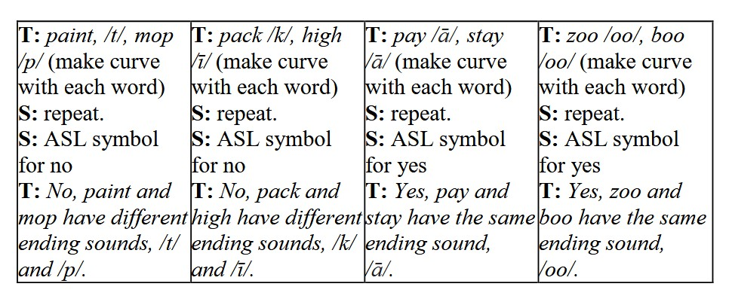
Letter Bundles in the Morning Message
Ending Sound
T: globe, /b/, fan /n/ (make curve with each word) S: repeat S: ASL symbol for no T: No, globe and fan have different ending sounds, /b/ and /n/. | T: all, /ll/, fall /ll/ (make curve with each word) S: repeat S: ASL symbol for yes T: Yes, all and fall have the same ending sound, /ll/. | T: pay, /ā/, stay /ā/ (make curve with each word) S: repeat S: ASL symbol for yes T: Yes, pay and stay have the same ending sound, /ā/. | T: dog /g/, bag /g/ (make curve with each word) S: repeat S: ASL symbol for yes T: Yes, dog and bag have the same ending sound, /g/.

Slide 20
Letter Bundles in the Morning Message
Silly Sentences
Daffy Duck danced delightfully down donut doors.
Gorillas gladly gobble green grapes.
Beautiful butterflies bravely bounce __________.

Slide 21
Working with Letter Bundles in Small Groups

Slide 22
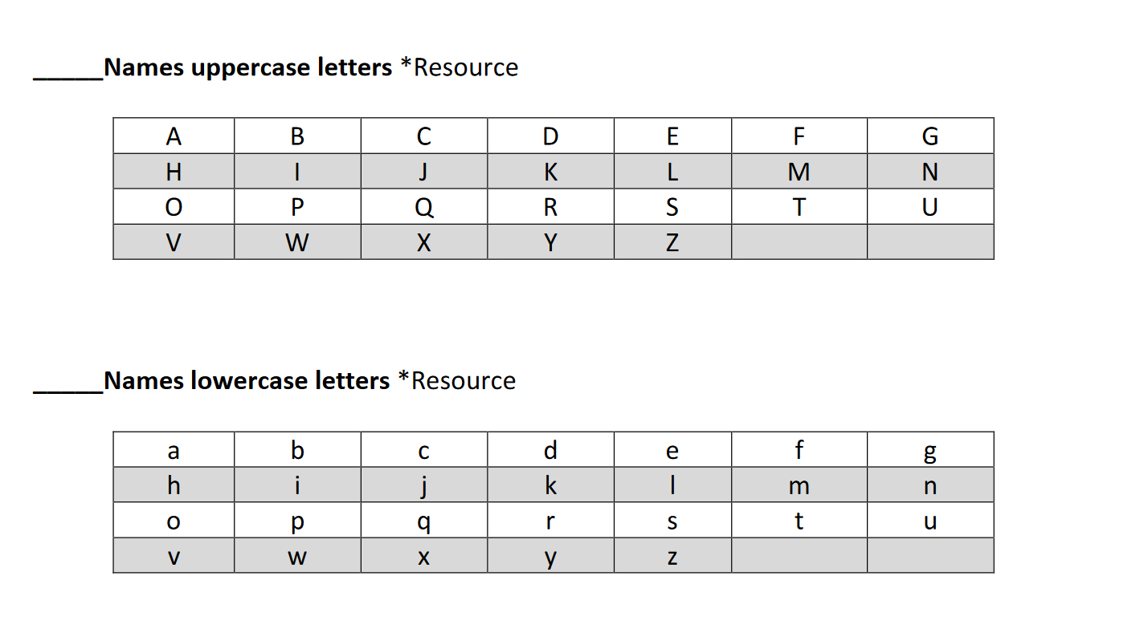
Letter Bundles in Small Groups
Provide individualized instruction.
Use assessment data to target students’ needs.
Differentiate instruction for each group.

Slide 23
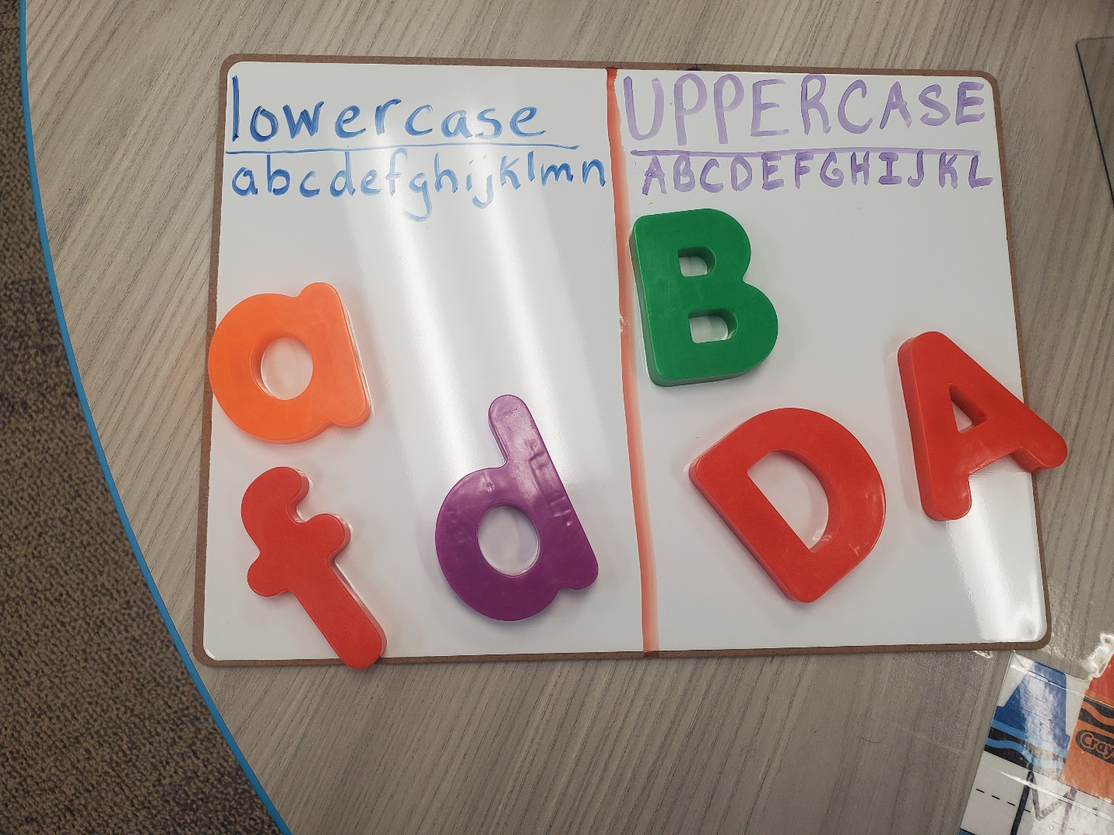
Letter Bundles in Small Groups
Use assessments to target the needs of your students.
Standards
PK.FL.WC.4a. Begin to recognize the difference between upper and lowercase letters.

Slide 24
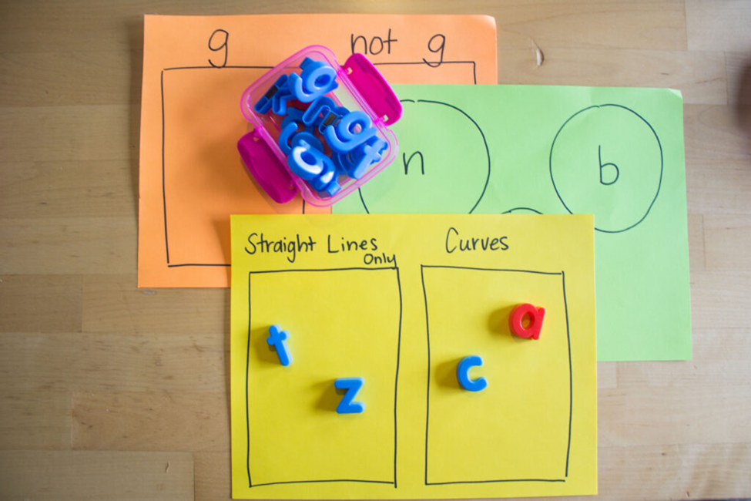
Letter Bundles in Small Groups
Use assessments to target the needs of your students.
Standard
PK.FL.WC.4 b. Begin to print the distinctive features of letter forms
(circle, line, diagonal, crossed lines, etc.).

Slide 25
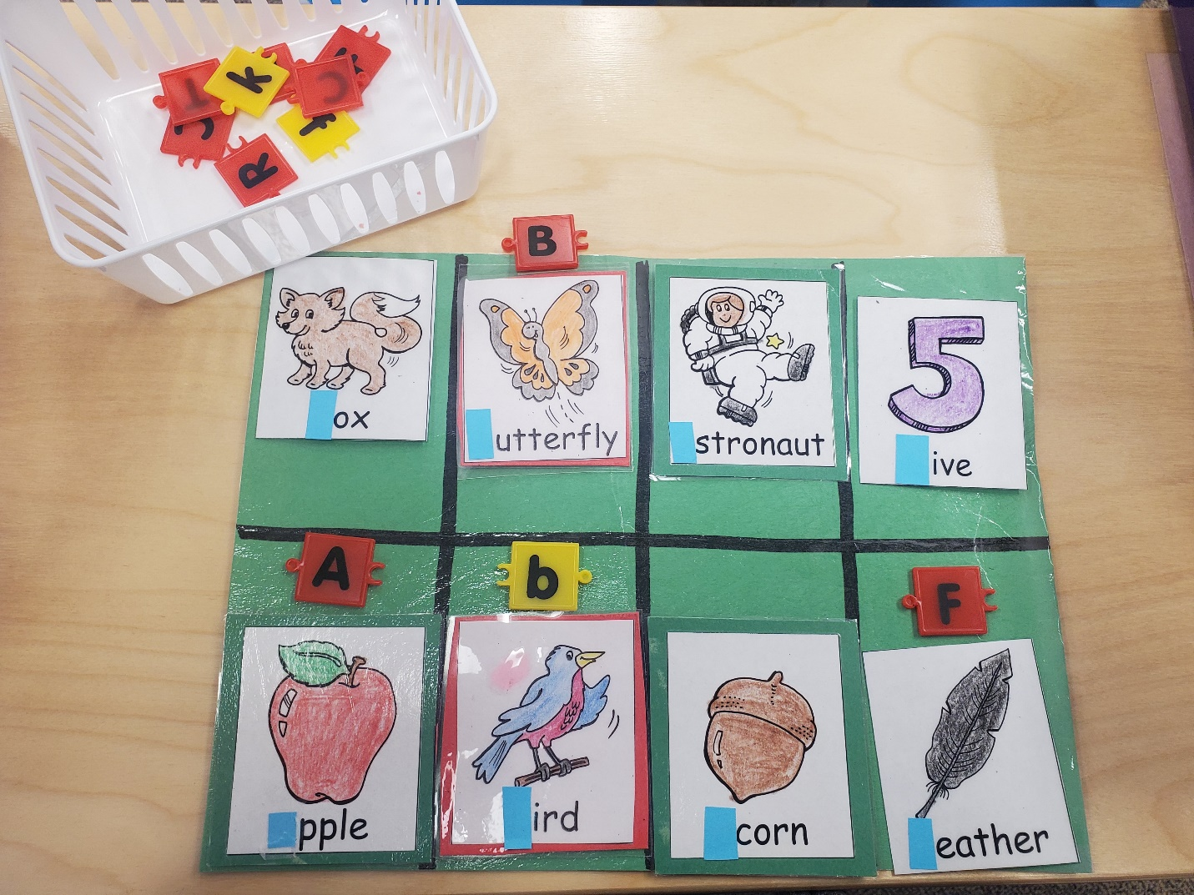
Letter Bundles in Small Groups
Use assessments to target the needs of your students.
Standards
PK.FL.PC.1d. Recognize familiar uppercase letters and some of the most common lowercase letters.
PK.FL.PWR.3a. Begin to demonstrate knowledge of one-to-one letter sound correspondence by producing the most frequent sound for familiar consonants.

Slide 26
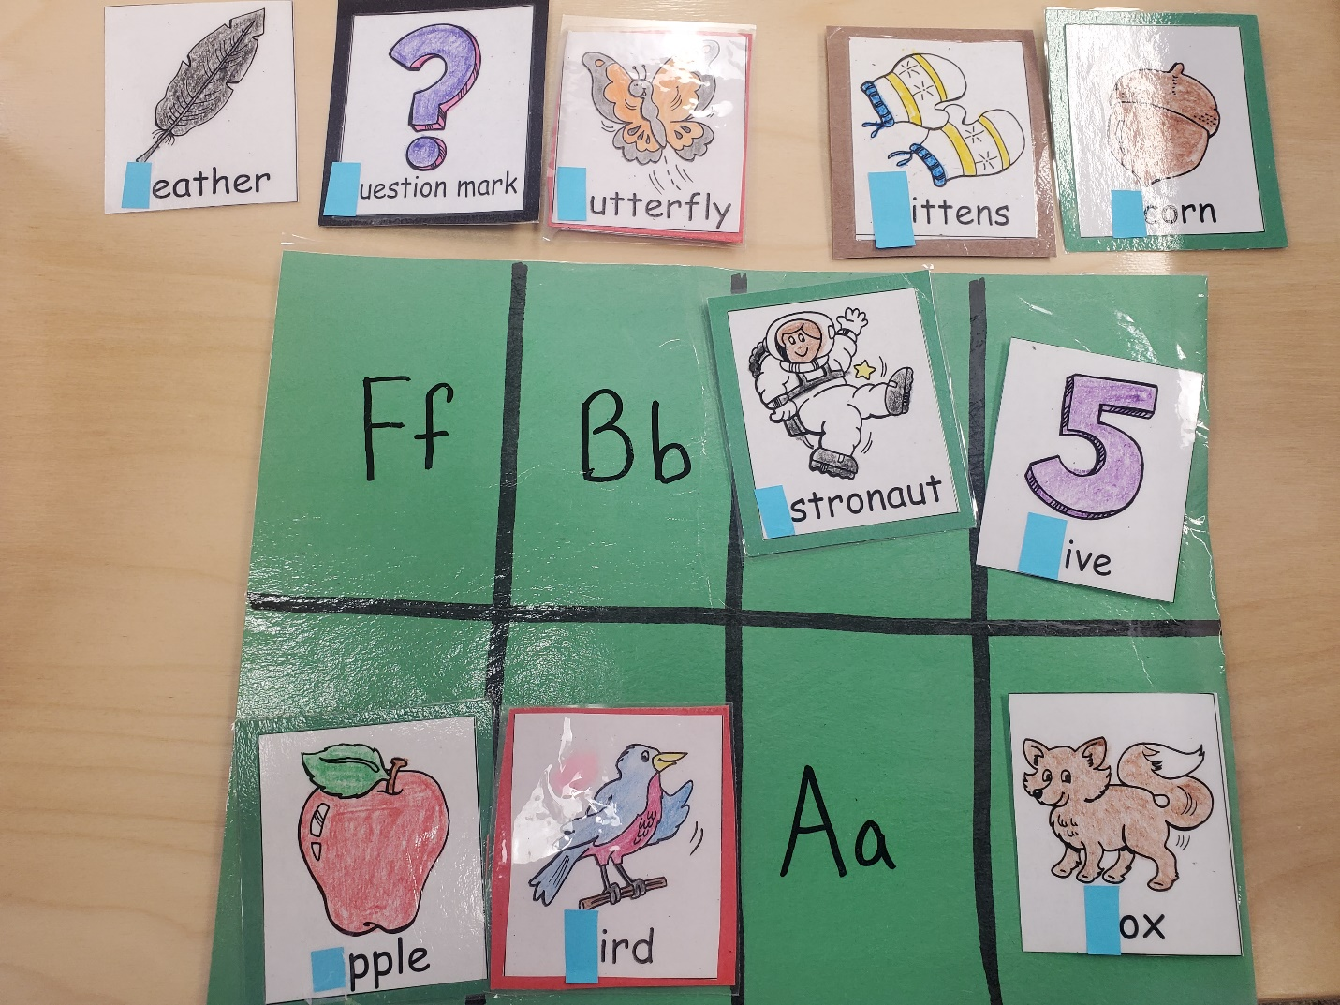
Letter Bundles in Small Groups
Use assessments to target the needs of your students.
Standards
PK.FL.PC.1d. Recognize familiar uppercase letters and some of the most common lowercase letters.
PK.FL.PWR.3a. Begin to demonstrate knowledge of one-to-one letter sound correspondence by producing the most frequent sound for familiar consonants.

Slide 27
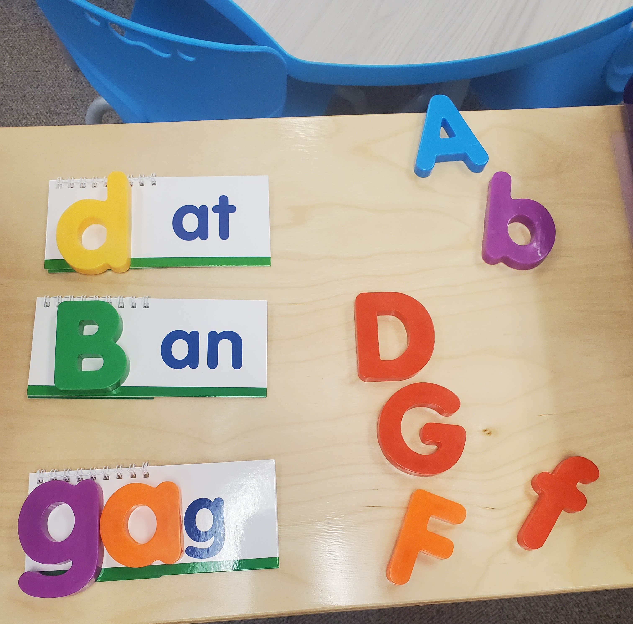
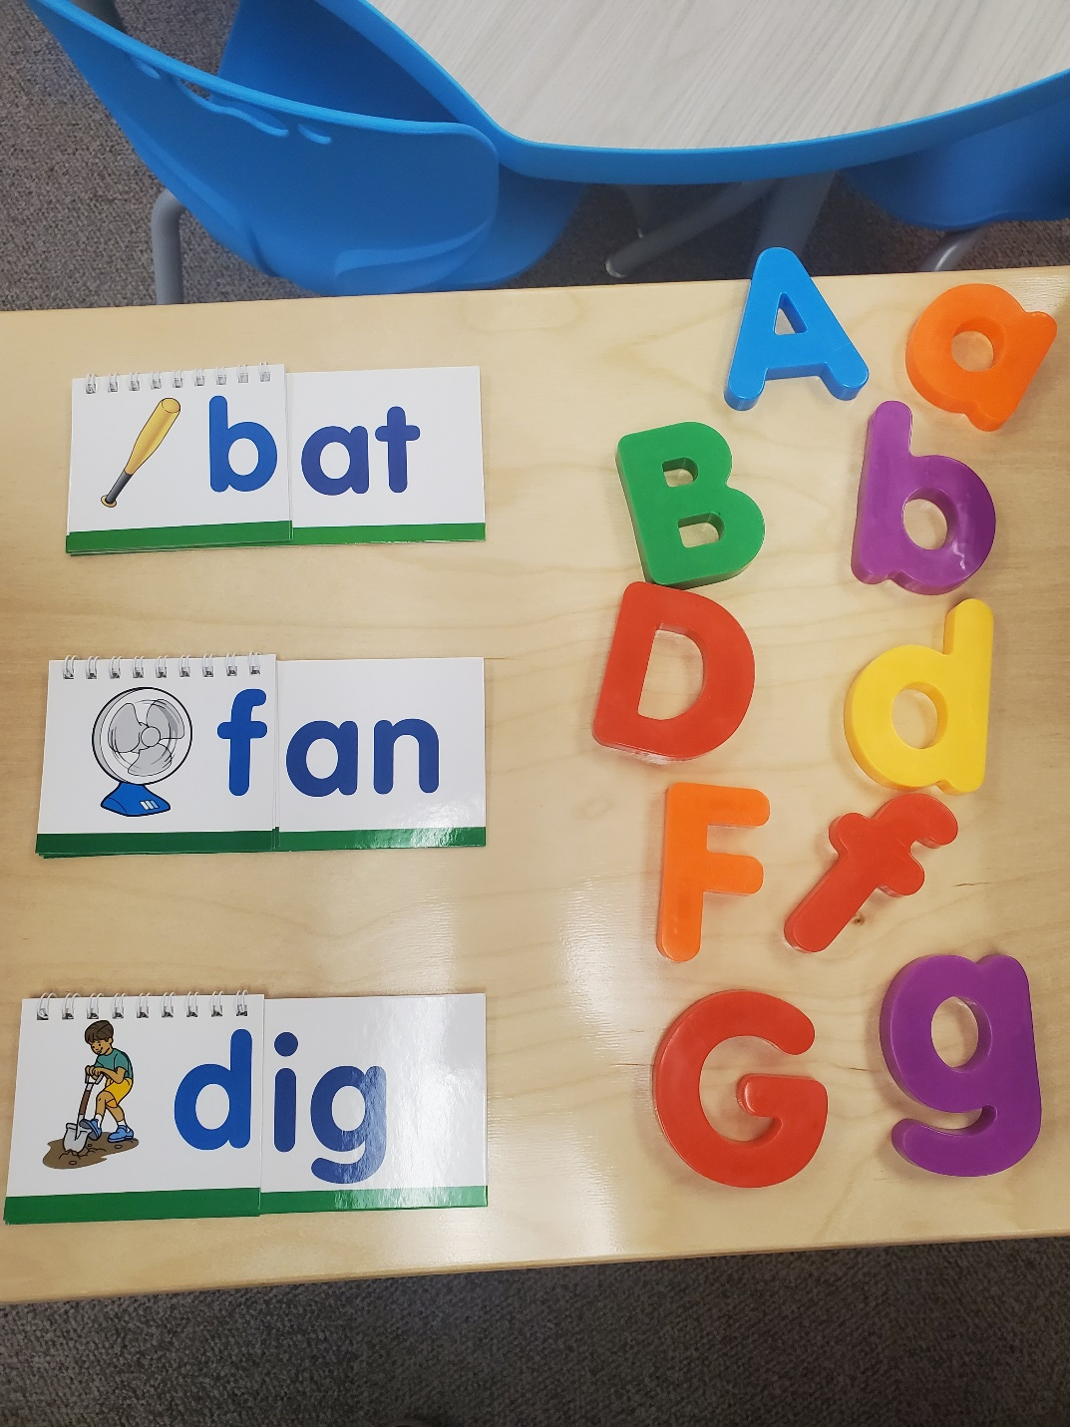
Letter Bundles in Small Groups
Use assessments to target the needs of your students.
Standard
PK.FL.PA.2 d. Begin to isolate and pronounce the initial, final,
and/or medial vowel sounds (phonemes) in two- and
three-phoneme (VC or CVC) words, excluding CVC
words ending with /l/, /r/, or /x/.

Slide 28
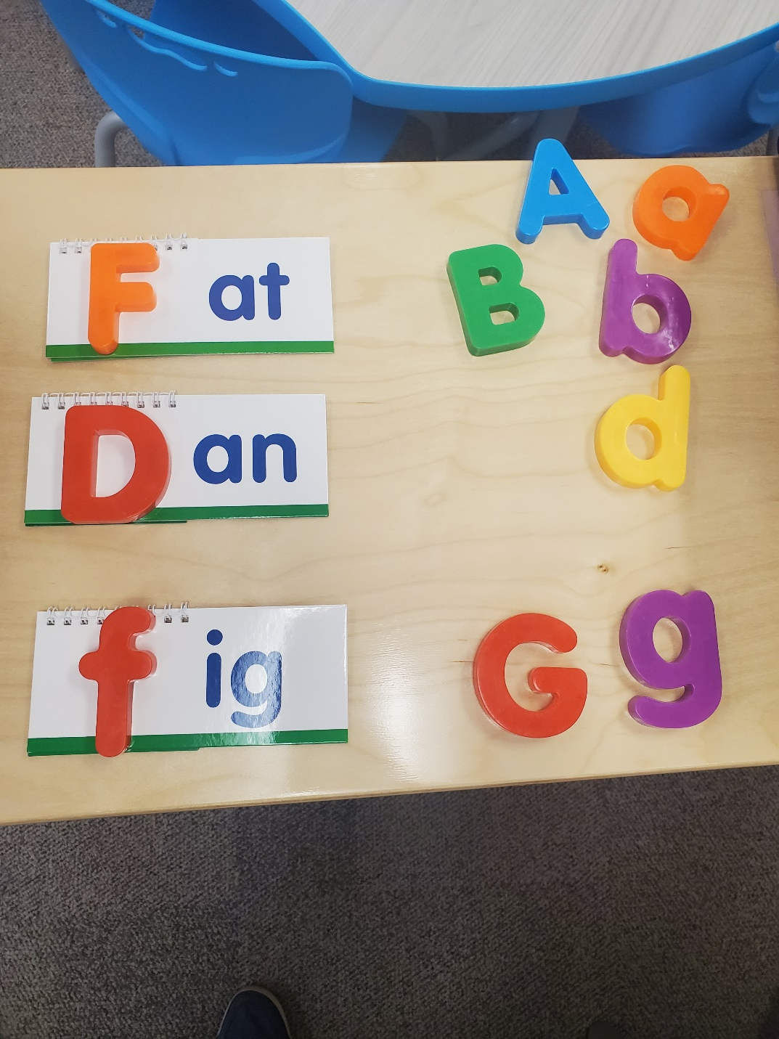
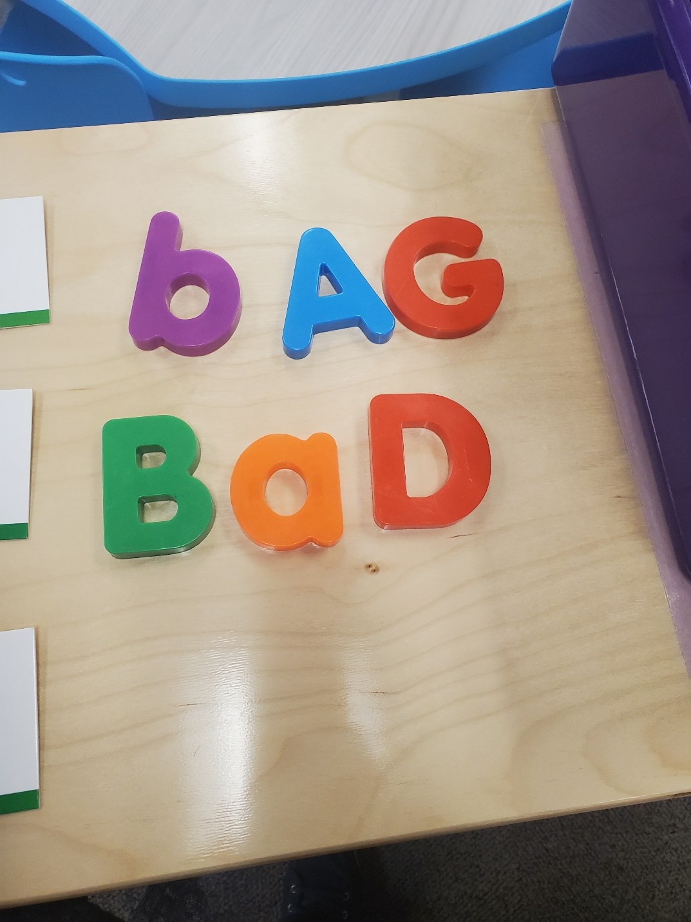
Letter Bundles in Small Groups
Use assessments to target the needs of your students.
Standard
PK.FL.PA.2 d. Begin to isolate and pronounce the initial, final,
and/or medial vowel sounds (phonemes) in two- and
three-phoneme (VC or CVC) words, excluding CVC
words ending with /l/, /r/, or /x/.

Slide 29
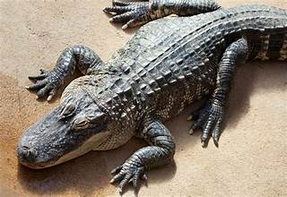
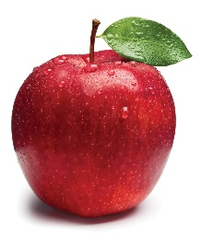
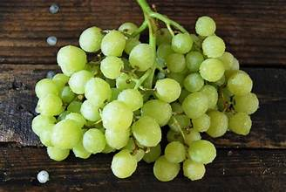
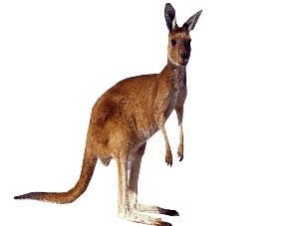
Letter Bundles in Small Groups
Same Beginning Sound?
Use assessments to target the needs of your students.
Standard
PK.FL.PA.2 e. Identify whether or not two words begin or end with
the same sound.

Slide 30
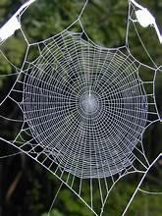
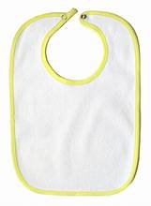
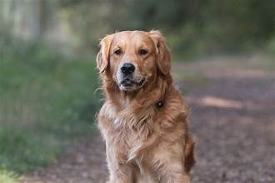
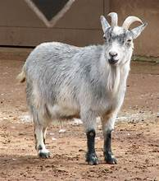
Letter Bundles in Small Groups
Same Ending Sound?
Use assessments to target the needs of your students.
Standard
PK.FL.PA.2 e. Identify whether or not two words begin or end with
the same sound.

Slide 31
Working with Letter Bundles in Large Group

Slide 32
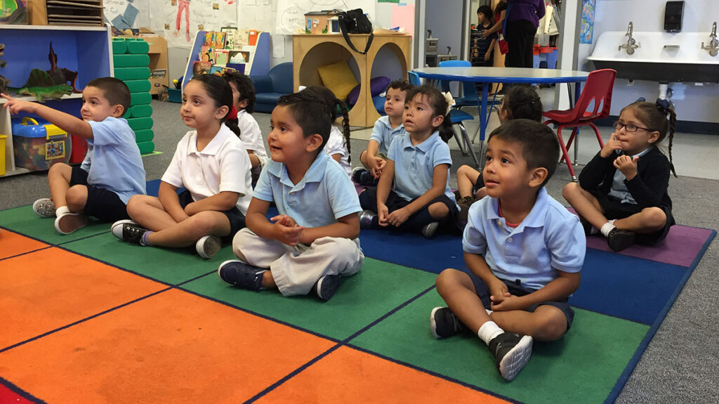
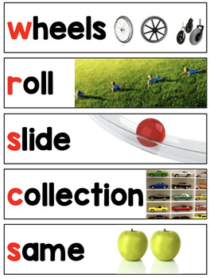
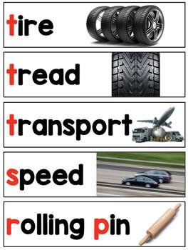
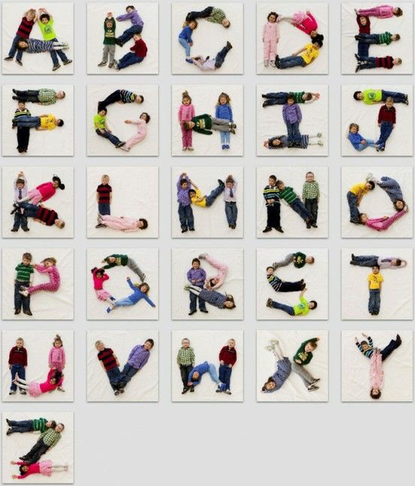
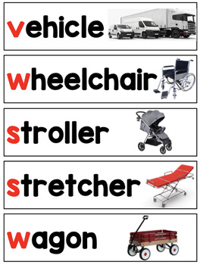
Letter Bundles in Large Group

Slide 33
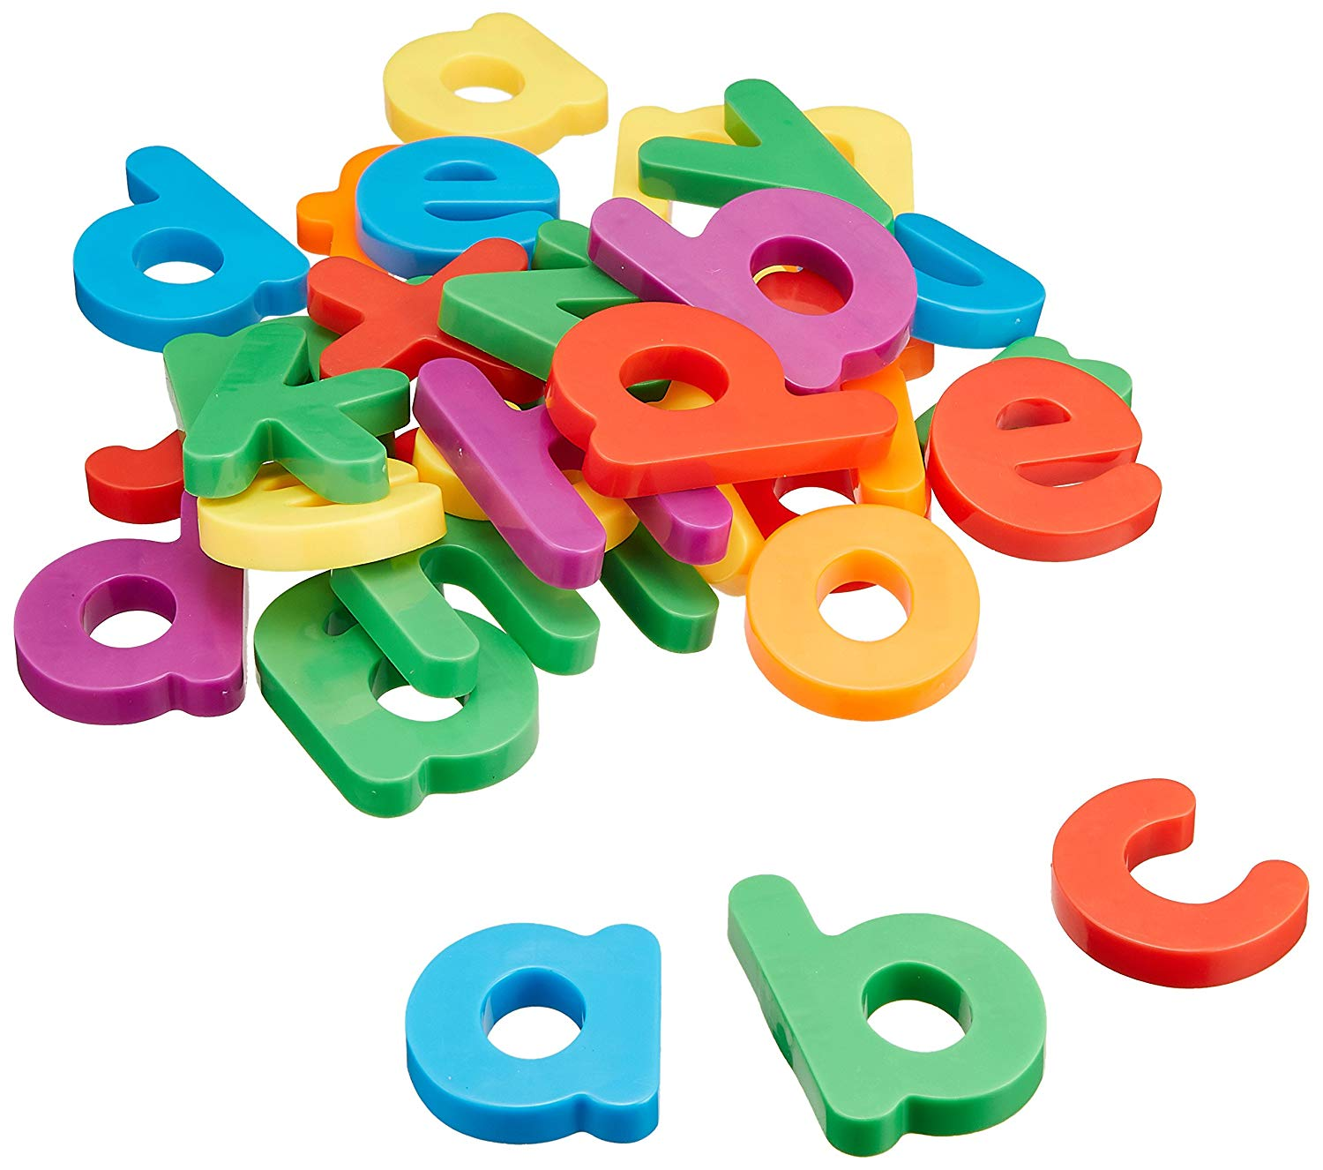
Letter Bundles in Large Groups
Use assessments to target the needs of your students.
Brigance
B-7 Prints uppercase letters in sequence

Slide 34
Letter Bundles in Large Groups
What are the different ways we use water?
Aerobics
Boiling, Bathing
Drinking
Freezing, Floating
Growing plants
Creative Curriculum
Water Study
Investigation #1

Slide 35
Letter Bundles in Large Group

Slide 36
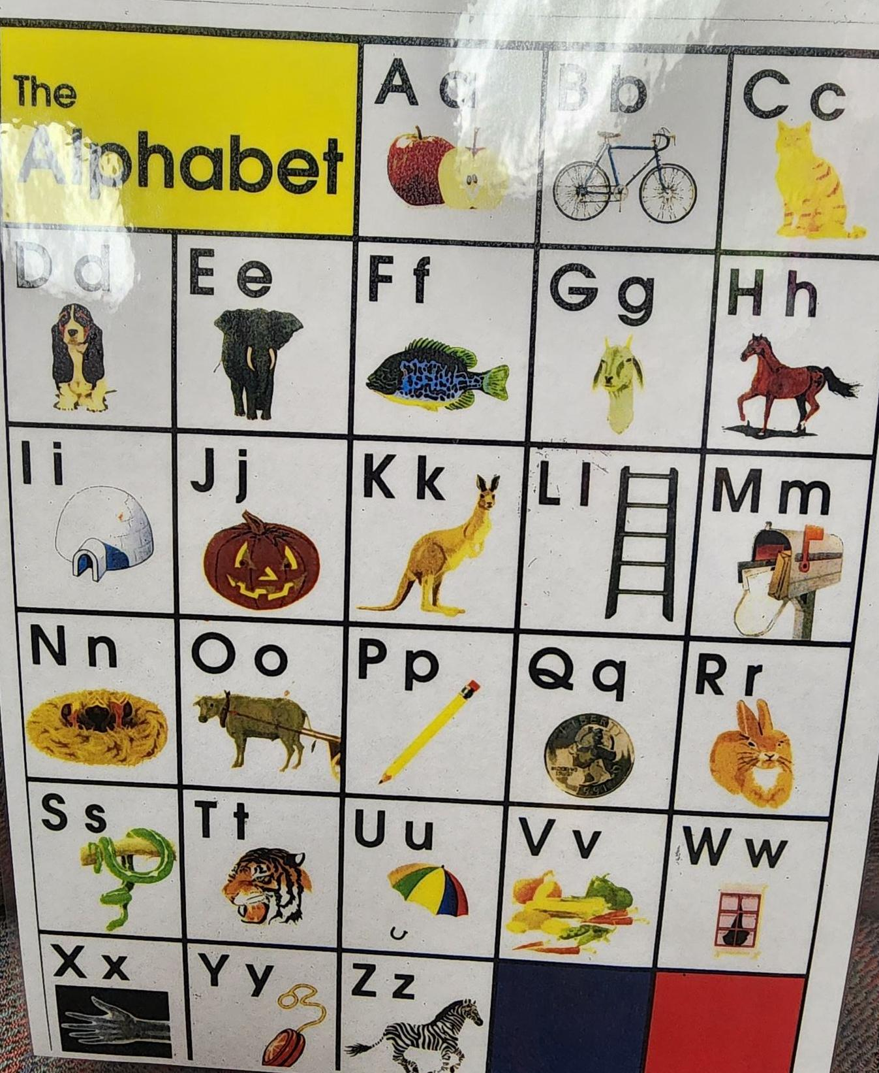
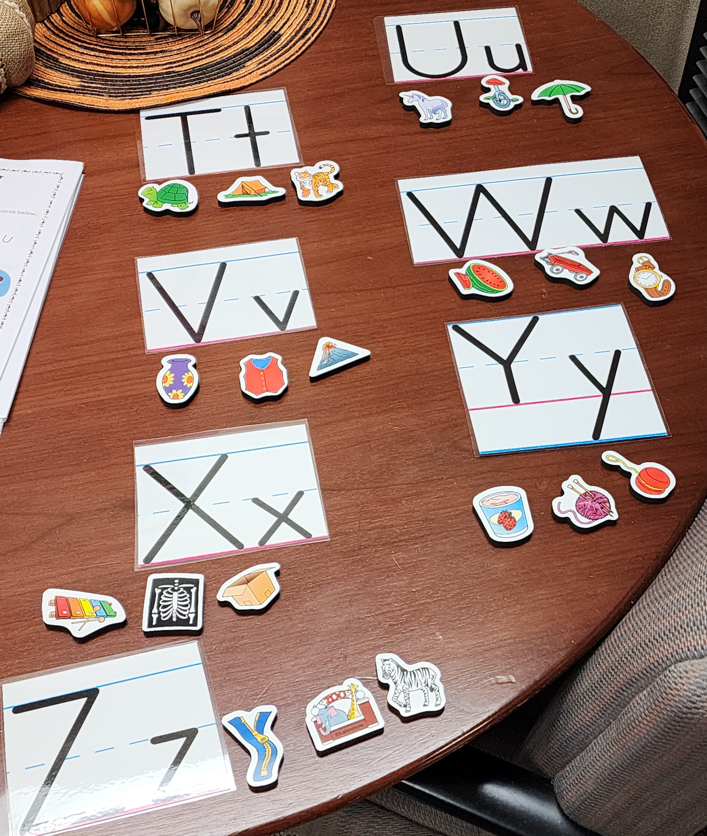
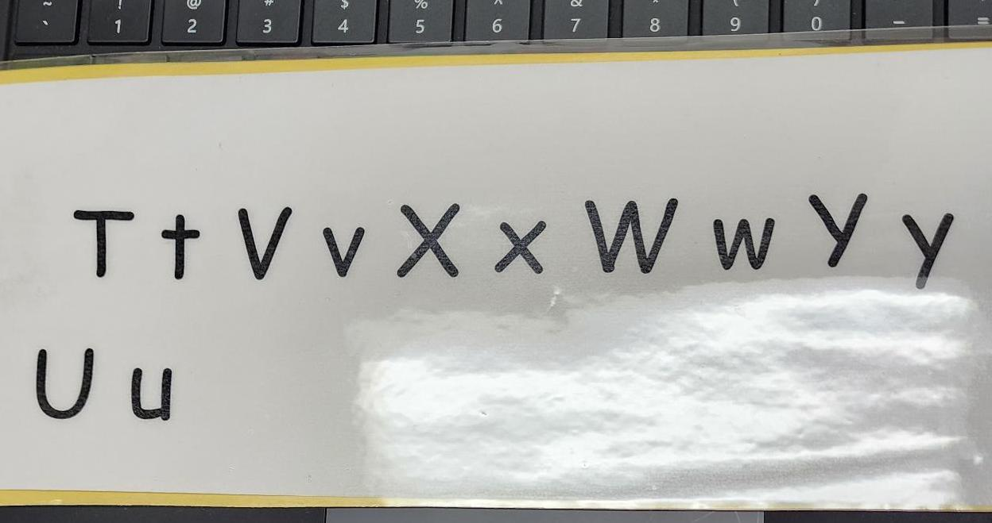
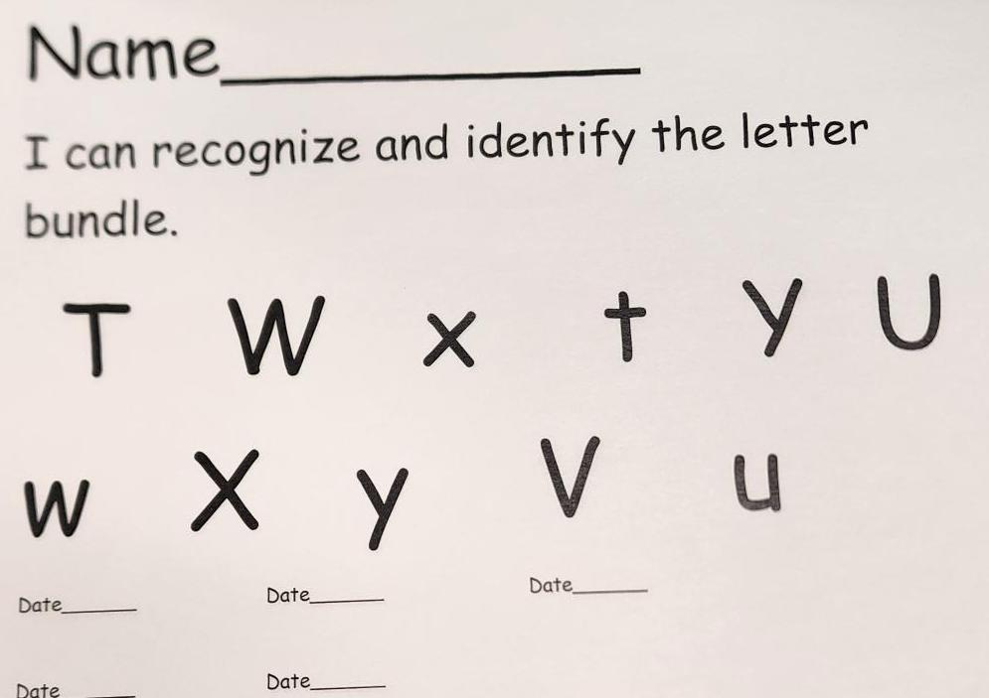
This Week’s Bundle: Aa, Bb, Ff, Dd, Gg
By looking at the things on the table what do you think we are about to do?

Slide 37
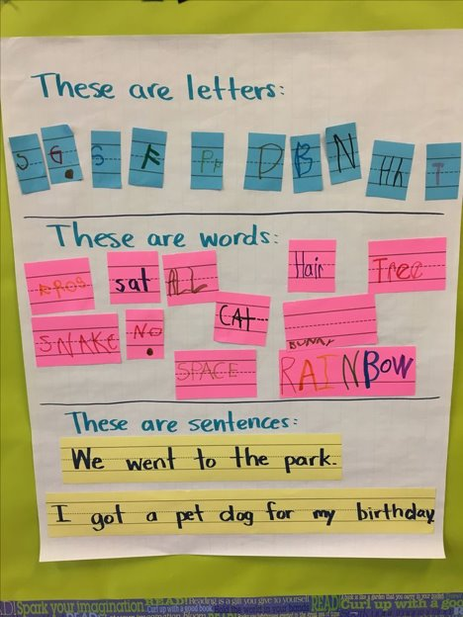
CLASS Connections
We are talking about letters.
What do we know about letters?
(Write what students say)

Slide 38
Activity Ideas
“Let's point to and name our letters.”
“What can we do next?”
“Now, using the letter cards, turn to your shoulder partner and take turns saying each letter.”
“Let's look at our focus letters: Aa, Bb, Ff, Dd, Gg-how can we sort them?” (Concept Development)
“Let’s talk about the letter Aa.”

Slide 39
Activity Ideas
When students give you something that begins with that letter, ask them questions. Ex: “What do you know about an astronaut? What is the difference between an airplane and a rocket ship?” (Concept development/quality feedback/language modeling)
Use picture magnets to sort.
“Let's practice writing the letter Aa.”
Model writing by using self talk- “I am taking my pencil and then I am starting from the bottom going up using a diagonal line then diagonal line down. Then I am going to draw a horizontal line in the middle.”

Slide 40
Working with Letter Bundles in Interest Areas

Slide 41
Interest Area Objectives
✓ Art: I can create a pinwheel and pulleys.
✓ Blocks: I can explore force and speed by racing wheeled items down a ramp.
✓ Discovery: I can explore wheels and how they help us move.
✓ Dramatic Play: I can work with wheeled kitchen tools such as pizza cutters and rolling pins.
✓ Foundational Literacy: I can form and write the letters of the alphabet.
✓ Library: I can explore books to learn about vehicles and other modes of transportation.
✓ Listening: I can listen to my favorite book about wheels.
✓ Music and Movement: I can act out and demonstrate how different wheeled items (skateboards, wheelchairs, etc.) move people.
✓ Sand and Water: I can explore water and water wheels.
✓ Technology: I can use the mouse/tablet to play educational games about colors and shapes.
✓ Toys and Games: I can play with wheeled toys.
✓ Writing: I can create a story about my favorite object with wheels and where it can take me.

Slide 42
Interest Area Intentional Learning
✓ Art: I can create letters using different materials focusing on the letter bundle for that week.
✓ Blocks: I can create letters using blocks.
✓ Discovery: I can explore wheels, draw different wheels, and label them.
✓ Dramatic Play: I can write down wheeled kitchen tool words such as pizza cutters and rolling pins and draw a picture to make a kitchen tool book.
✓ Foundational Literacy: I can form and write the letters of the alphabet and focus on the letter bundle for the week.
✓ Library: I can explore books to learn about vehicles and other modes of transportation.
✓ Listening: I can listen to my favorite book about wheels.
✓ Music and Movement: I can act out and demonstrate how different wheeled items (skateboards, wheelchairs, etc.) move people.
✓ Sand and Water: I can find and match lower case letters to uppercase letters focusing on the letter bundle for the week.
✓ Technology: I can use the mouse/tablet to play educational games about colors and shapes.
✓ Writing: I can draw pictures that begin with(letter bundle for that week) and label the picture.

Slide 43
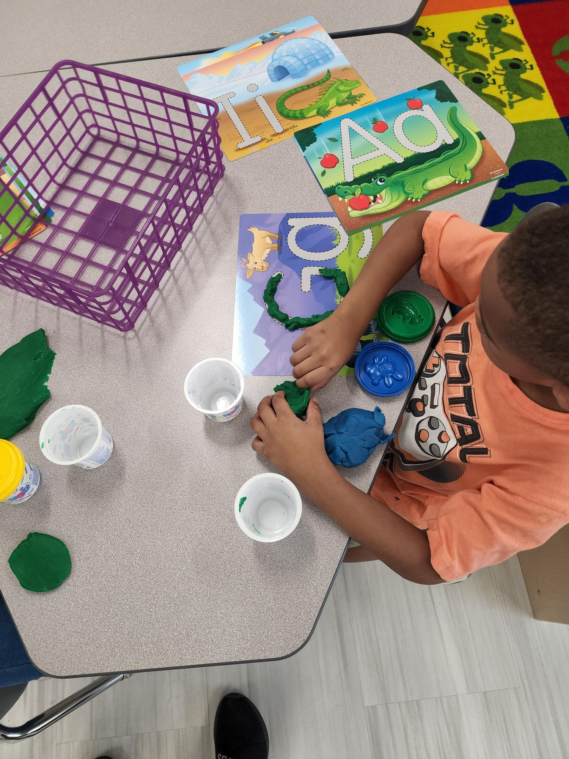
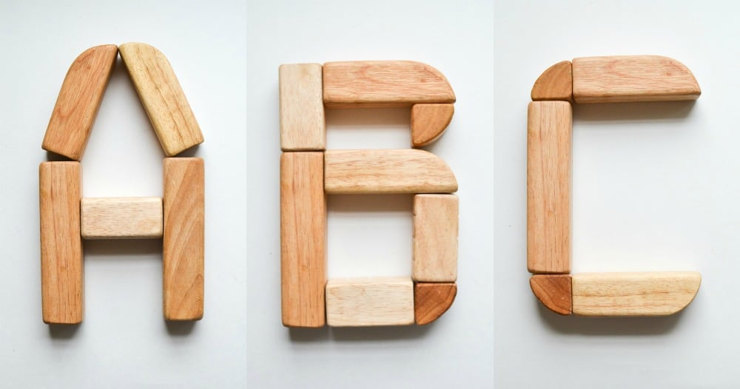
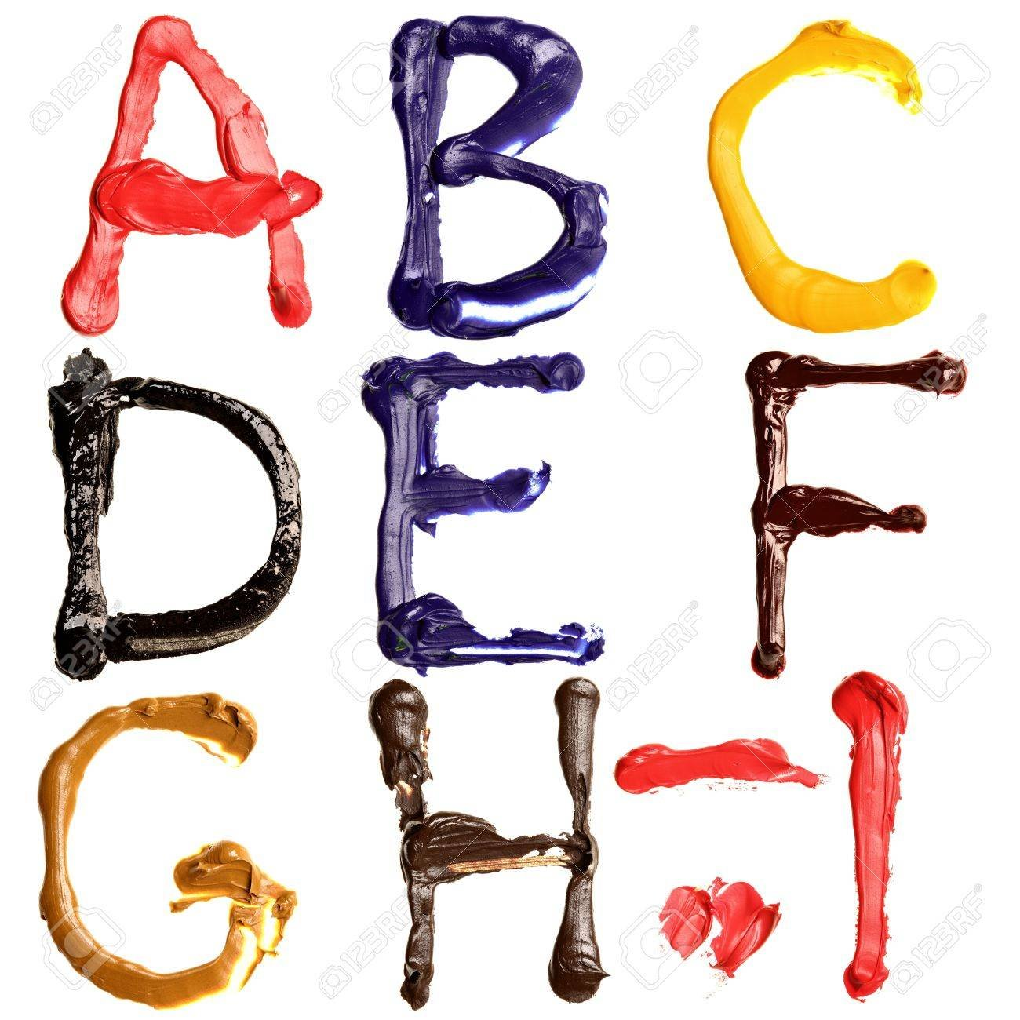
Interest Area Ideas
Blocks
Art
Dramatic Play

Slide 44
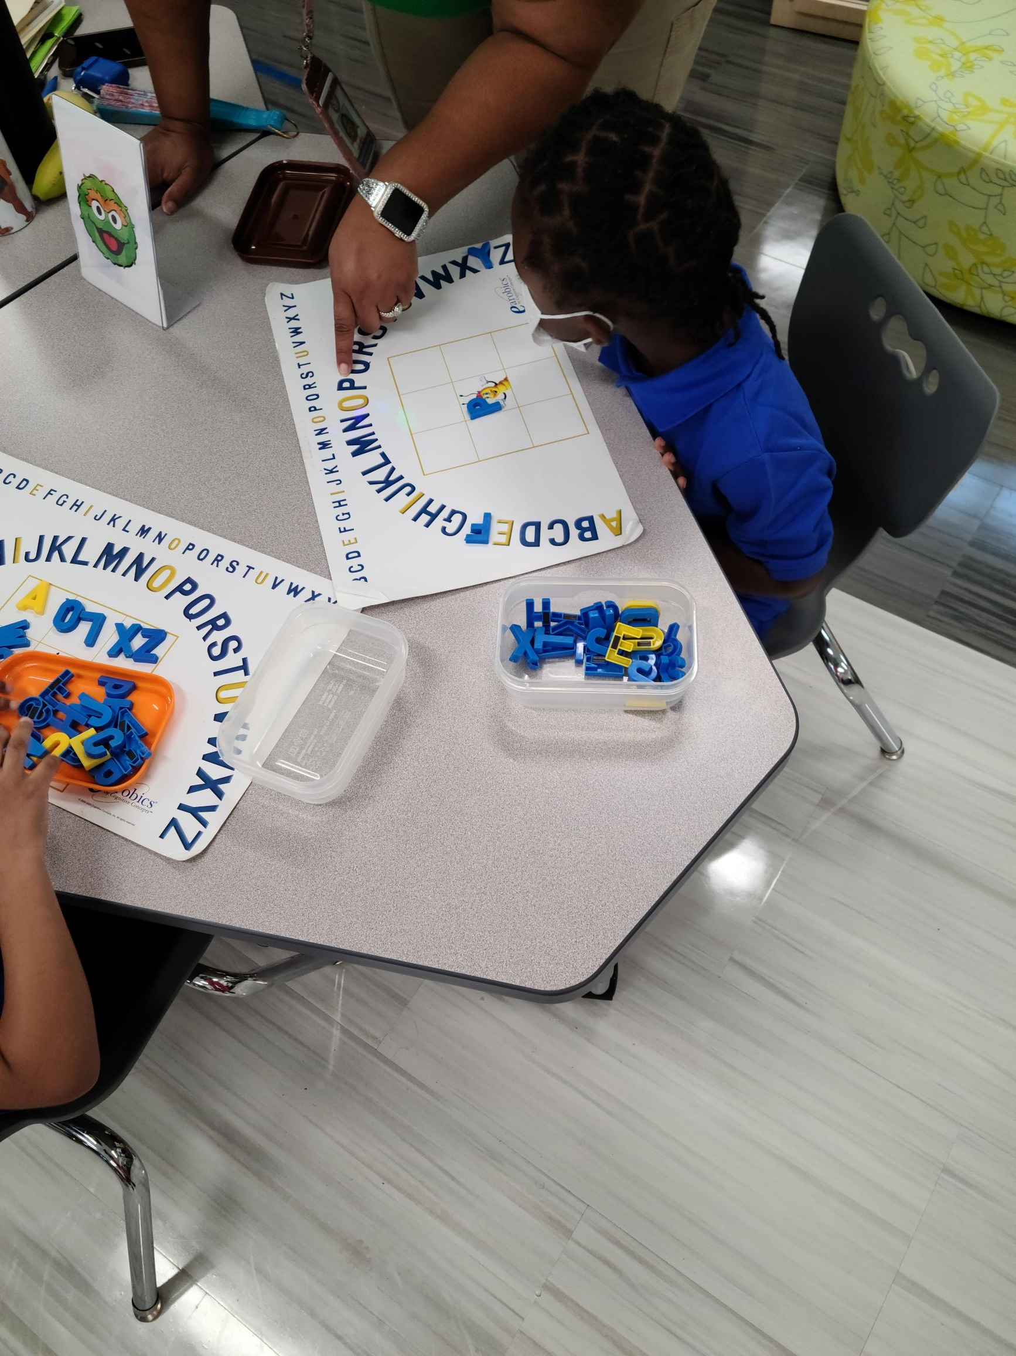
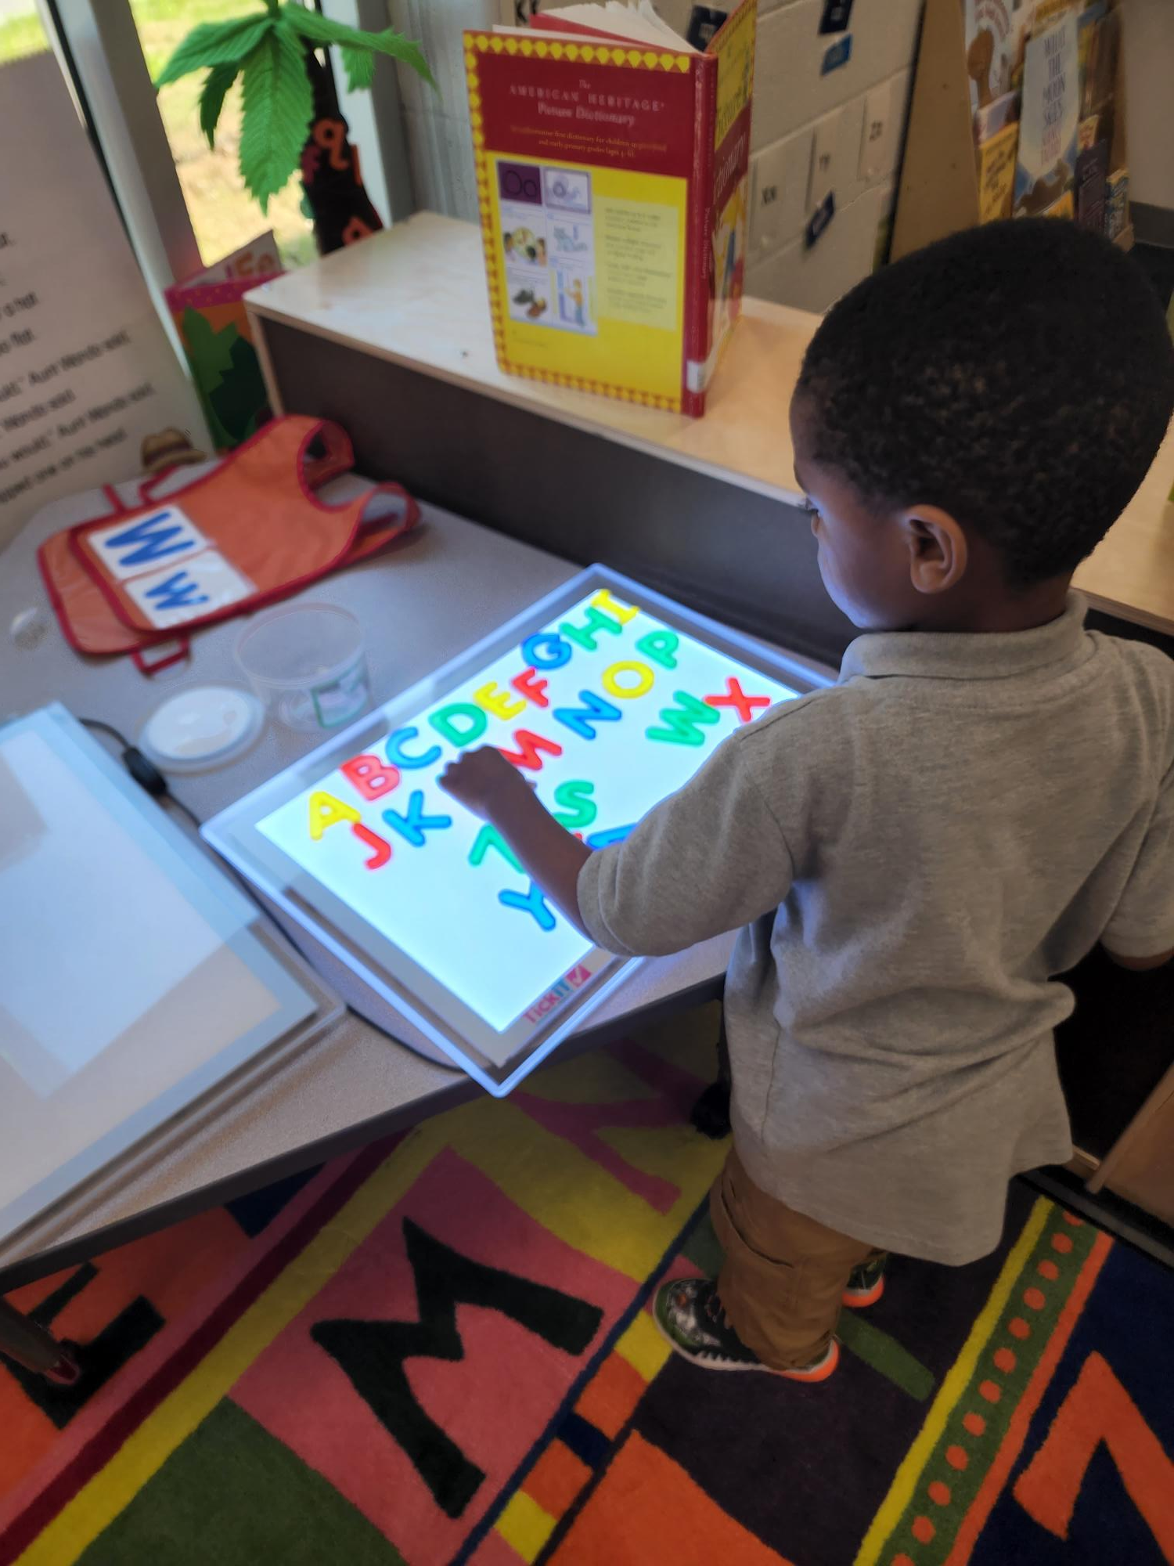
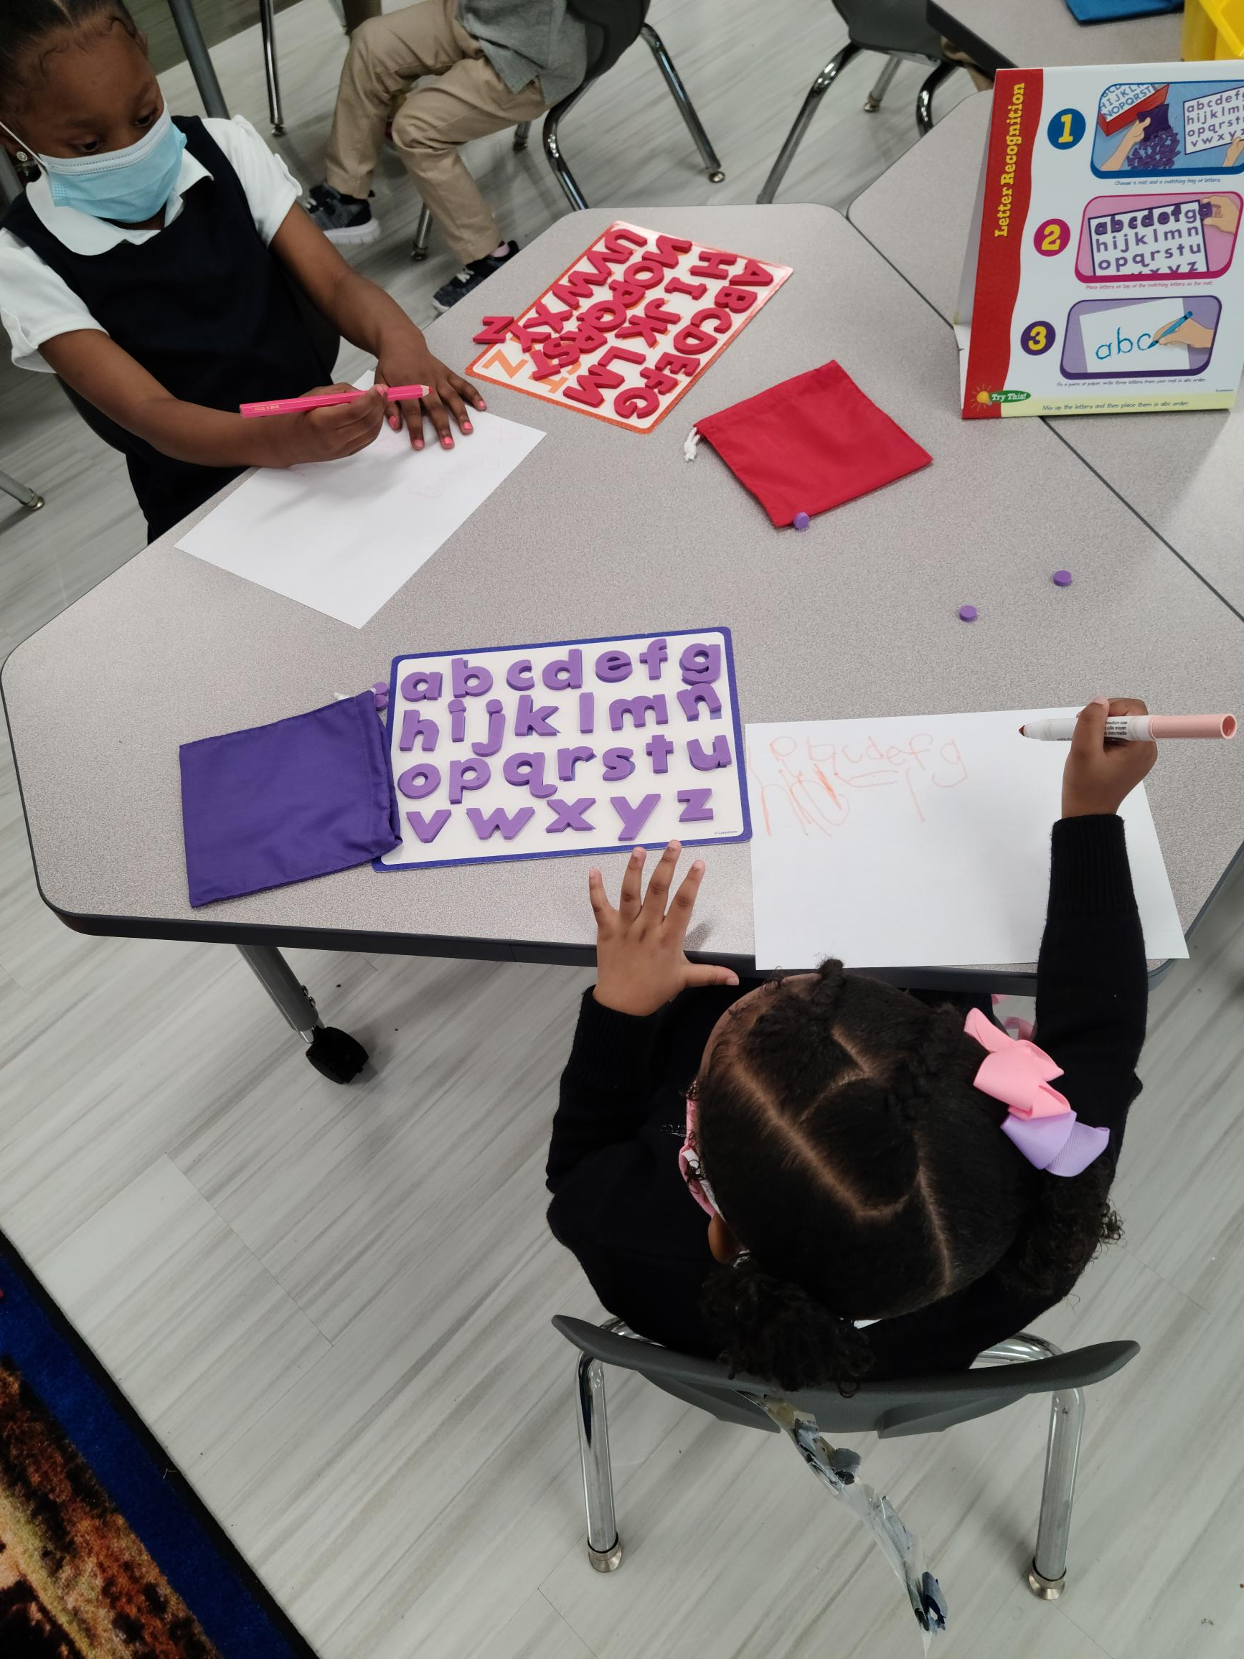
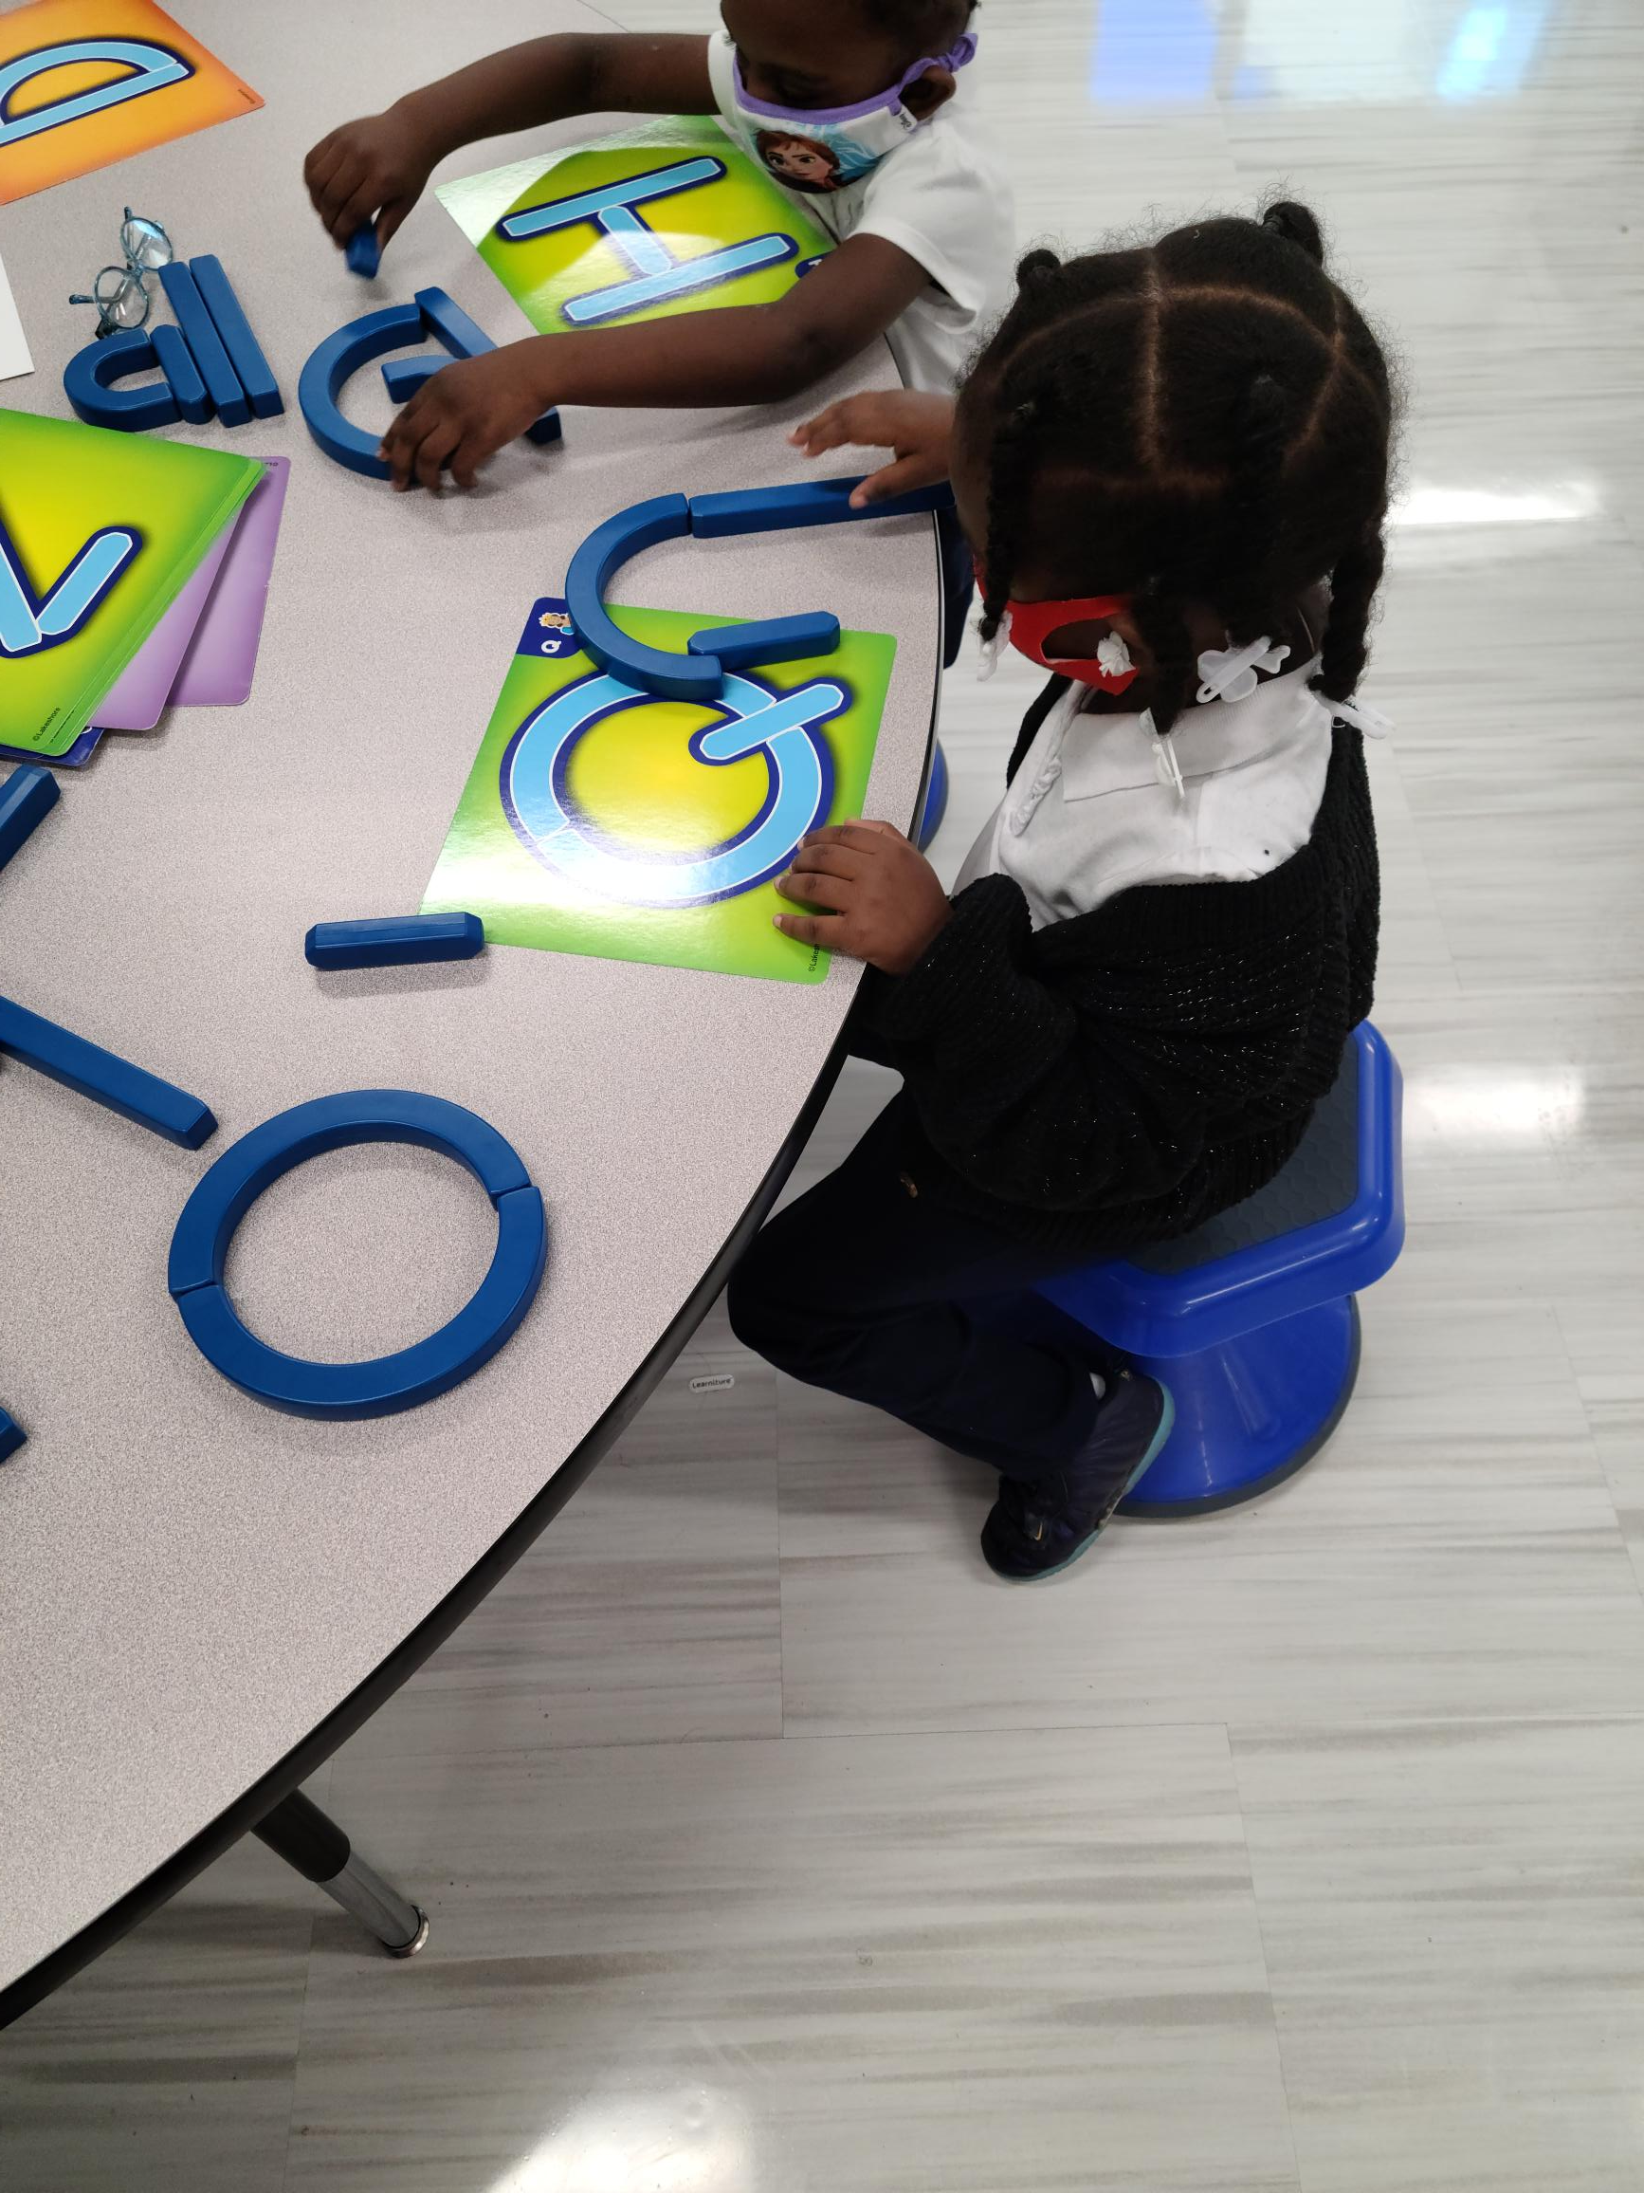
Interest Area Ideas
Writing or Foundational Literacy

Slide 45
Upcoming PD Opportunities
“Toolbox Tuesdays”
Building Gross and Fine Motor Skills
Tuesday, February 13th, 4:15-5:45pm
Shady Grove Early Learning Center
“The Coaching Corner”
Differentiating Literacy Small Group Instruction
Monday, February 26th, 4-5:30pm
Virtual Session

Slide 46
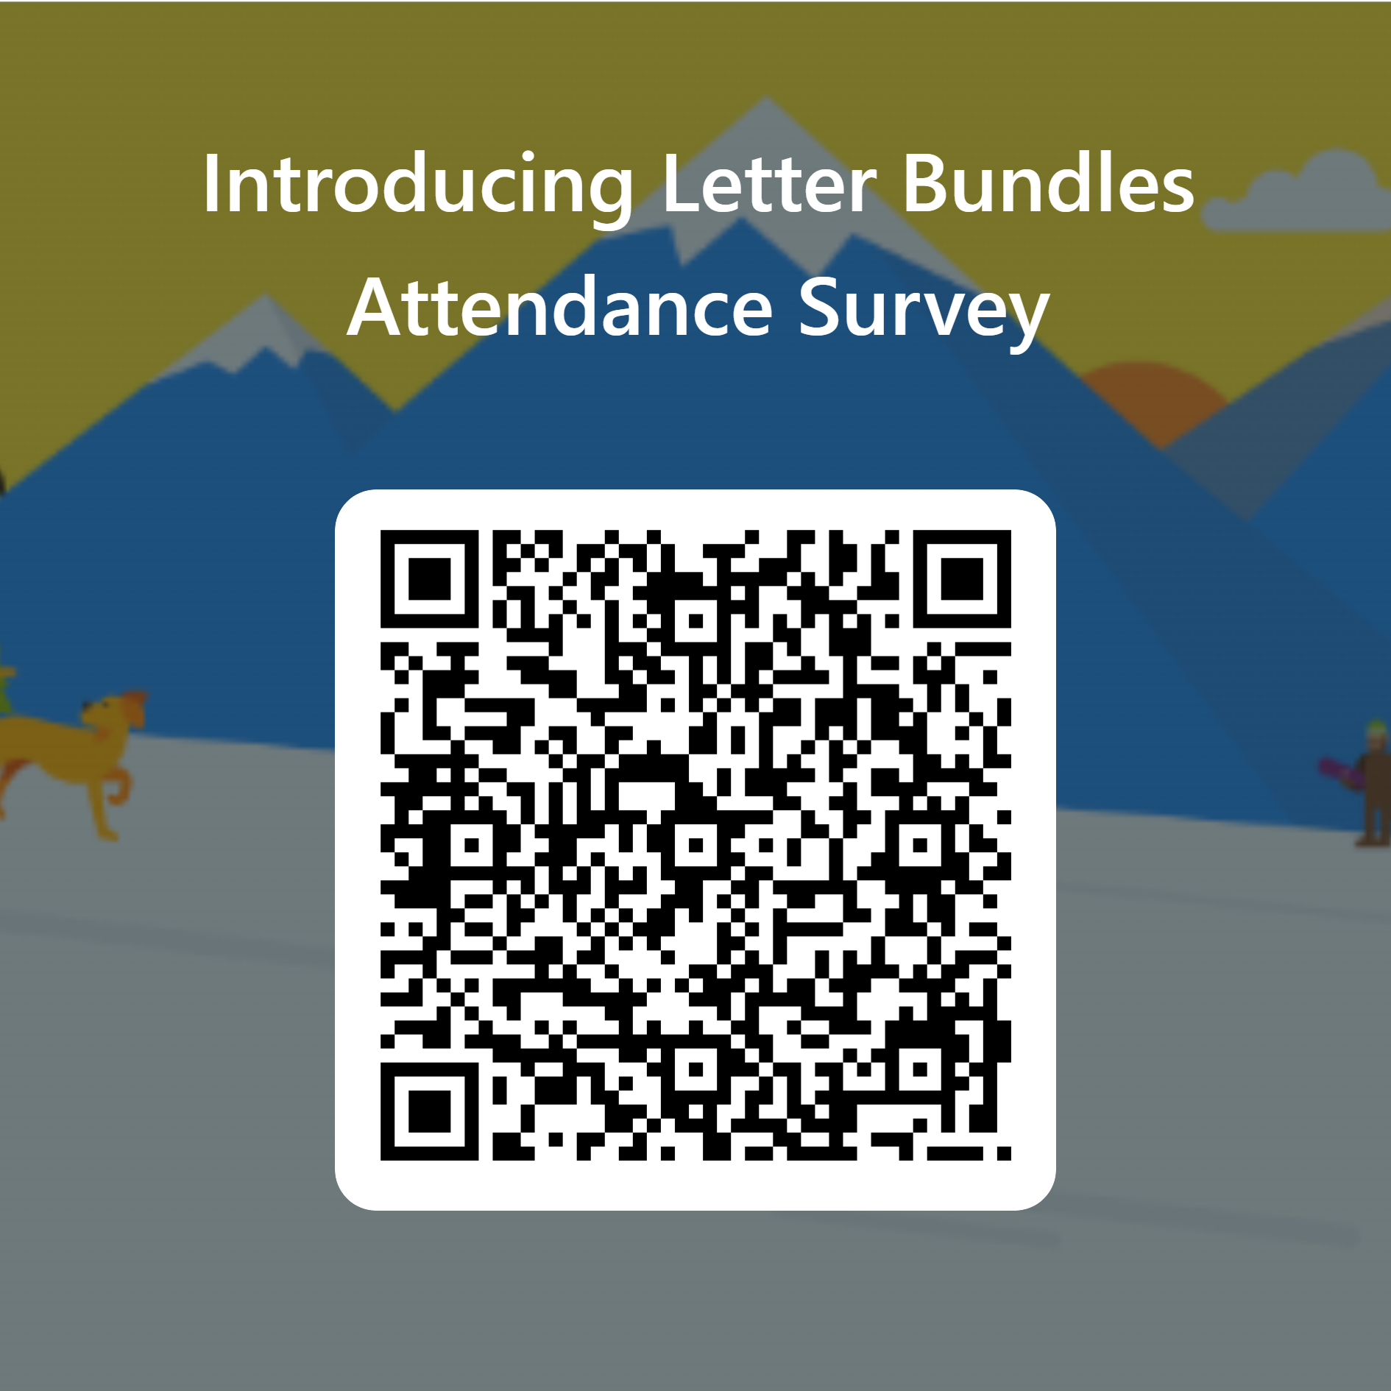
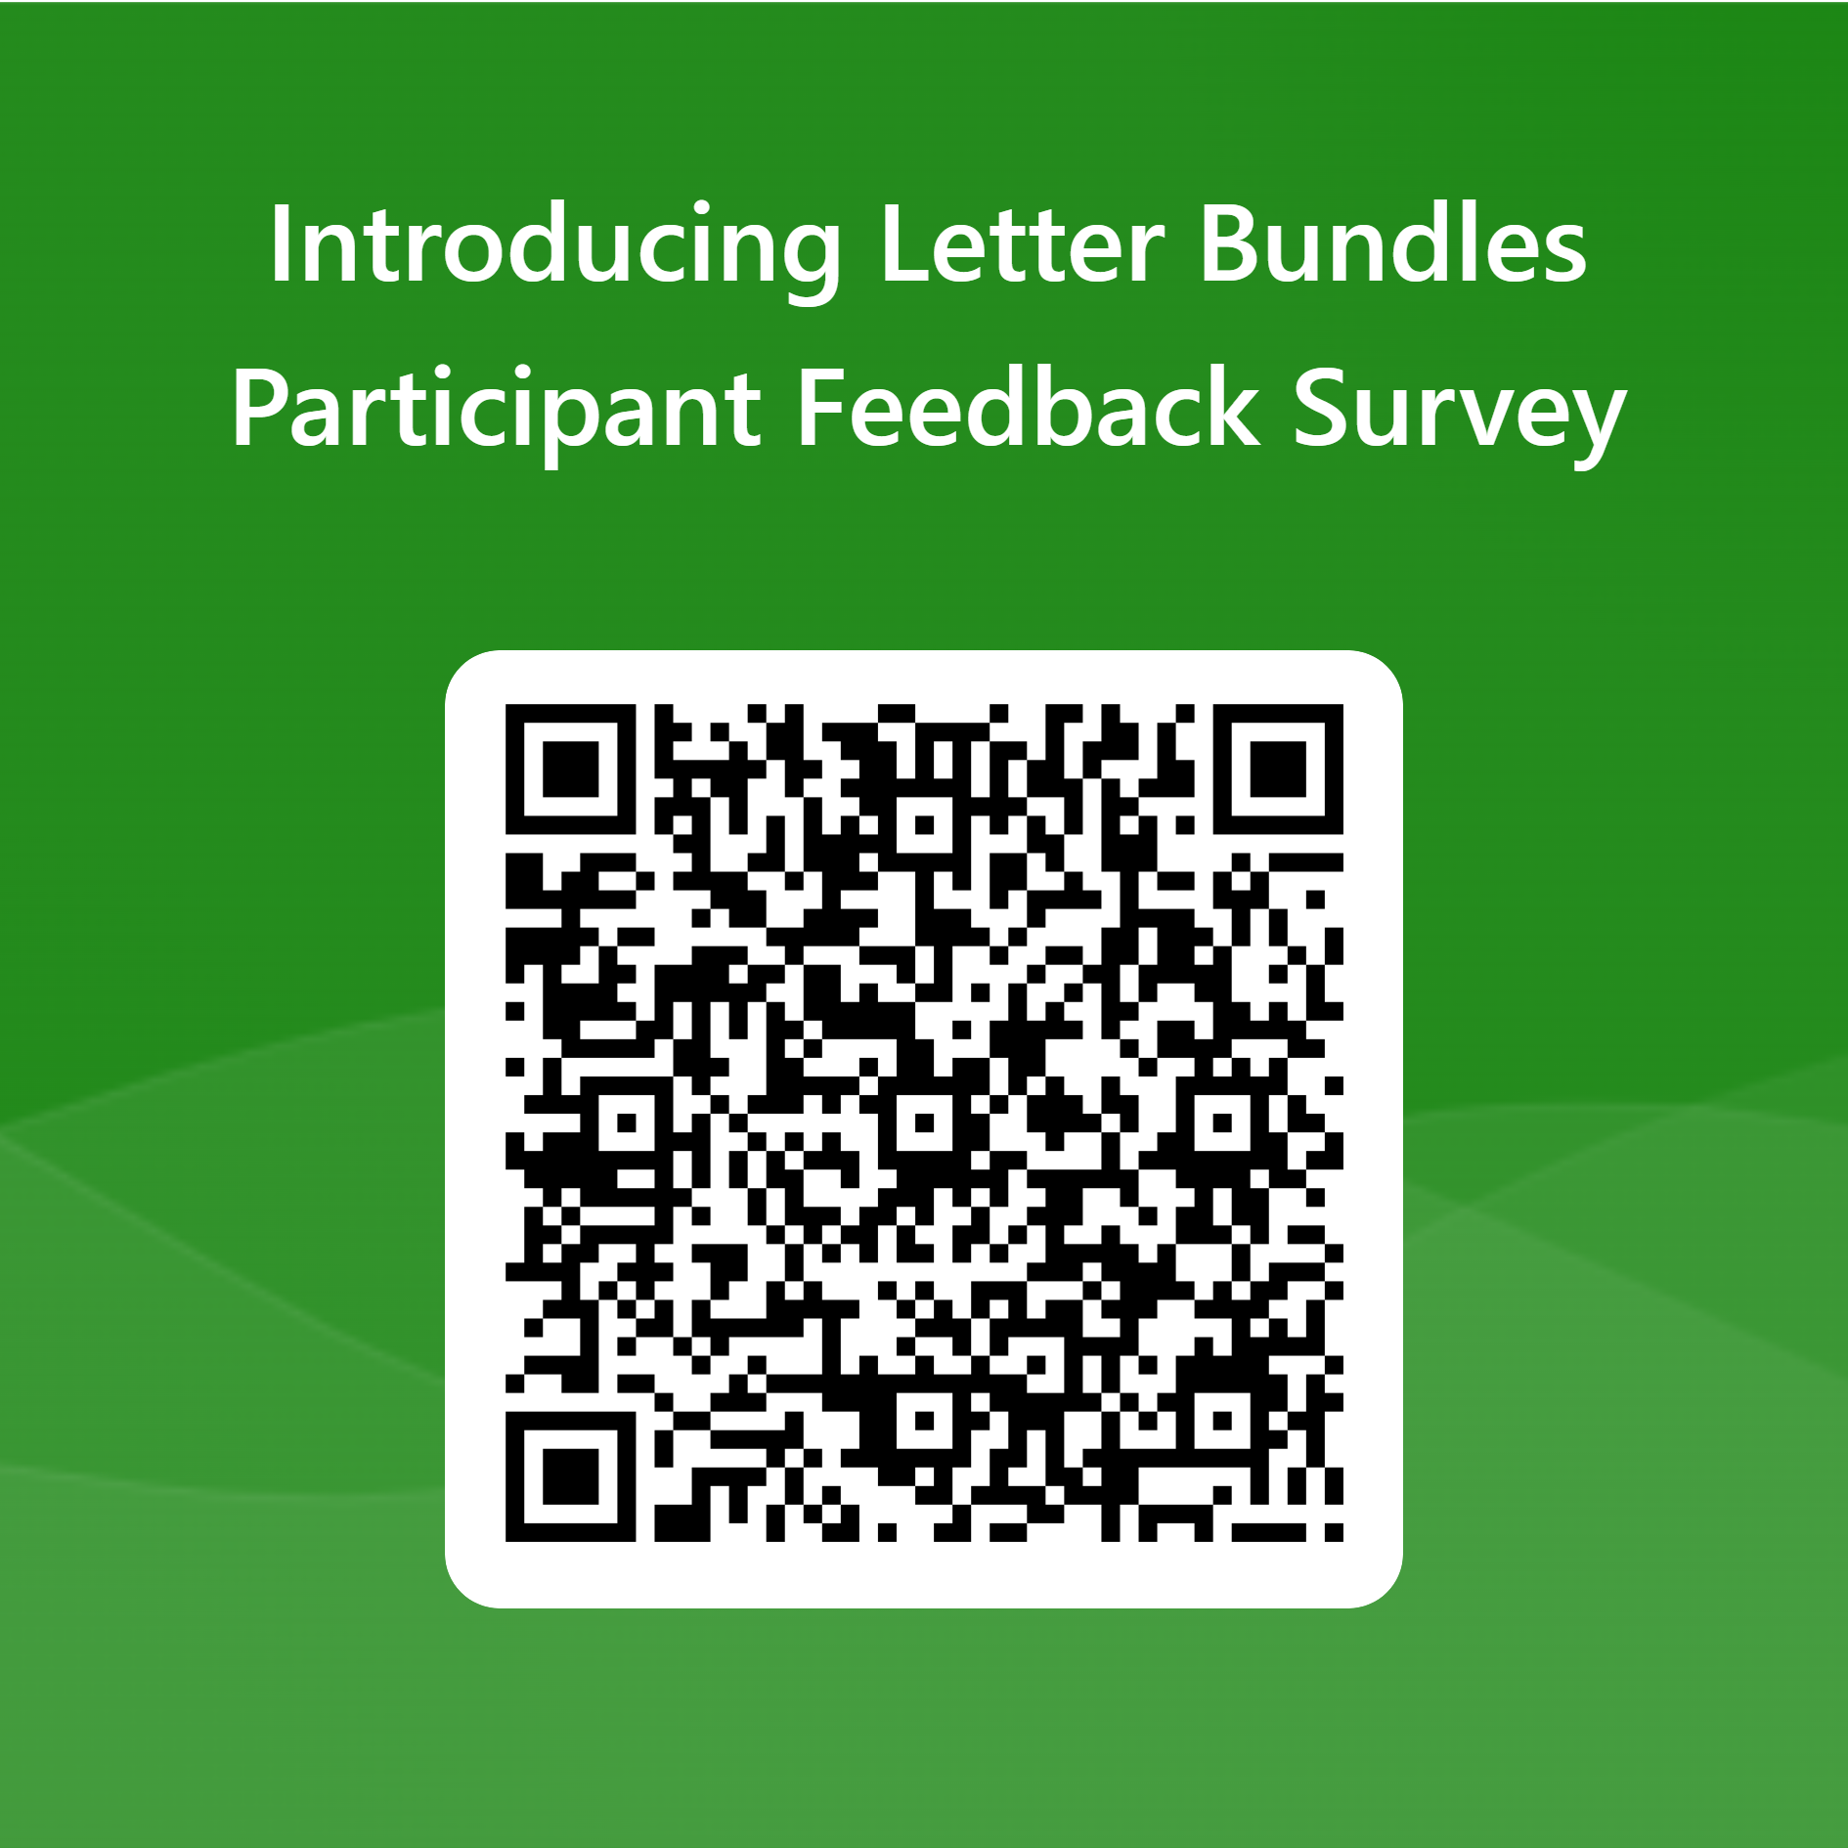
Thanks for Coming!
Attendance
Feedback
bit.ly/jan22att
bit.ly/jan22surv

