Slide 1
Making Stories and
Read-Alouds
Come to Life
April 2024
Coaching Corner
Presented By:
Dr. D. Beard, J. Smith and L. Suggs-Young

Slide 2
Session Norms
Be engaged.
Be collaborative.
Be solutions-oriented.
Be open-minded.

Slide 3
Objectives:
As a result of this session, participants will…
Understand strategies for engaging students in robust richer read-alouds and vocabulary.
Explore ideas on how to engage in first, second, and third readings, using guidance from Creative Curriculum.
Acquire hands-on methods to connect stories throughout the instructional day.

Slide 4
Agenda:
Question of the Day-Icebreaker
Introduction to Read-Alouds
Strategies for Engaging Students
Book Discussions and Vocabulary
Connecting Stories throughout the Instructional Day
Key Ideas and Closure

Slide 5
What do you like most about
read- alouds? Why?

Slide 6
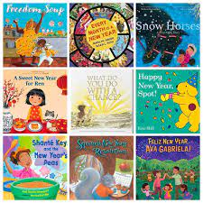
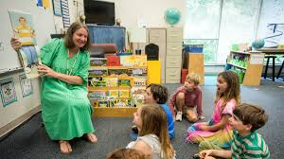
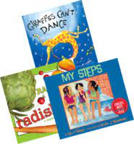
Read-Alouds

Slide 7
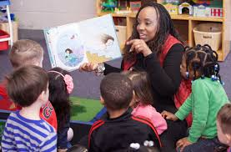
Read-Aloud
A read aloud is an instructional strategy used where an adult (teacher, parent, or caregiver) reads text aloud to children.
This instructional strategy is a primary way to enrich children's vocabulary and oral language. Read-alouds provide children with an opportunity to observe and hear text read aloud fluently and develop and gain knowledge of print.

Slide 8
Read Aloud
Reading texts aloud is the single most important activity for building the knowledge required for successful reading.
Reading aloud is a powerful way to engage children in the literacy process.
The read-aloud experience increase students' vocabulary development and comprehension growth.
The read-aloud experience helps children build and support their listening and speaking abilities and enhances their overall language development.

Slide 9
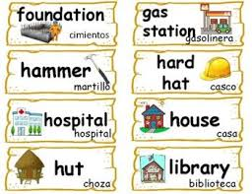
Benefits of Read-Alouds
Builds connection between speech and print
Increases vocabulary
Provides a model of fluent reading
Builds bonds between the reader and listener
Improves listening skills and comprehension
Promotes literacy as a source of enjoyment

Slide 10
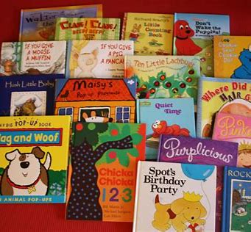
Preparation
Notes:
Reading aloud in ways that interest, excite, and engage children is not a skill that comes easily for all teachers, but it can be developed over time. Being prepared for the read aloud is the first step to ensuring that students are engaged.

Slide 11
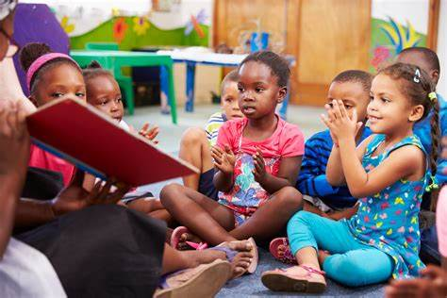
When Preparing:
Have materials ready (book, easel, props, vocabulary words with pictures, etc.).
Pre-read and become familiar with the book (correct pronunciations, child-friendly definitions).
Write questions and prompts on Post-it notes.
Notes:
-Practice reading the book before you read it aloud to student's so that you become very familiar with the language, characters and plot.
-Place post-it notes on the appropriate pages so you will know how and when to prompt the children's thinking.

Slide 12
What are some strategies you currently use to engage students during read-alouds?

Slide 13
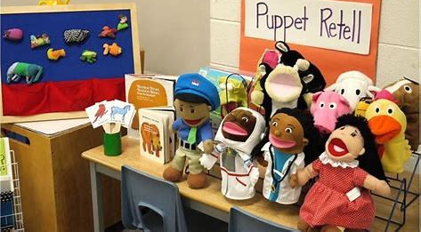
Engaging Students
Notes:
Now we will discuss strategies that can be used to keep students focused and engaged during the read aloud.

Slide 14
Strategies for Engaging Students
Vary vocal tones.
Use props & sound effects.
Show excitement about the story.
Ensure rich vocabulary is embedded.
Use a variety of questions. (comprehension & open-ended)
Notes:
-Use your voice and facial expressions to make the characters and their experiences come alive.
-Props can help draw children's attention to the story and enrich their understanding. Props can be chosen to be the focus of vocabulary words or for actions or expressions.
-Show excitement about the story. Our student's usually match our energy. If we are excited about a story, our students will be excited too. They will know when it is one of your favorite books, because you are excited about reading it. Some books may not be as exciting or interesting to us. For those books, it is really important for you to practice reading it before you read it aloud to children so that you can show the same type of enthusiasm during the reading.
-Change or define words to help the children understand the story and can comprehend what is being read.
-Ensure that you are asking higher order thinking questions as you are reading. Ask how and why questions. You can also give students an opportunity to offer their predictions by asking what might happen next.

Slide 15
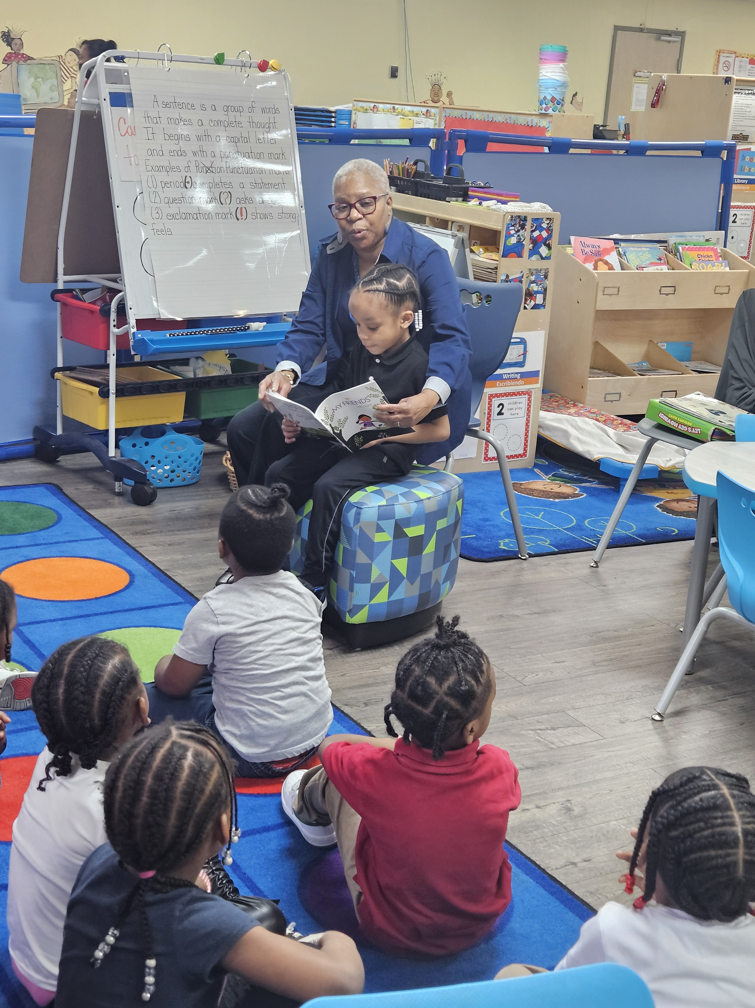
MORE ENGAGEMENT:
Audio/video read-along
Puppets
Role-playing
Let the students read
Use re-telling cards
Invite guest readers (RMR)

Slide 16
Notes:
As you are watching a portion of this read aloud, think about strategies that you notice the teacher using. Be ready to share in the chat.

Slide 17
Think about your read-aloud style when sharing books with children...
Notes:
Do you read quickly? Slowly? Loudly? Softly? Do you prefer that children wait until you finish reading before adding their own ideas?
Consider recording a read-aloud session and watching it to think of ways that you could change your approach to reading.

Slide 18
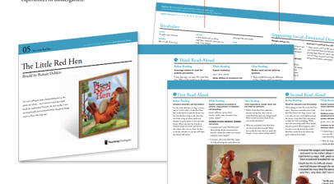
Book Discussions
Notes:
With the Creative Curriculum, most books are read 3-5 times over two school weeks to help young students strengthen their comprehension skills and expand their listening and speaking vocabularies. We will discuss the differences between the first, second and third read over the next few slides.

Slide 19
Repeated Read-Aloud Approach:
Book Introduction
Vocabulary
Comments and Questions
After-reading Questions
Notes:
Each read-aloud should consist of the four components of the repeated read-aloud approach which are book introduction, vocabulary, comments and questions and after-reading questions.

Slide 20
Book Discussions – 1st Read
Book Introduction
-Introduce students to the book (title, author and illustrator).
-Name the characters and hint at the problem they will face.
Vocabulary
-While reading, define 5-8 vocabulary words that you have previously chosen.
Comments and Questions
-Comment on character motives and actions.
After-Reading Questions
-Pose after-reading questions and be prepared to help students answer them.
Notes:
Book Introduction-
-Explain how the story is related to familiar feelings or a recent experience.
-Explain how the book is related to what the children are studying.
Vocabulary techniques-
-Point to an illustration that shows the meaning of the word ( i.e. pointing to a cradle as you read the word cradle)
-Give a very brief definition of a word as you read in in the text. (i.e. shrink. Shrink means get smaller and smaller)
Comments and Questions-
-Talk about what characters are doing, thinking, and feeling.
During the first read, it's important to remember not to phrase these comments as questions.

Slide 21
Book Discussions – 2nd Read
Book Introduction
-Help students recall ideas that were introduced in the first read-aloud as well as name the characters and state the problem before reading the second time.
Vocabulary
-Continue to highlight and define vocabulary words. Emphasize them by dramatizing them and adding more explanations.
Comments and Questions
-While reading, ask questions about the characters and make comments as needed to help students understand the characters' actions, thoughts and feelings.
After-Reading Questions
-Pose after-reading questions, including questions that prompt children to think about what could happen next with the characters after the story ends.
Notes:
The second read-aloud should occur one or two days after the first read-aloud.

Slide 22
Book Discussions – 3rd Read
Book Introduction
-Invite students to identify the main characters and talk about the problem the characters face.
Vocabulary
-As students retell the story, encourage them to use the book's vocabulary to explain what is happening in each illustration.
-Emphasize some words by using them in a context that is familiar to children but not directly related to the story.
Comments and Questions
-Read some pages of the book between the student's reconstruction of the story to keep the pace but maintain the focus on the children's retellings and interpretations.
After-Reading Questions
-Pose after-reading questions and help children listen to and respond to each other's comments.
Notes:
The third read-aloud should occur a few days after the second read-aloud (within a week). By the third read-aloud, students should be able to retell the story and interpret it and reconstruct it with or without support.
-To assist students, show illustrations and ask, "what is happening here?" or "what happens next?"
-When words have multiple meanings, emphasize the meaning the author intended.

Slide 23
How do you connect stories throughout the day?

Slide 24
Making Connections Throughout the Day
Incorporating science, math, art, writing, and literacy into classroom hands-on activities using books can provide students with an enriched learning experience. After you read and discuss your book, don't stop there.
Identify key concepts from the book that can be connected to each subject.
Design & Integrate hands-on activities.
Foster exploration and curiosity.
Reflect & Extend the learning.
Document and Display what students learned and created!
Notes:
The third read-aloud should occur a few days after the second read-aloud (within a week). By the third read-aloud, students should be able to retell the story and interpret it and reconstruct it with or without support.
-To assist students, show illustrations and ask, "what is happening here?" or "what happens next?"
-When words have multiple meanings, emphasize the meaning the author intended.

Slide 25
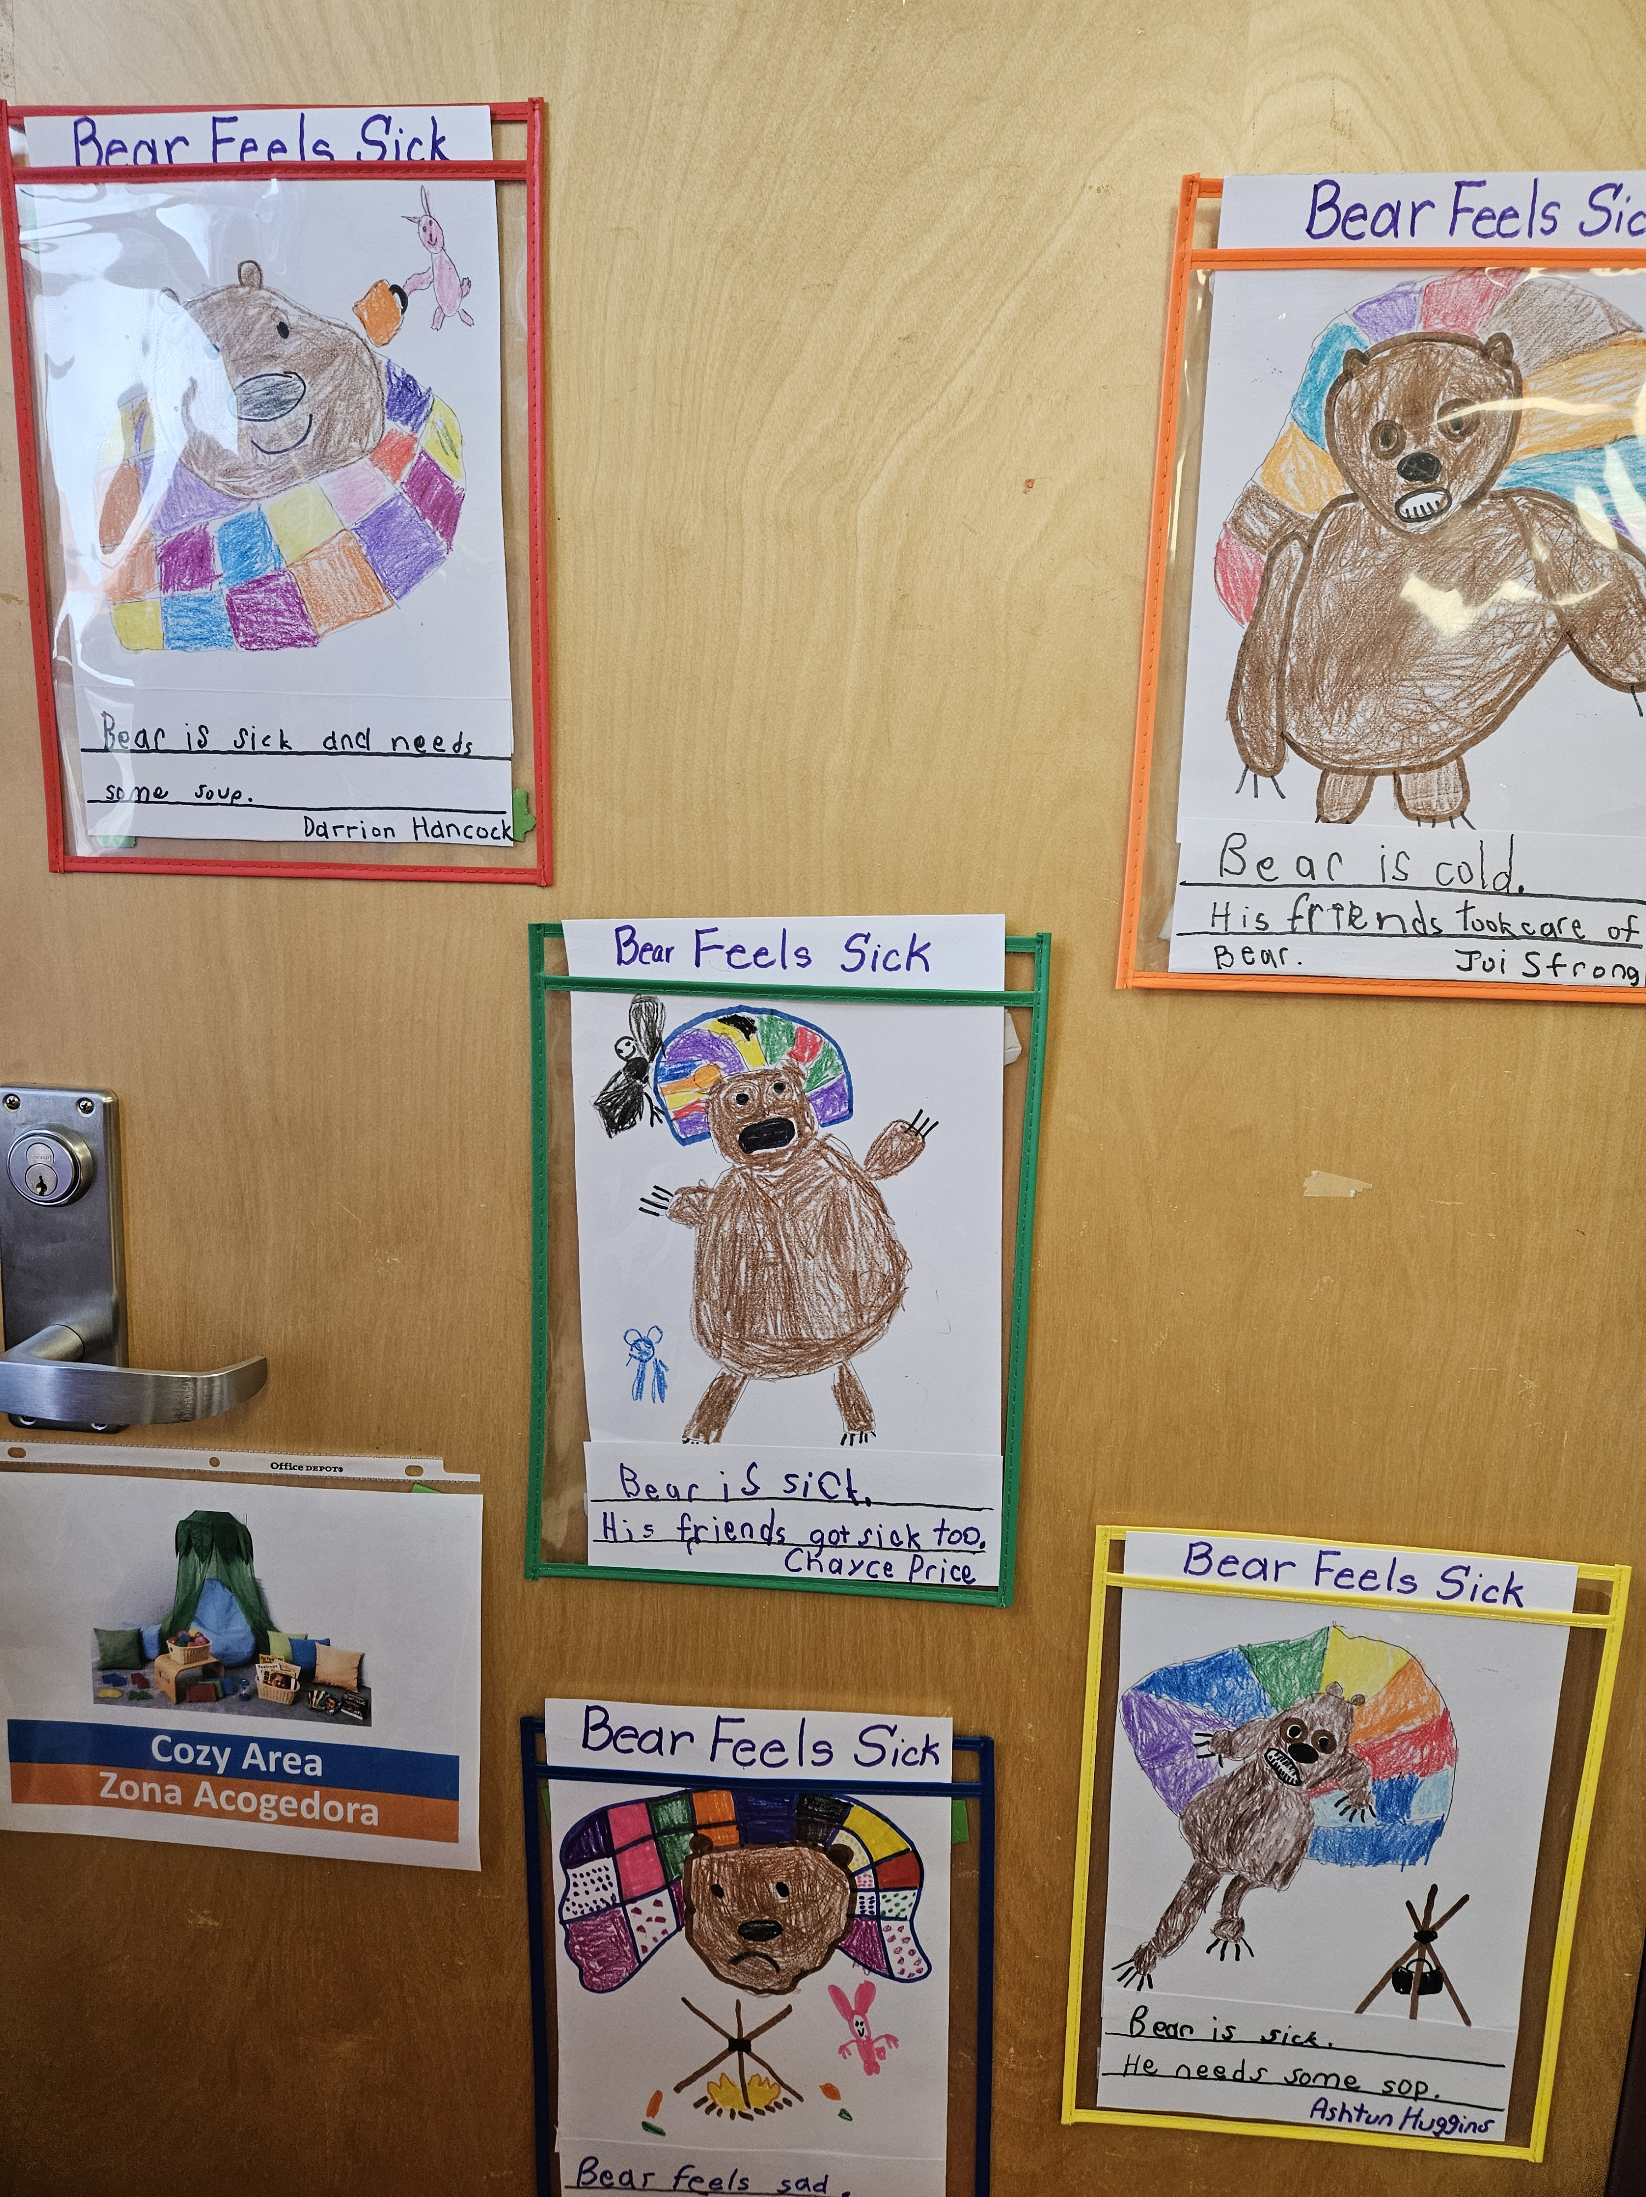
Making Connections
Large Group Literacy
Small Group Literacy
Writing
Venn Diagram/Charts
Concept Dev. /CLASS
Notes:
Discuss ideas for each.

Slide 26
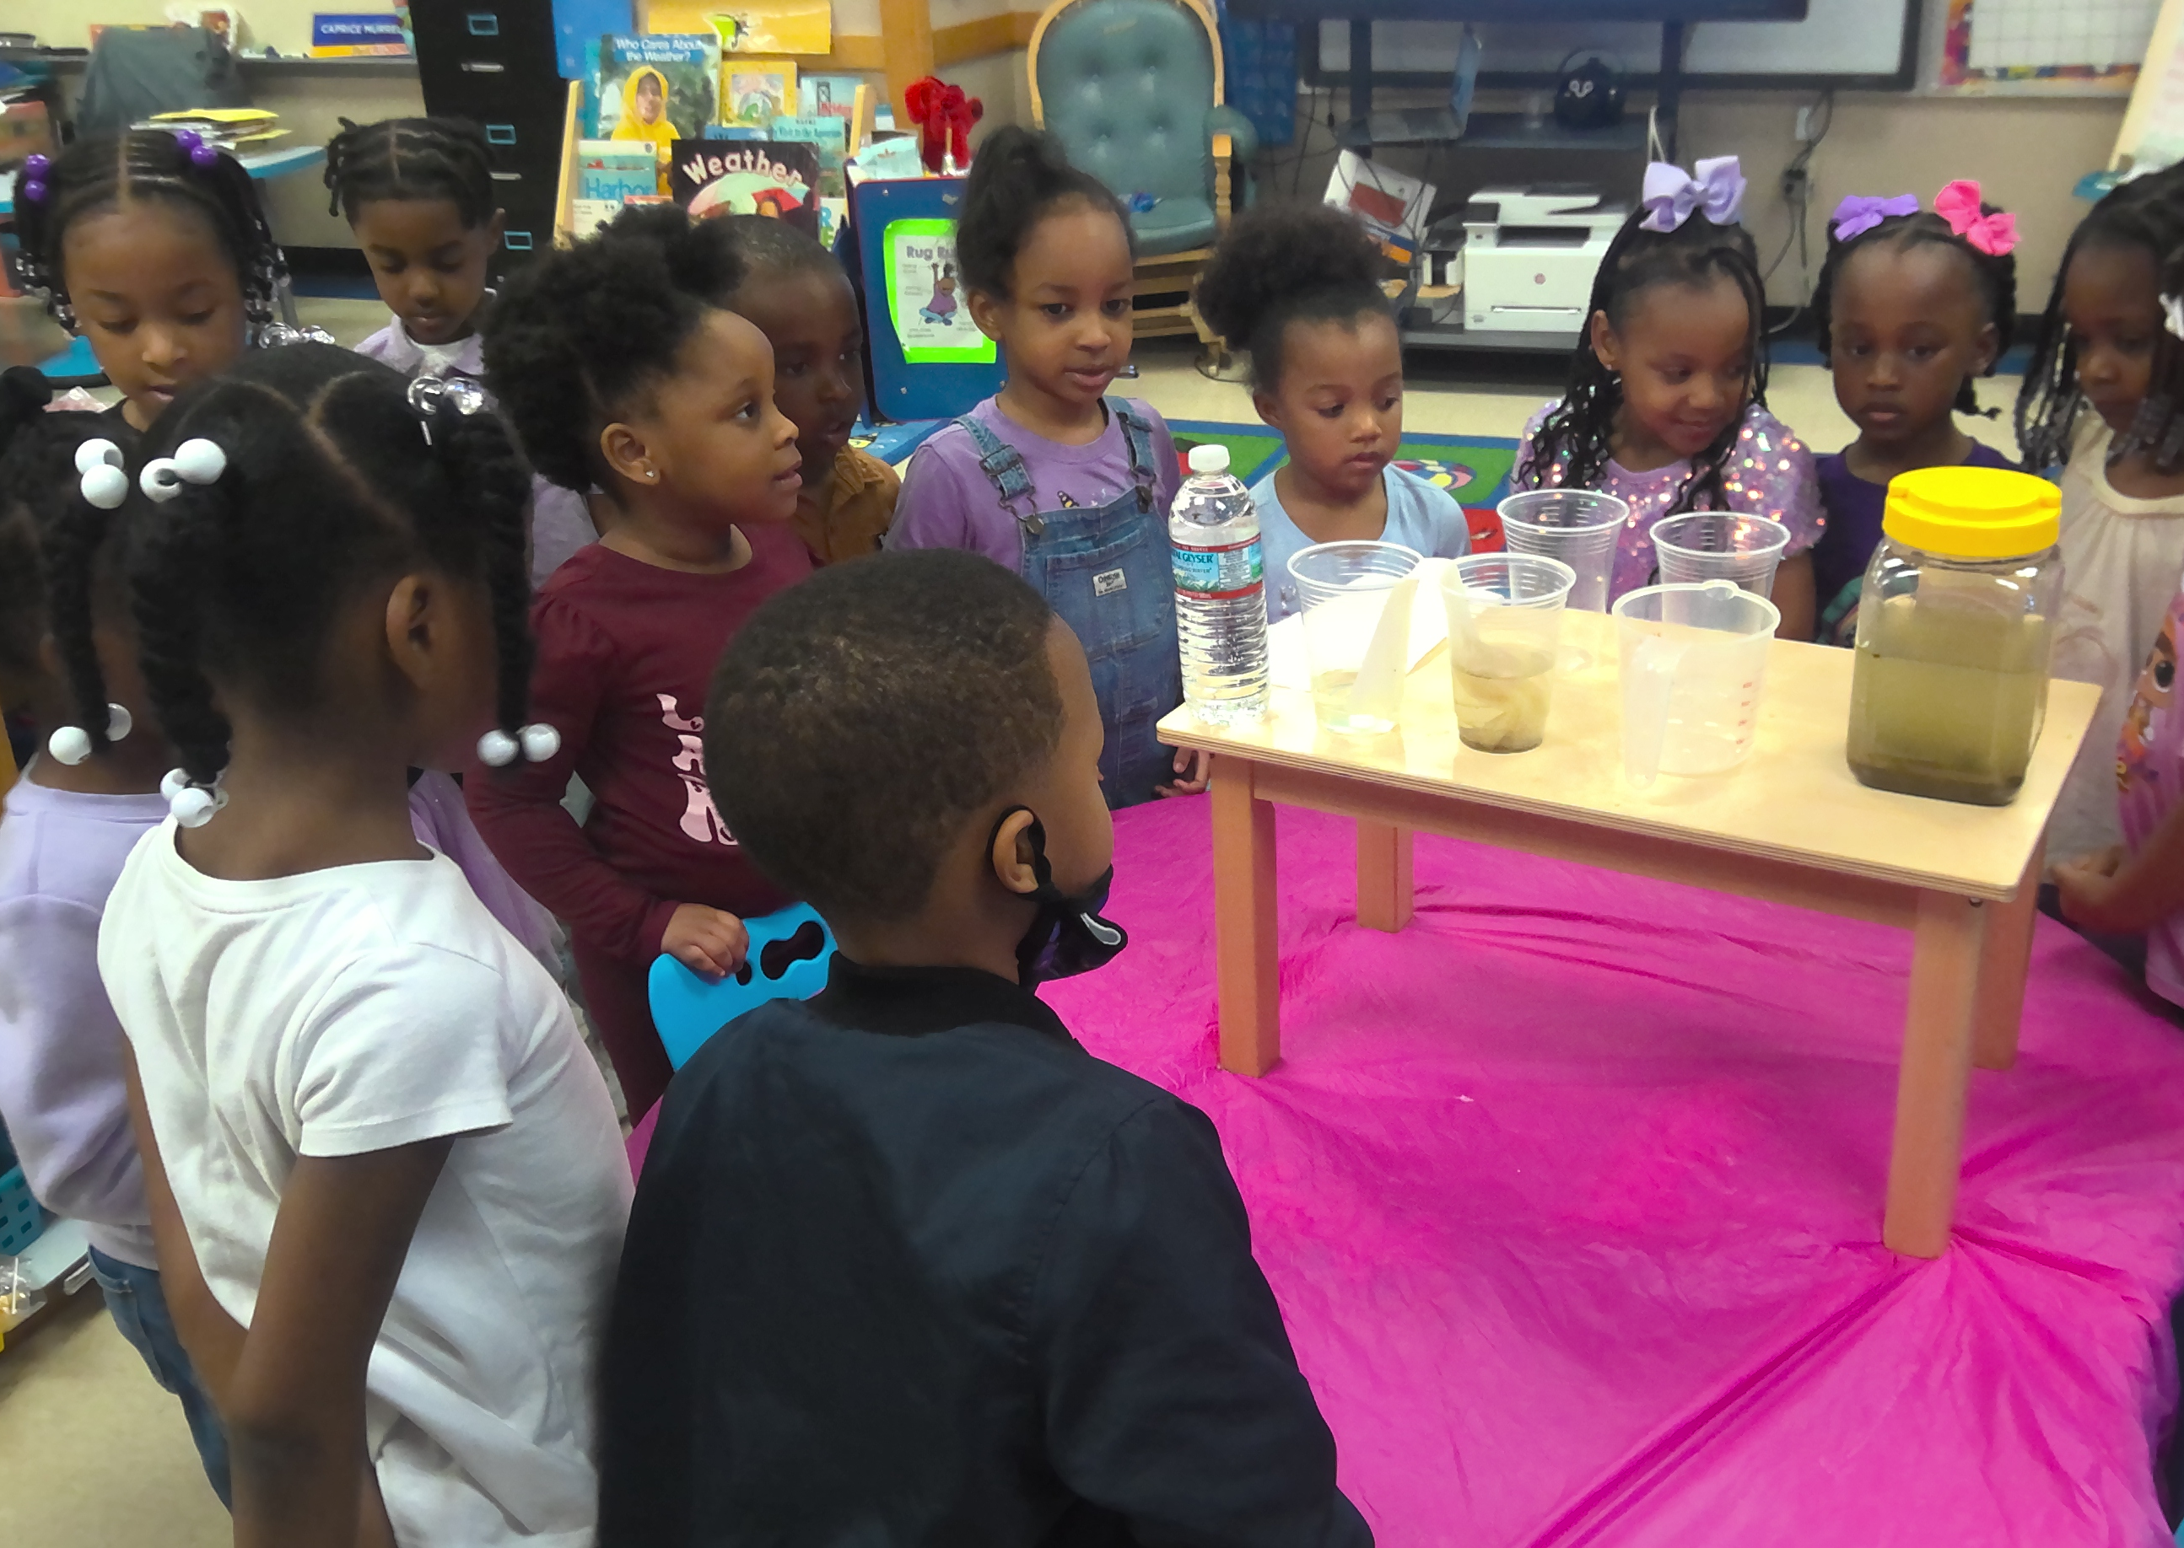
The Water Princess

Slide 28
Be Intentional
Know the material you are reading (annotate before reading).
Plan questions in advance.
Clarify new vocabulary.
Plan & Integrate activities
Connect to prior learning.

Slide 29
The End Goal
Recalling/retelling familiar stories
Reading sight words
“Reading” words and pictures
Understanding conventions of print
Dramatizing stories and characters
Engaging in social interactions and taking turns
Building a love for reading!

Slide 30
Questions?

Slide 31
Attendance Procedures
Attendance:
Feedback:
bit.ly/apr22att
bit.ly/apr22surv
Notes:
The third read-aloud should occur a few days after the second read-aloud (within a week). By the third read-aloud, students should be able to retell the story and interpret it and reconstruct it with or without support.
-To assist students, show illustrations and ask, "what is happening here?" or "what happens next?"
-When words have multiple meanings, emphasize the meaning the author intended.

