Slide 1
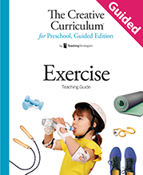
Question of the Day

Slide 2
Exploring the Topic

Slide 3
Can you run in place?

Slide 4
What types of exercise do you like to do?

Slide 5
What exercise do you do outside?

Slide 6
What type of exercise is _____ doing?

Slide 7
Investigation
#1

Slide 8
Can you jump five times?

Slide 9
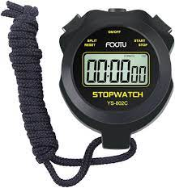
Do you know what this is?

Slide 10
How long can you stand on one foot?

Slide 11
Can you bend down and touch your toes?

Slide 12
How do you know your muscles are strong?

Slide 13
Investigation
#2

Slide 14
What exercises do people do outdoors?

Slide 15
What would you like to ask our visitor?

Slide 16
Do you like to dance?

Slide 17
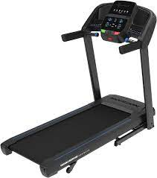
Do you know what this is called?

Slide 18
Investigation
#3

Slide 19
How many times can you jump?

Slide 20
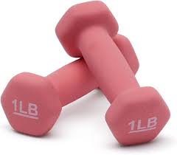
What do people use these for?

Slide 21
Can you walk in
a straight line?

Slide 22
Can you do this pose?

Slide 23
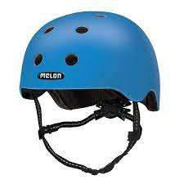
When do you wear this?

Slide 24
Celebrating Learning

Slide 25
What would you like to share with families at the celebration?

Slide 26
What is your favorite exercise?

