Slide 1
Question of the Day

Slide 2
Focus Question 1

Slide 3
Can you find your name and put it on the board?

Slide 4
Have you ever lost something?

Slide 5
Can you name someone in your family?

Slide 6
Do you know how
to use this?

Slide 7
Do you know the name of this place?

Slide 8
Focus Question 2

Slide 9
Have you ever felt sad?

Slide 10
Have you ever felt scared?

Slide 11
What makes you feel happy?

Slide 12
Focus Question 3

Slide 13
Do we run in our classroom?

Slide 14
What rules should we have in our classroom?

Slide 15
Can you name one of our classroom rules?

Slide 16
How many fingers are on your hand: two or five?

Slide 17
Have you ever seen someone _______?

Slide 18
Focus Question 4

Slide 19
What do you do when you get to school?

Slide 20
What do you do after you wake up in the morning?

Slide 21
What do we do when we first get to school?

Slide 22
Focus Question 5

Slide 23
What do you think this book is about?

Slide 24
Have you seen this person at our school?

Slide 25
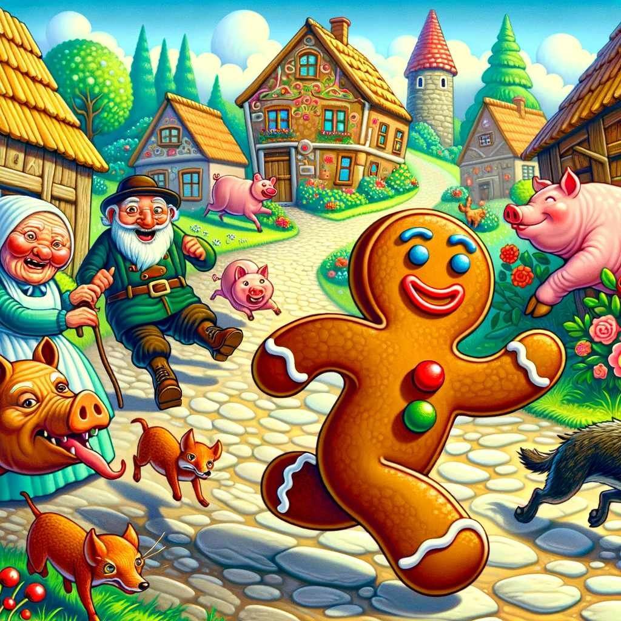
Does this man go to our school?

Slide 26
Where did the Gingerbread Man go?

Slide 27
Focus Question 6

Slide 28
Would you like to play with this truck?

Slide 29
Can you name a friend you have at school?

Slide 30
What do you like to do with your friends?

Slide 31
Which book would you like to read today?

Slide 32
What should you do when you and a friend want the same toy?

Slide 33
Ministudy

Slide 34
Do you know what sound this makes?

Slide 35
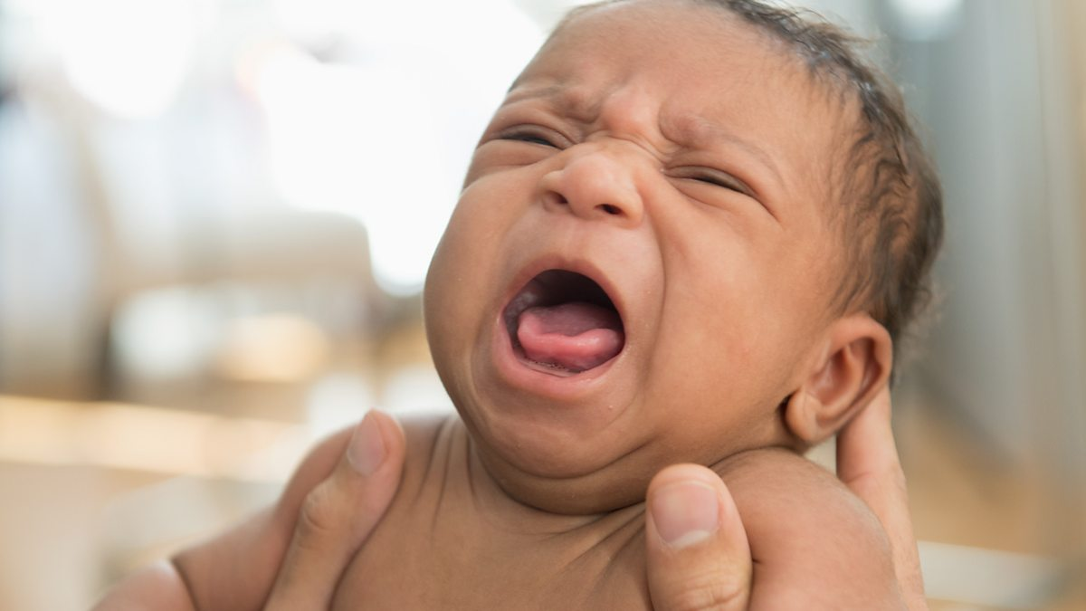
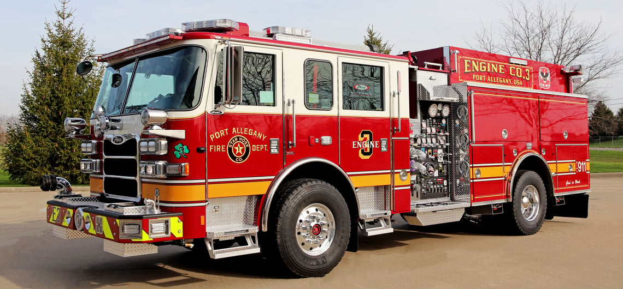
Which one do you think makes a louder sound?

Slide 36
Does this make a sound?

Slide 37
Does this make a sound?

Slide 38
Can we make sounds
with this?

