Slide 1
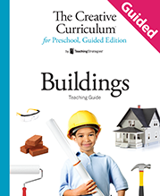
Question of the Day

Slide 2
Exploring the Topic

Slide 3
Can you point to your eyes, ears, and nose?

Slide 4
What does our school’s door look like?

Slide 5
Where do you go when it’s raining outside?

Slide 6
What do you want to know about buildings?

Slide 7
Investigation
#1

Slide 8
How many buildings do you think we will see on our walk today?

Slide 9
What type of
building is this?

Slide 10
Is this building a home?

Slide 11
Can you find and put on your name tag?

Slide 12
Have you gone to the doctor before?

Slide 13
Investigation
#2

Slide 14
What do you think this book will be about?

Slide 15
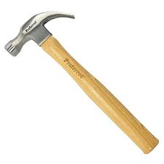
Who uses this tool?

Slide 16
What questions would you like to ask our visitor?

Slide 17
Investigation
#3

Slide 18
Which building in this story was the strongest?

Slide 19
What happened to this house?

Slide 20
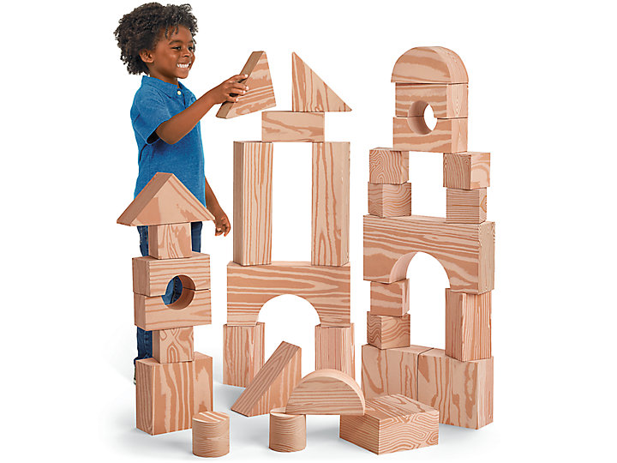
Is this building sturdy?

Slide 21
Investigation
#4

Slide 22
What is the name of the community you live in?

Slide 23
What type of buildings are you building for our community?

Slide 24
What should we name our community?

Slide 25
Celebrating Learning

Slide 26
How can we invite our guests to visit our community?

Slide 27
How many buildings are in our community?

