Slide 1

The U.S. Constitution
You need to know the articles and the 27 amendments

Slide 2

Your assignment:
You need to KNOW all 7 Articles and all 27 Amendments
You don’t need to know any more information than what is contained on these slides. There are many Quizlets, etc. out there to help you memorize these things, but be careful.
When tested on this, the only answers that will be accepted will be the information that is contained in these slides.

Slide 3
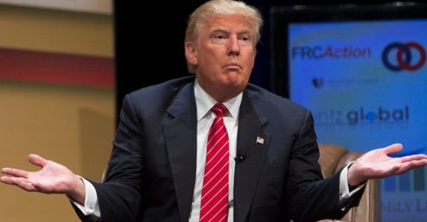
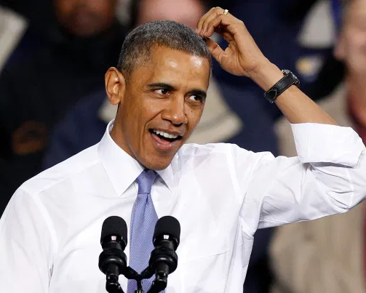
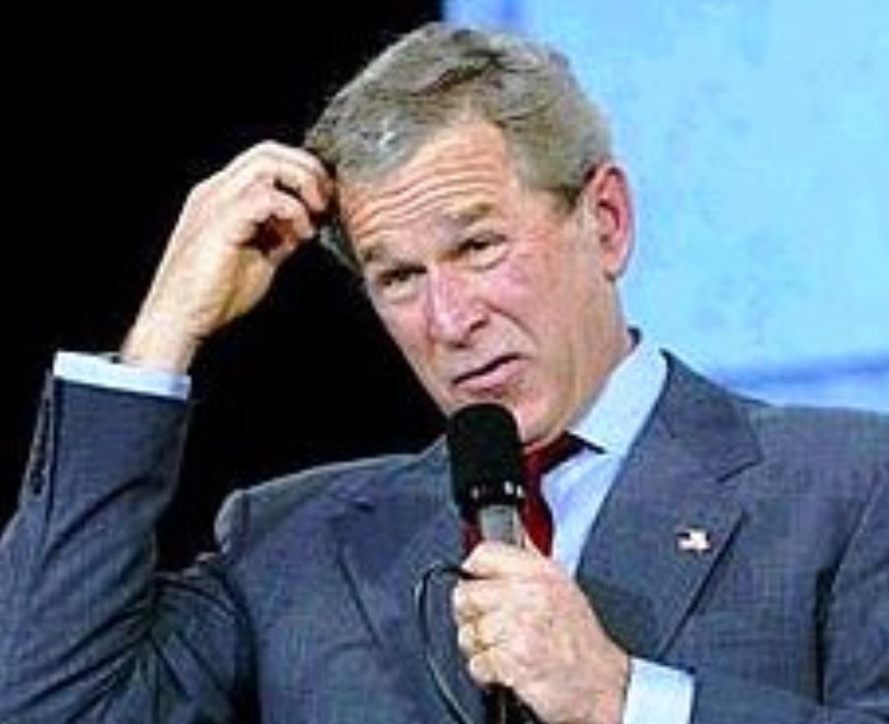
Expect a quiz on this in the first few days of class
You will be quizzed on this repeatedly throughout the year
Learning it now is the easiest way to make sure you’re always ready and to keep your quiz average high.

Slide 4
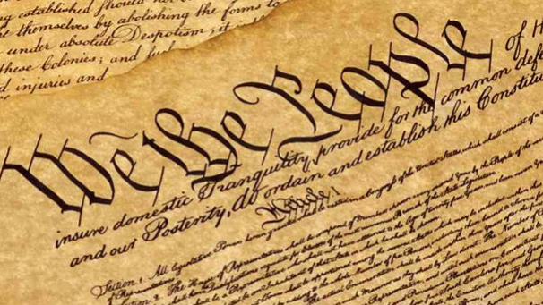
preamble

Slide 5
To form a more perfect union
We the people….
Establish justice
Ensure domestic tranquility
Provide for the common defense
Promote the general welfare
Secure the blessings of liberty

Slide 6
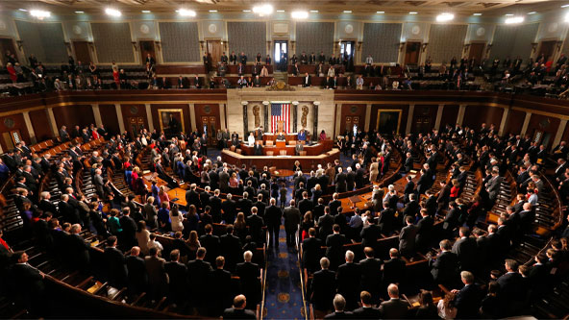
articles

Slide 7
Article I
Sets up the legislative branch (Congress)

Slide 8
Article II
Sets up the executive branch
(POTUS & Bureaucracy)

Slide 9
Article III
Sets up the judicial branch
(SCOTUS & federal courts)

Slide 10
Article IV
Relations between the states

Slide 11
Article V
Amendment process

Slide 12
Article VI
Supremacy Clause

Slide 13
Article VII
Ratification of the Constitution

Slide 14
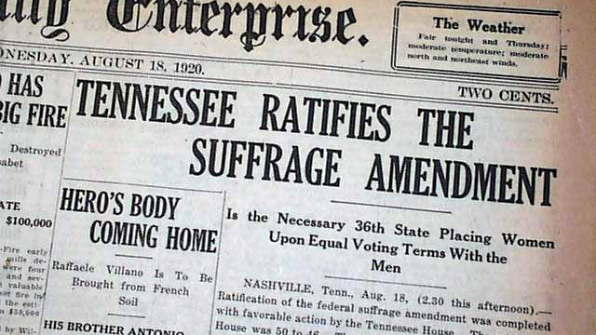
amendments

Slide 15
Freedom of Religion
First Amendment
Freedom of Speech
Freedom of Press
Freedom of Assembly
Freedom to Petition the Govt

Slide 16
Second Amendment
Right to Bear Arms

Slide 17
Third Amendment
No Quartering of Troops

Slide 18
Fourth Amendment
No Illegal Searches or Seizure of Property

Slide 19
Due Process of Law
No Self Incrimination
Fifth Amendment
No Double Jeopardy
Eminent Domain

Slide 20
Sixth Amendment
Right to speedy and public trial
Right to counsel

Slide 21
Right to jury in civil cases
Seventh Amendment

Slide 22
Eighth Amendment
No cruel or unusual punishment or excessive bail

Slide 23
Ninth Amendment
Rights reserved to the people

Slide 24
Tenth Amendment
Powers reserved to the states

Slide 25
Lawsuits against states
11th Amendment

Slide 26
12th Amendment
Changes the Electoral College

Slide 27
13th Amendment
Abolition of slavery

Slide 28
Citizenship defined
14th Amendment
Equal Protection Clause
Due Process Clause (states)

Slide 29
Can’t deny right to vote based on race
15th Amendment

Slide 30
16th Amendment
Income tax

Slide 31
17th Amendment
Direct election of the Senate

Slide 32
18th Amendment
Prohibition of alcohol

Slide 33
19th Amendment
Can’t deny right to vote based on gender

Slide 34
20th Amendment
End of “lame duck” period

Slide 35
21st Amendment
Repeal of Prohibition (18th)

Slide 36
22nd Amendment
Two Term Limit for POTUS

Slide 37
23rd Amendment
Voting rights for Washington DC

Slide 38
24th Amendment
Bans the poll tax

Slide 39
25th Amendment
Presidential succession and disability

Slide 40
26th Amendment
Voting Age changed to 18

Slide 41
27th Amendment
Pay raises for Congress

Slide 42

Your assignment:
You need to be prepared to be quizzed on this information.
I will ask you either of these two ways:
  What is the eighth amendment?
  Which amendment protects you from cruel and unusual punishments?
If you download this as a slide deck or PowerPoint file, it’s animated so you can use it like flash cards.
If you have any questions over the summer you can email rakestrawatwork@gmail.com

