Slide 1
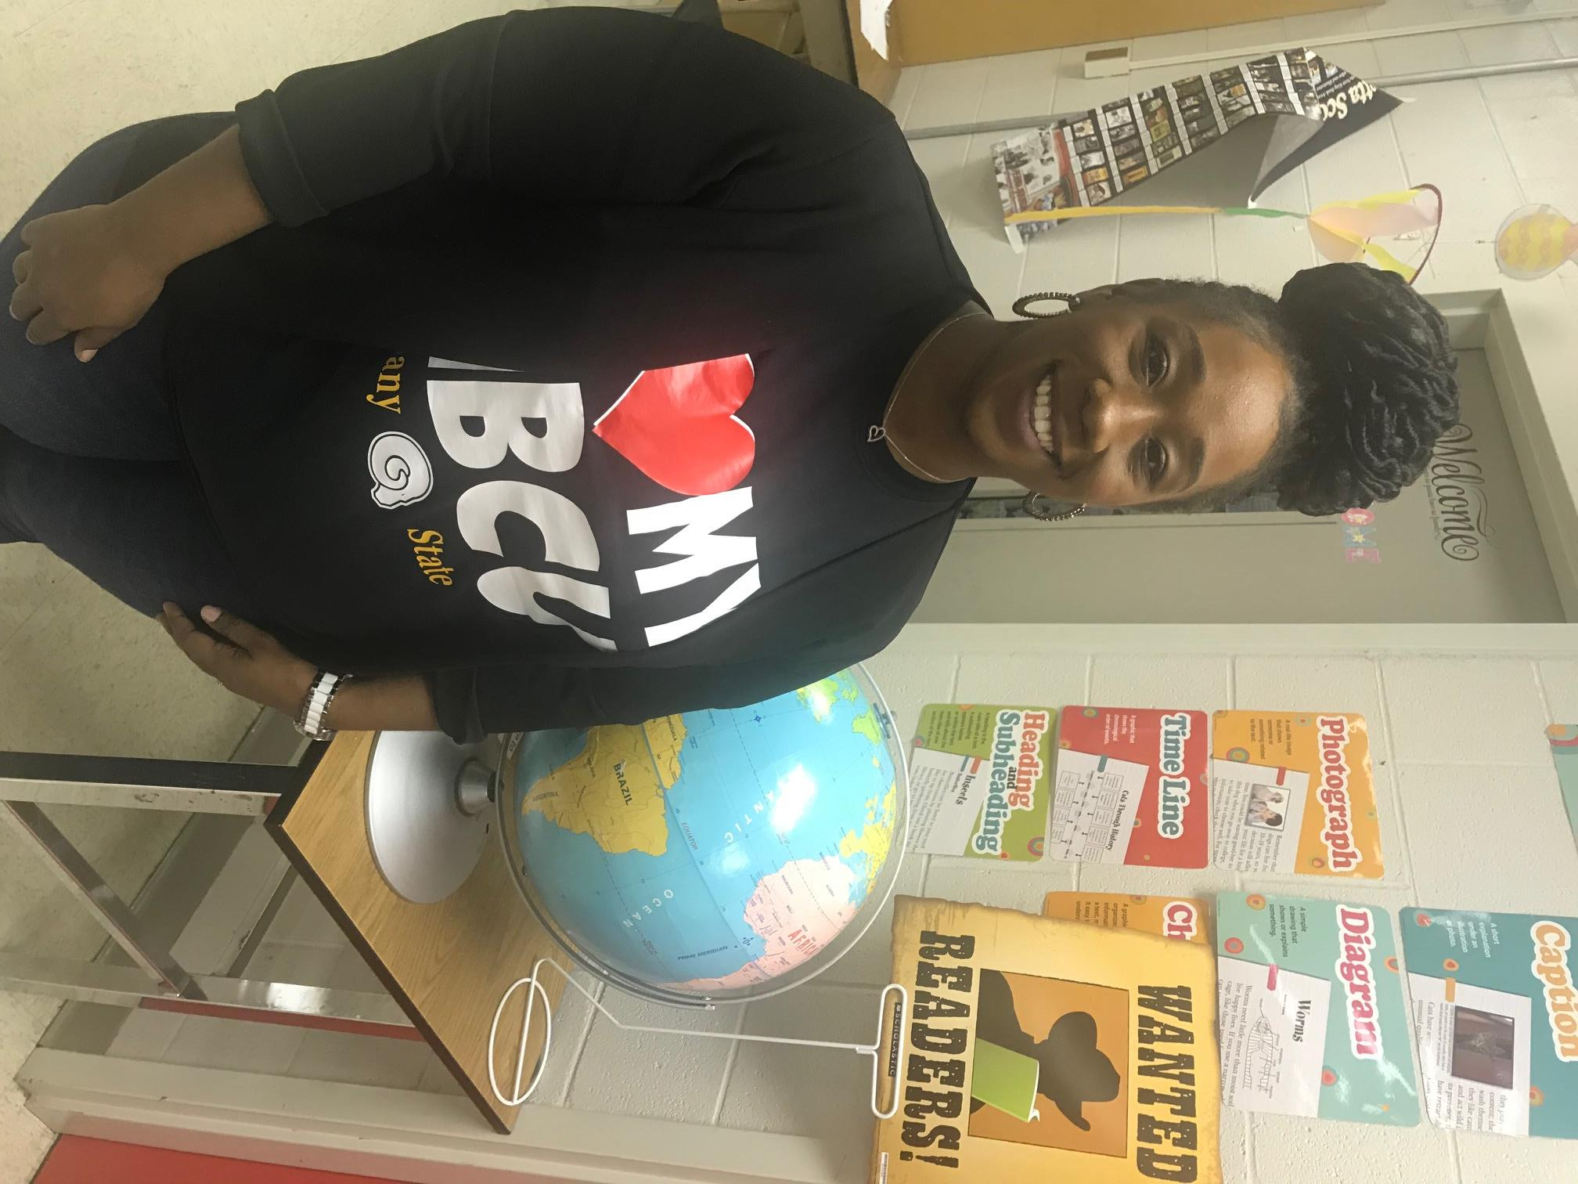
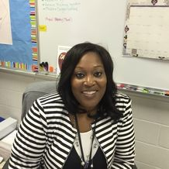
What do school counselors DO?
Kate Bond Elementary
We work alongside teachers and parents to help students develop
socially and emotionally, and help remove any barriers to learning!
Kindergarten through 2nd Grade
Mrs. Crystal Ashmon
Phone: 901-416-0015
ashmoncl@scsk12.org
3rd through 5th Grade
Mrs. Yumeekia Mitchell
Phone: 901-416-4860
mitchellyn@scsk12.org
SCHOOL COUNSELING
SCHOOL COUNSELING
We provide:
Mrs. Crystal Ashmon (Grades K-2)
Mrs. Yumeekia Mitchell (Grades 3-5)
Classroom guidance lessons
Small group counseling
Short-term individual counseling
Consultation with parents and teachers
Parent workshops
Crisis intervention
Community resource referrals (including longer term therapy services)
Schoolwide programming (Red Ribbon Week, Kindness Week, College and Career Awareness Week, etc.)
***Confidentiality and your family’s privacy are important to us. What you or your child discuss with a counselor is private except in cases required by law (when abuse or neglect are suspected).***

Slide 2
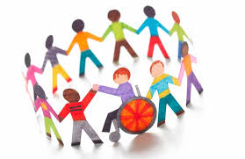
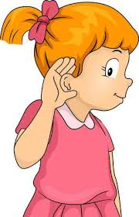
How can we support parents?
What types of things do we talk with students about in class lessons and in counseling?
Why do kids need
school counseling?
Help handle social or emotional concerns you have about your child.
Improving parent-child communication.
Family difficulties or concerns that affect your child at school.
Referrals for community resources.
Understanding the developmental changes of childhood.
Helping your child to be on time to school every day.
Discussing concerns about your child’s academic achievement.
• Children learn best when they feel good about themselves and their relationships with others.
• Children who understand their feelings are better able to control their behavior.
• We know that stress can affect focus and learning, but its impact can be reduced with proven self-regulation strategies.
• Schools, parents, and communities that
communicate and collaborate provide the most
effective support to children.
• Attitudes formed during elementary school shape
future attitudes towards learning, self, and society.
Making and keeping friends
Setting goals
Teamwork
Feeling good about yourself
Making good choices
Being responsible
Managing strong feelings
Conflict resolution
How does a
student see a
school counselor?
Self-referral
Parent referral
Administrative, teacher, or other staff referral
Online Referral Link: https://forms.gle/zQ91ox69c4Dby8ah7

