Slide 1

WHITE STATION HIGH SCHOOL
SENIOR NIGHT- September 11, 2025

Slide 2
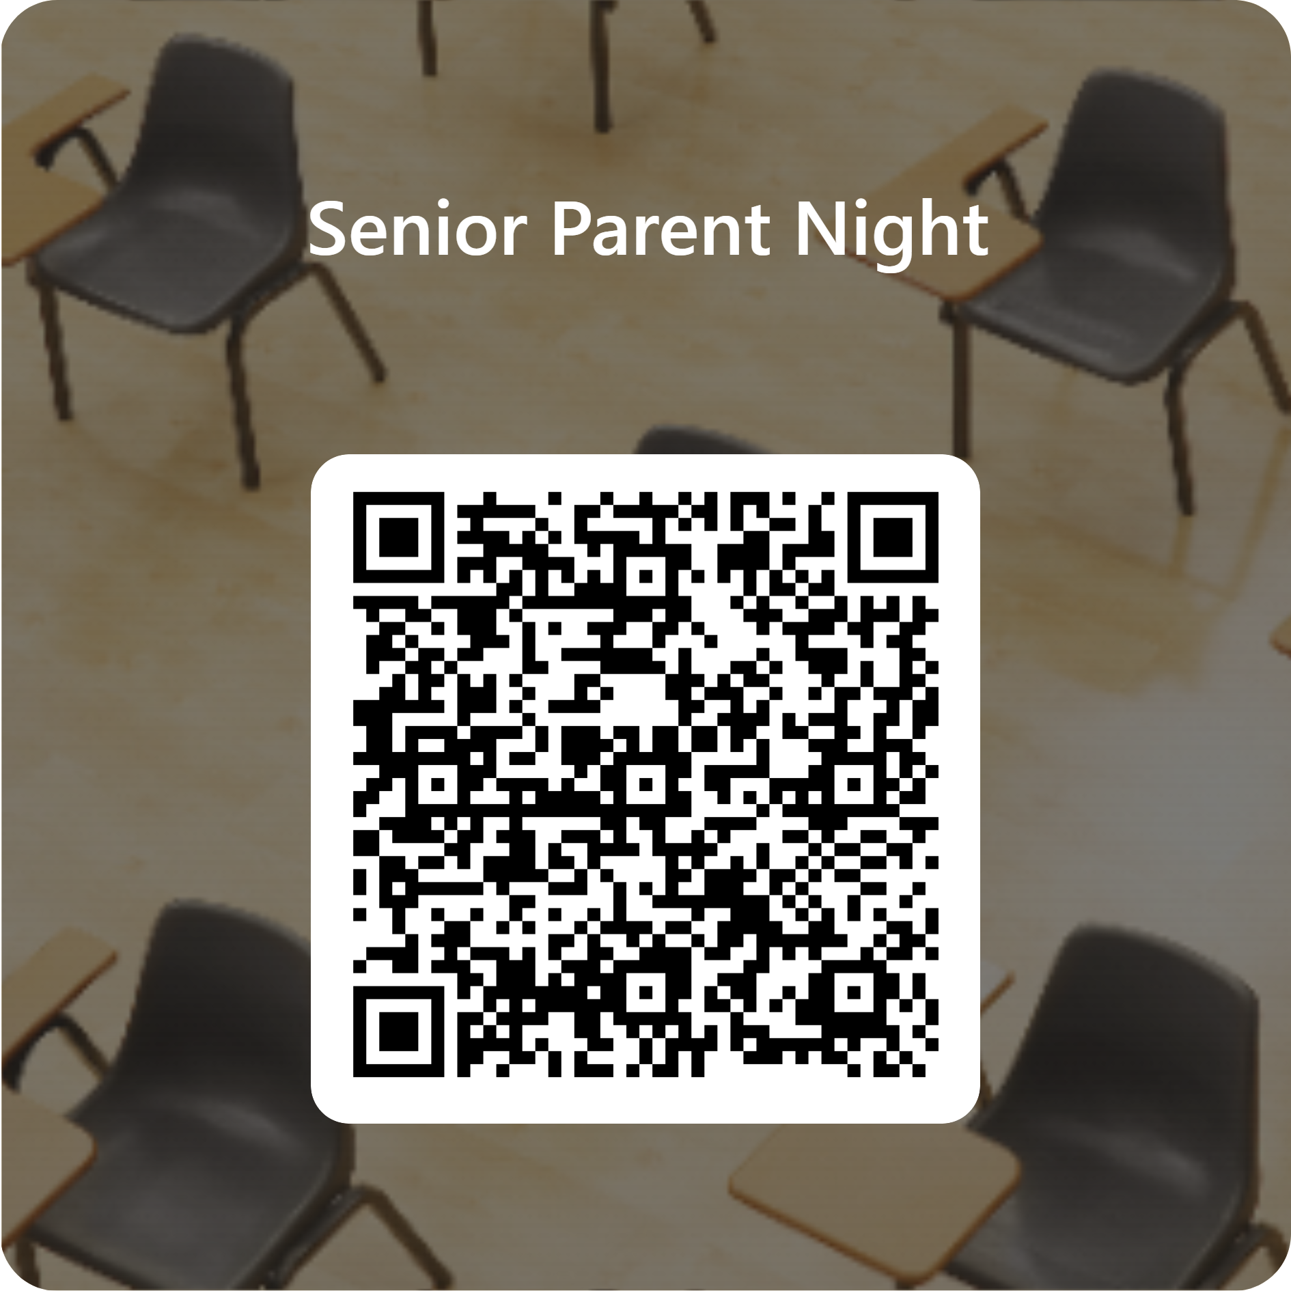
scan to sign-in!

Slide 3

Senior Administrator
Arkisha Durham
email: wilsonah@scsk12.org
office: 901-416-7918

Slide 4
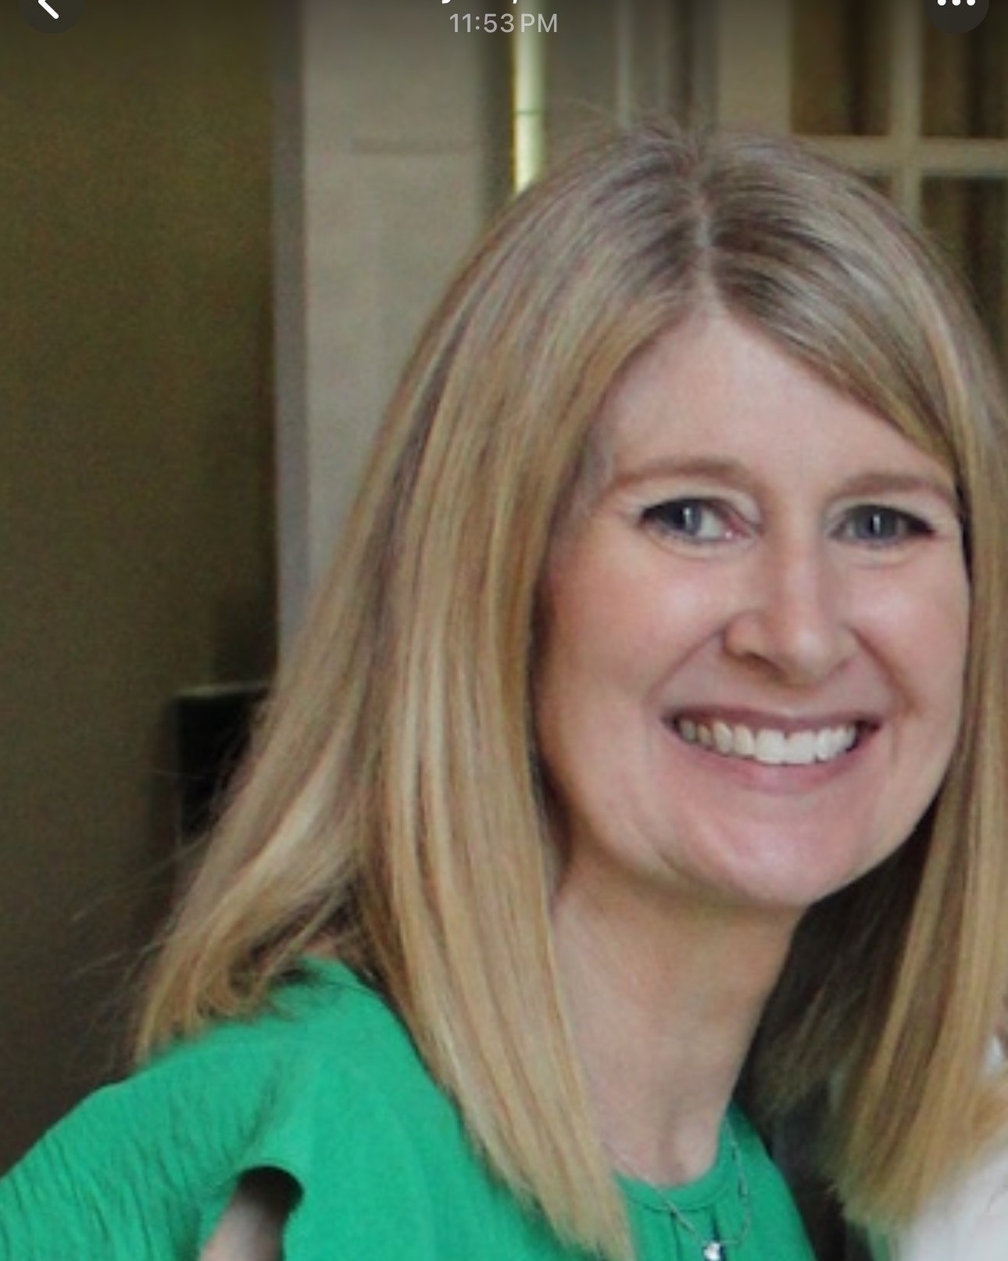
Senior counselor
Leslie Fleming (last name A-E & S-Z) email: flemingl@scsk12.org
office: 901-416-8894

Slide 5

Senior counselor
Heather Heaston (last name F-R) email: heastonha@scsk12.org
office: 901-416-7935

Slide 6

Graduation Coach
Janvincent Waller
WALLERJ@scsk12.org

Slide 7
Important dates
September 15, 2025, 8am-10am- College and Career Fair- WSHS Senior Gym
October 21, 2025, Senior ACT on campus (digital during the school day)
November 17, 2025, ASVAB Test on campus- sign up will begin October 20, 2025
December 3, 2025, 8:30am- TN Promise Meeting- School Auditorium
April 11, 2026, 7:00pm-11:00pm- Prom
Senior Activities will be announced via school announcements.
Senior Fees will be announced after seniors meet with Josten's on September 17, 2025.
May 14, 2026 (waiting on District approval)

Slide 8
College visits- On campus
Announced thorough Spartan Communication
Publicized on the school website
Posted outside the Junior and Senior English teachers’ classrooms
Juniors and Seniors can pick up a form from Mrs. Fleming, Mrs. Heaston, and Mr. Waller prior to the meeting
Must have teacher’s permission to attend the meeting during that class period
Present the signed permission form at the meeting

Slide 9
College visits- off campus
Seniors have two-excused absences in the Fall
Complete a WSHS College Visitation Form before the visit:
  Forms can be picked up from Mrs. Fleming or Mrs. Heaston
  Forms must be completed before the visit and turned into Mrs. Schusster-Student Services Office
  Proof of attendance must be obtained from the college/university and turned into Mrs. Schusster within three days of returning to school. The absence will not count against 1st semester exemptions

Slide 10
Graduation requirements
4 English Credits
4 Math Credits
3.5 Social Studies Credits- World History/Geography, US History, US Government, Economics, and Personal Finance
2 Foreign Language Credits- must be two years of the same language
1 Fine Art Credit
1 Lifetime Wellness Credit and an additional .5 PE Credit
3 Elective Focus Credits
Pass the Civics Test (will be given Fall and Spring Semester)
Obtain an ACT score
Substitutions:
ROTC 1 and ROTC 2= Lifetime Wellness and PE
ROTC 3= US Government and Personal Finance
Marketing 1= Economics
School Sport or Marching Band with a signed waiver on file= .5 PE credit
3 Science Credits- Biology, Chemistry or Physics, and one additional lab science

Slide 11
TN PROMISE SCHOLARSHIP
TN PROMISE
  Two-year scholarship for community college or trade school with no GPA or ACT requirement
  Application deadline is November 3, 2025 (no exceptions)
  Must attend one meeting- December 3, 2025, during school
  Complete 8 hours of community service
  Complete the FAFSA

Slide 12
TN HOPE/LOTTERY SCHOLARSHIP
Four-year scholarship to any Tennessee school worth $16,000 over four years
Requires a 3.00 (unweighted) GPA or a 21 on the ACT
Complete the FAFSA and select at least one TN school to receive your information

Slide 13
Applying to college
Common Application
Common Black College Application
College/University Website

Slide 14
Common application
A free online application platform that allows students to apply to multiple colleges at once
Tracking documents and deadlines: The Common App dashboard helps students keep track of application documents and deadlines.
Researching financial aid: Students can use the Common App to research financial aid and scholarships.
Secondary school report- Counselor will need a minimum of two weeks’ notice, parent letter, student letter, and resume
Request ONLY TWO teachers for recommendations

Slide 15
Common Black application
The Common Black College Application is a wonderful one-stop shop for students applying to HBCUs.
The Common Black College Application widget is now in Clever in the College Readiness section!
MSCS covers the fee to allow students to use this service at no cost to them.
The promo code for the 2025-2026 school year is coming soon…

Slide 16
College/university website
Waive Application Fee
Only applying to that one school

Slide 17
Requesting your Transcript…

Slide 18

questions

