Slide 1
Paying for College
Felicia Orr, Ph.D.
Tennessee Higher Education Commission
TSAC Director College Access
Felicia.orr@tn.gov or 615.390.4461

Slide 2

Federal Aid
Federal Student Aid provides more than $120 billion in financial aid to help pay for college or career school each year.
FAFSA
Free Application for Federal Student Aid
26-27 Available October 1, 2025 Apply at Studentaid.gov

Slide 3
2026-27 FAFSA
Available October 1, 2025 at studentaid.gov
2. State priority deadline is April 1, 2026
Information needed:
    2024 income/tax info
    Asset information
    Email address (student & parent)
    Social security number
    FSAID (both parents if not filing married filing jointly)
3. Federal Information helpline- 1800.433.3243
Notes:
First, it will be open at some point this December. Second, Tennessee’s priority deadline will be April 15. Third, anyone working on the FAFSA will now need a username/password to complete their part. Fourth, the student will complete their part of the FAFSA…

Slide 4
FAFSA parent(s)
Biological parent
Stepparent
  If married to biological parent
Adoptive parent
  Unless student was in foster care at age 13+

Slide 5
Who is NOT a FAFSA parent*?
Grandparent
Aunt/Uncle
Brother/Sister
Legal Guardian
Relative whom claimed the student for tax purposes
*Unless they have adopted the student

Slide 6
“Minor” Circumstances
Emancipated minor?
Have court-ordered legal guardian*?
Since age 13 – were an orphan, were in foster care, or were a ward of the court?
*If court papers read custody instead of guardianship, student will answer no and contact their college for guidance (e.g. unusual circumstance).

Slide 7
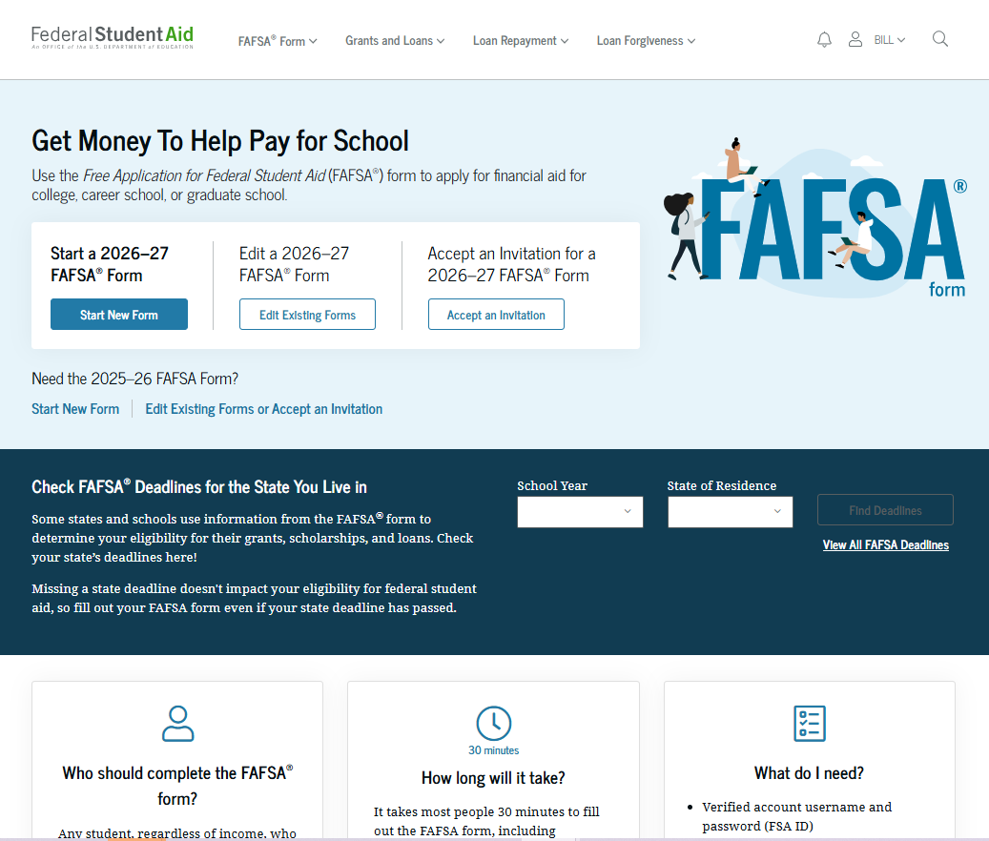
Dependent Student: FAFSA® Landing Page
This is the main FAFSA® landing page. On this page, students are directed to "Start New Form," "Edit Existing Forms," or "Accept an Invitation." For this section of the presentation, the student is beginning a new application.

Slide 8
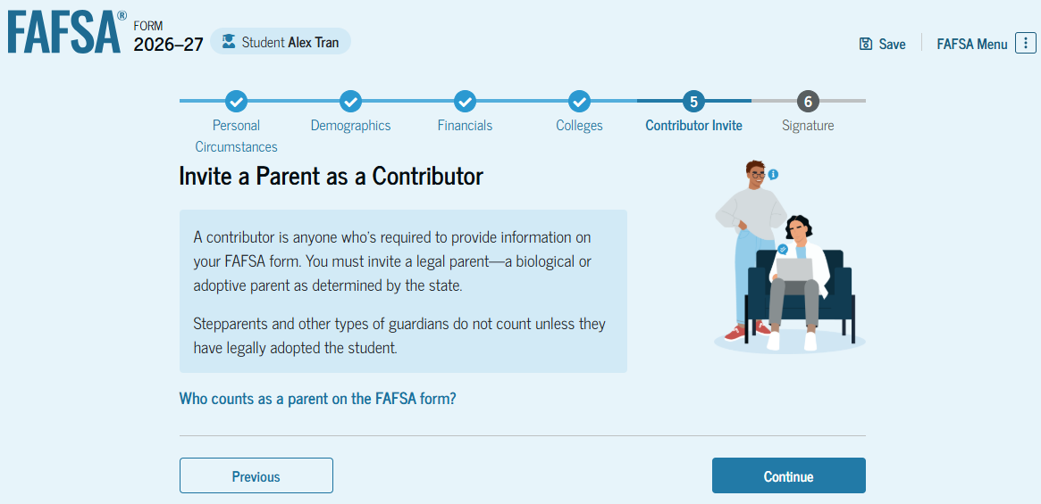
Introduction: Dependent Student Invites Contributor
This is the first page in the "Invite a Parent as a Contributor" section, which is the last student section to require information. It provides an overview of the section.

Slide 9
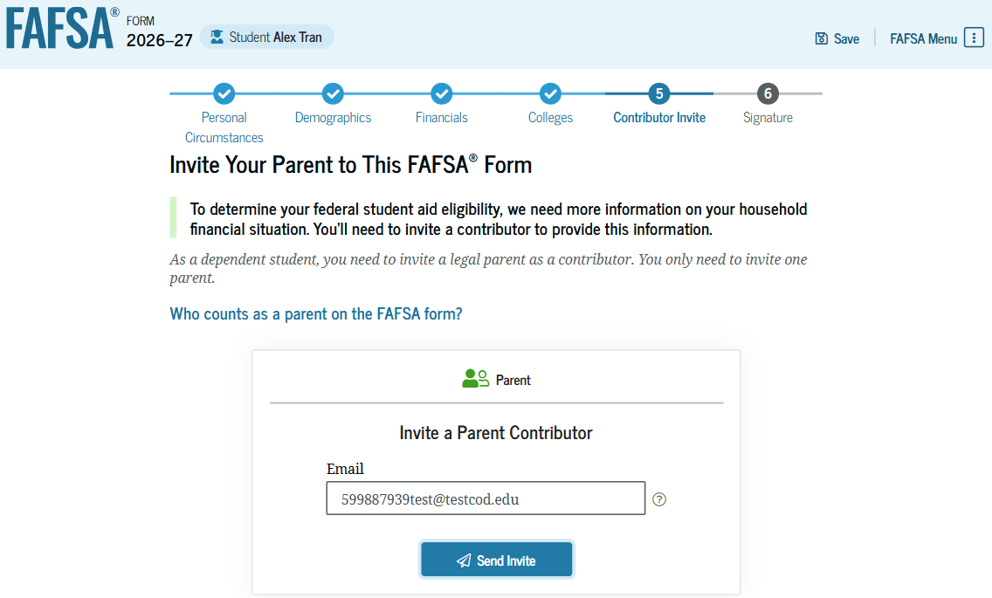
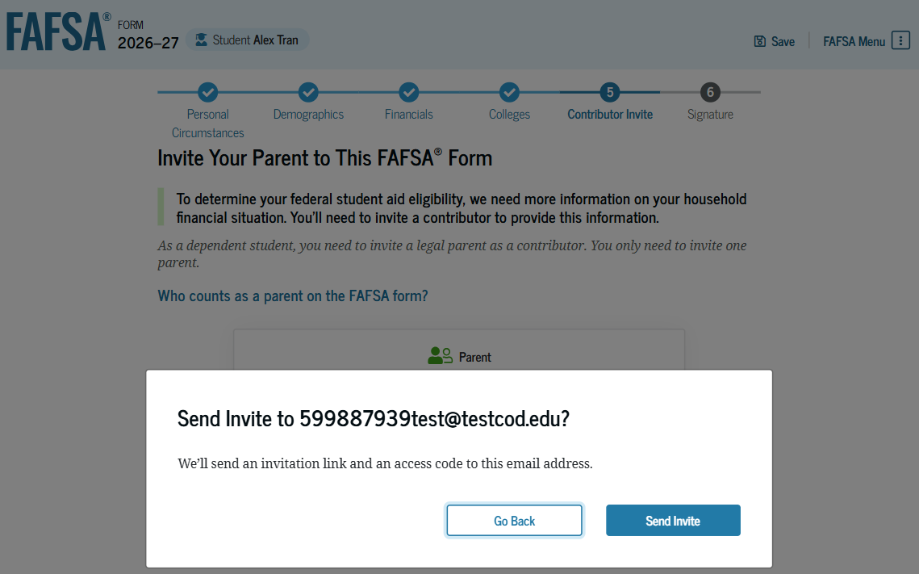
Dependent Student: Invite Contributor (Continued 1 of 2)
The student is asked to enter their parent’s email address to invite the parent to the FAFSA® form. After entering the email address, the student selects "Send Invite." A pop-up window appears, and the student confirms their parent’s email address by selecting "Send Invite."

Slide 10
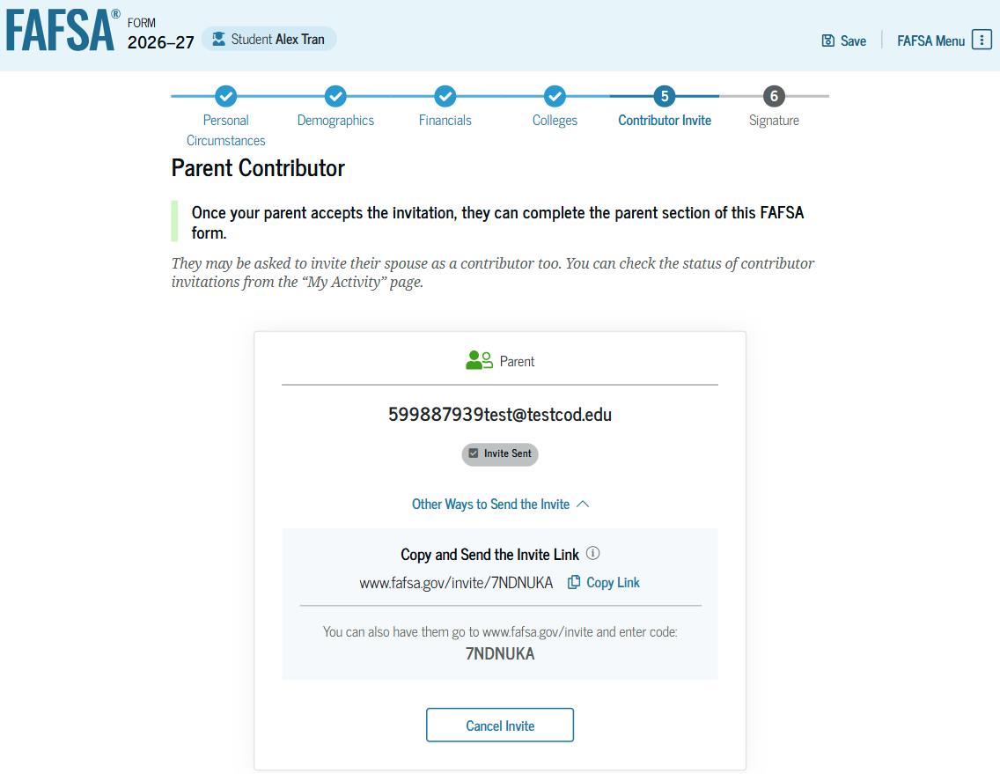
Dependent Student: Invite Contributor (Continued 2 of 2)
This page confirms the student’s parent will receive an email inviting them to the student’s FAFSA® form. The parent can access the form by accepting the invitation in the email. On this page, the student is also provided an invitation link and invitation code that can be shared directly with the parent.

Slide 11
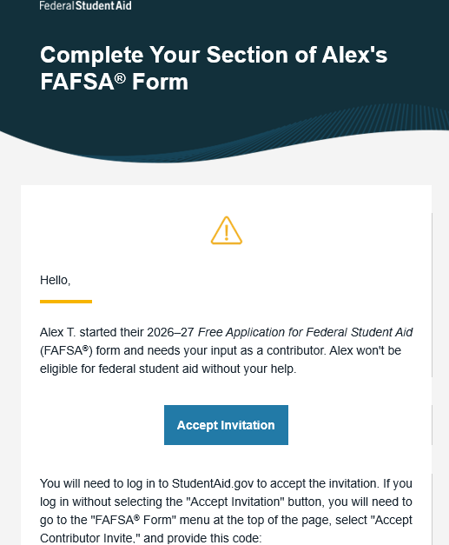
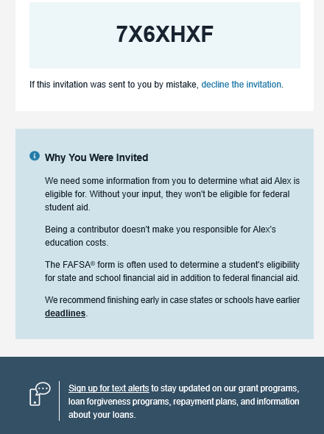
Dependent Student: Parent Email
This is NOT a view within StudentAid.gov or the FAFSA® form. This view demonstrates a parent opening the FAFSA invitation from their email. The parent selects "Accept Invitation" and is taken to StudentAid.gov.

Slide 12
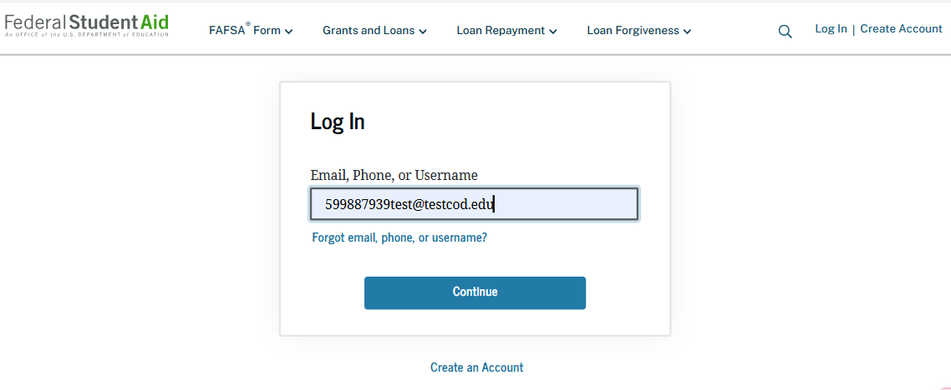
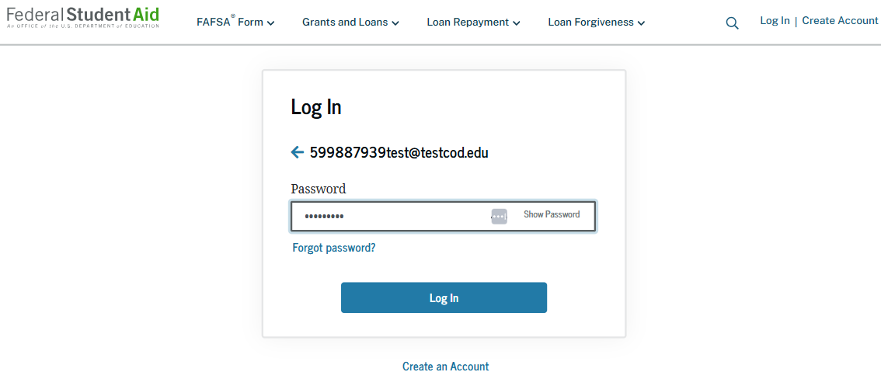
Dependent Student: Parent Log-in
The parent is taken from their email to the "Log In" page to enter their credentials. To access the FAFSA® form, all users are required to have a StudentAid.gov account username and password. If the parent doesn't have a username and password, they can select "Create an Account."

Slide 13
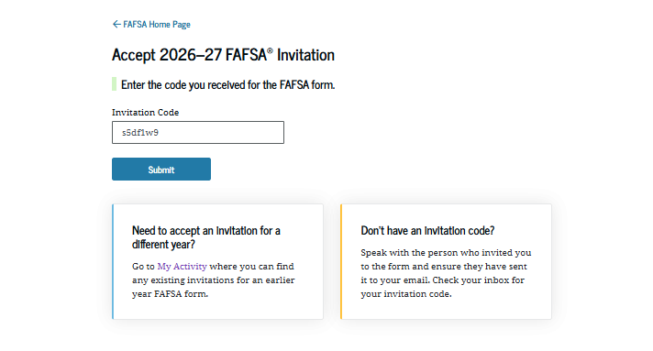
Dependent Student: Parent Accepts Invitation
After logging in, the parent is taken to the "Accept 2026–27 FAFSA® Invitation" page. The invitation code from the parent’s email automatically fills in the text box if the parent used the link from the email.

Slide 14
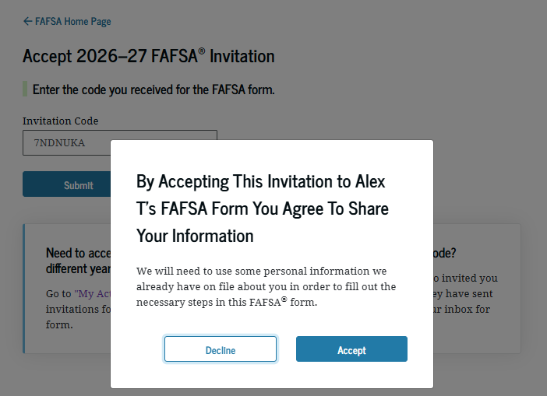
Dependent Student: Parent Accepts Invitation (Continued)
When the parent selects "Submit," a pop-up window appears, confirming the student’s name and reminding the parent that their personal information is needed to fill out the student’s FAFSA® form. The parent selects "Accept" to agree to sharing their information and enters the FAFSA form.

Slide 15
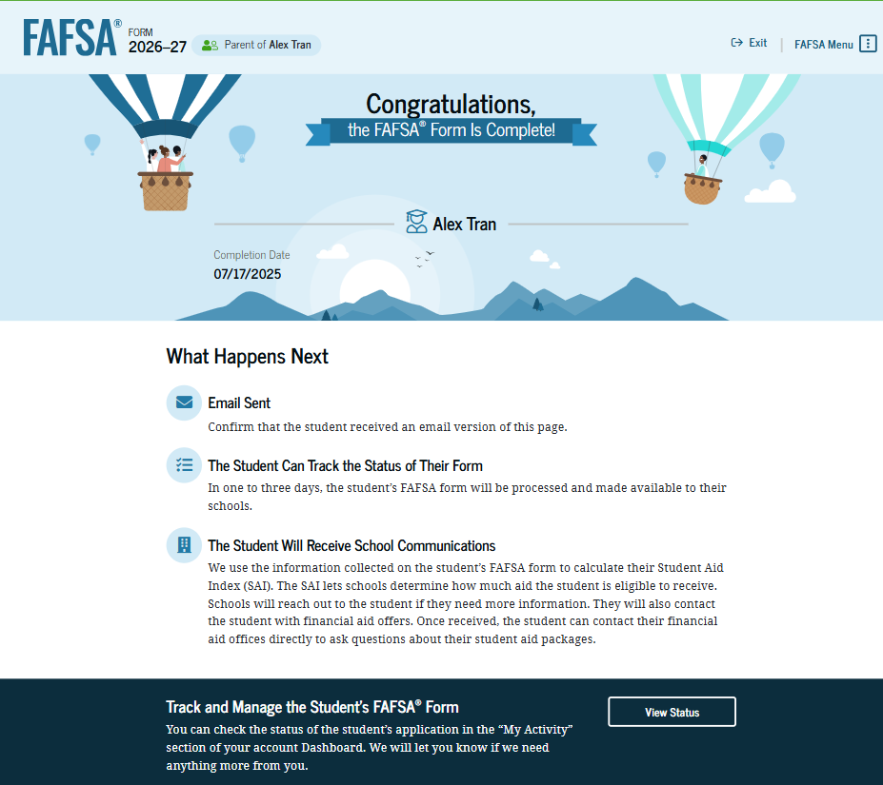
Dependent Student: Parent Confirmation
Upon submitting the student’s FAFSA® form, the parent is presented an abbreviated confirmation page. This page displays information about tracking the student’s FAFSA form and next steps. The student will receive an email with the full, detailed confirmation. With the student and parent sections completed and signed, the FAFSA form is now considered complete and submitted for processing.

Slide 16
TN 4-yr Public/Private
TSAA
0 – 3500 SAI
April 1
$1,000/$2,000 per semester
HOPE Scholarship
21 ACT/SAT or 3.0 GPA
$2,250/$2,850 per semester
Aspire
^{HOPE Supplement}
Parents AGI ≤$36,000
+$750 per semester
GAMS
^{HOPE Supplement}
29 ACT/SAT & 3.75 GPA
+$500 per semester
Need
*Student Aid Index (SAI) will replace EFC with the 2024-25 FAFSA year and thereafter
Merit

Slide 17
TN Community College
HOPE Scholarship
Aspire
^{HOPE Supplement}
21 ACT/SAT or 3.0 GPA
$1,600 per semester
TSAA
0 – 3500 SAI
April 1
$1,000 per semester
Parents AGI ≤$36,000
+$250 per semester
GAMS
^{HOPE Supplement}
29 ACT/SAT & 3.75 GPA
+$500 per semester
Need
Merit

Slide 18
TCAT
TSAA
0 – 3500 SAI
April 1
$667 per trimester
Wilder- Naifeh*
Certificate/
Diploma TCAT
$667 per trimester
*If a student is HOPE eligible upon graduation, enrolls at a TCAT
initially after high school and completes a diploma program, student may still receive HOPE by enrolling at a 2- or 4-year college within 3 years of diploma completion.
Need
*Student Aid Index (SAI) will replace EFC with the 2024-25 FAFSA
Merit

Slide 19
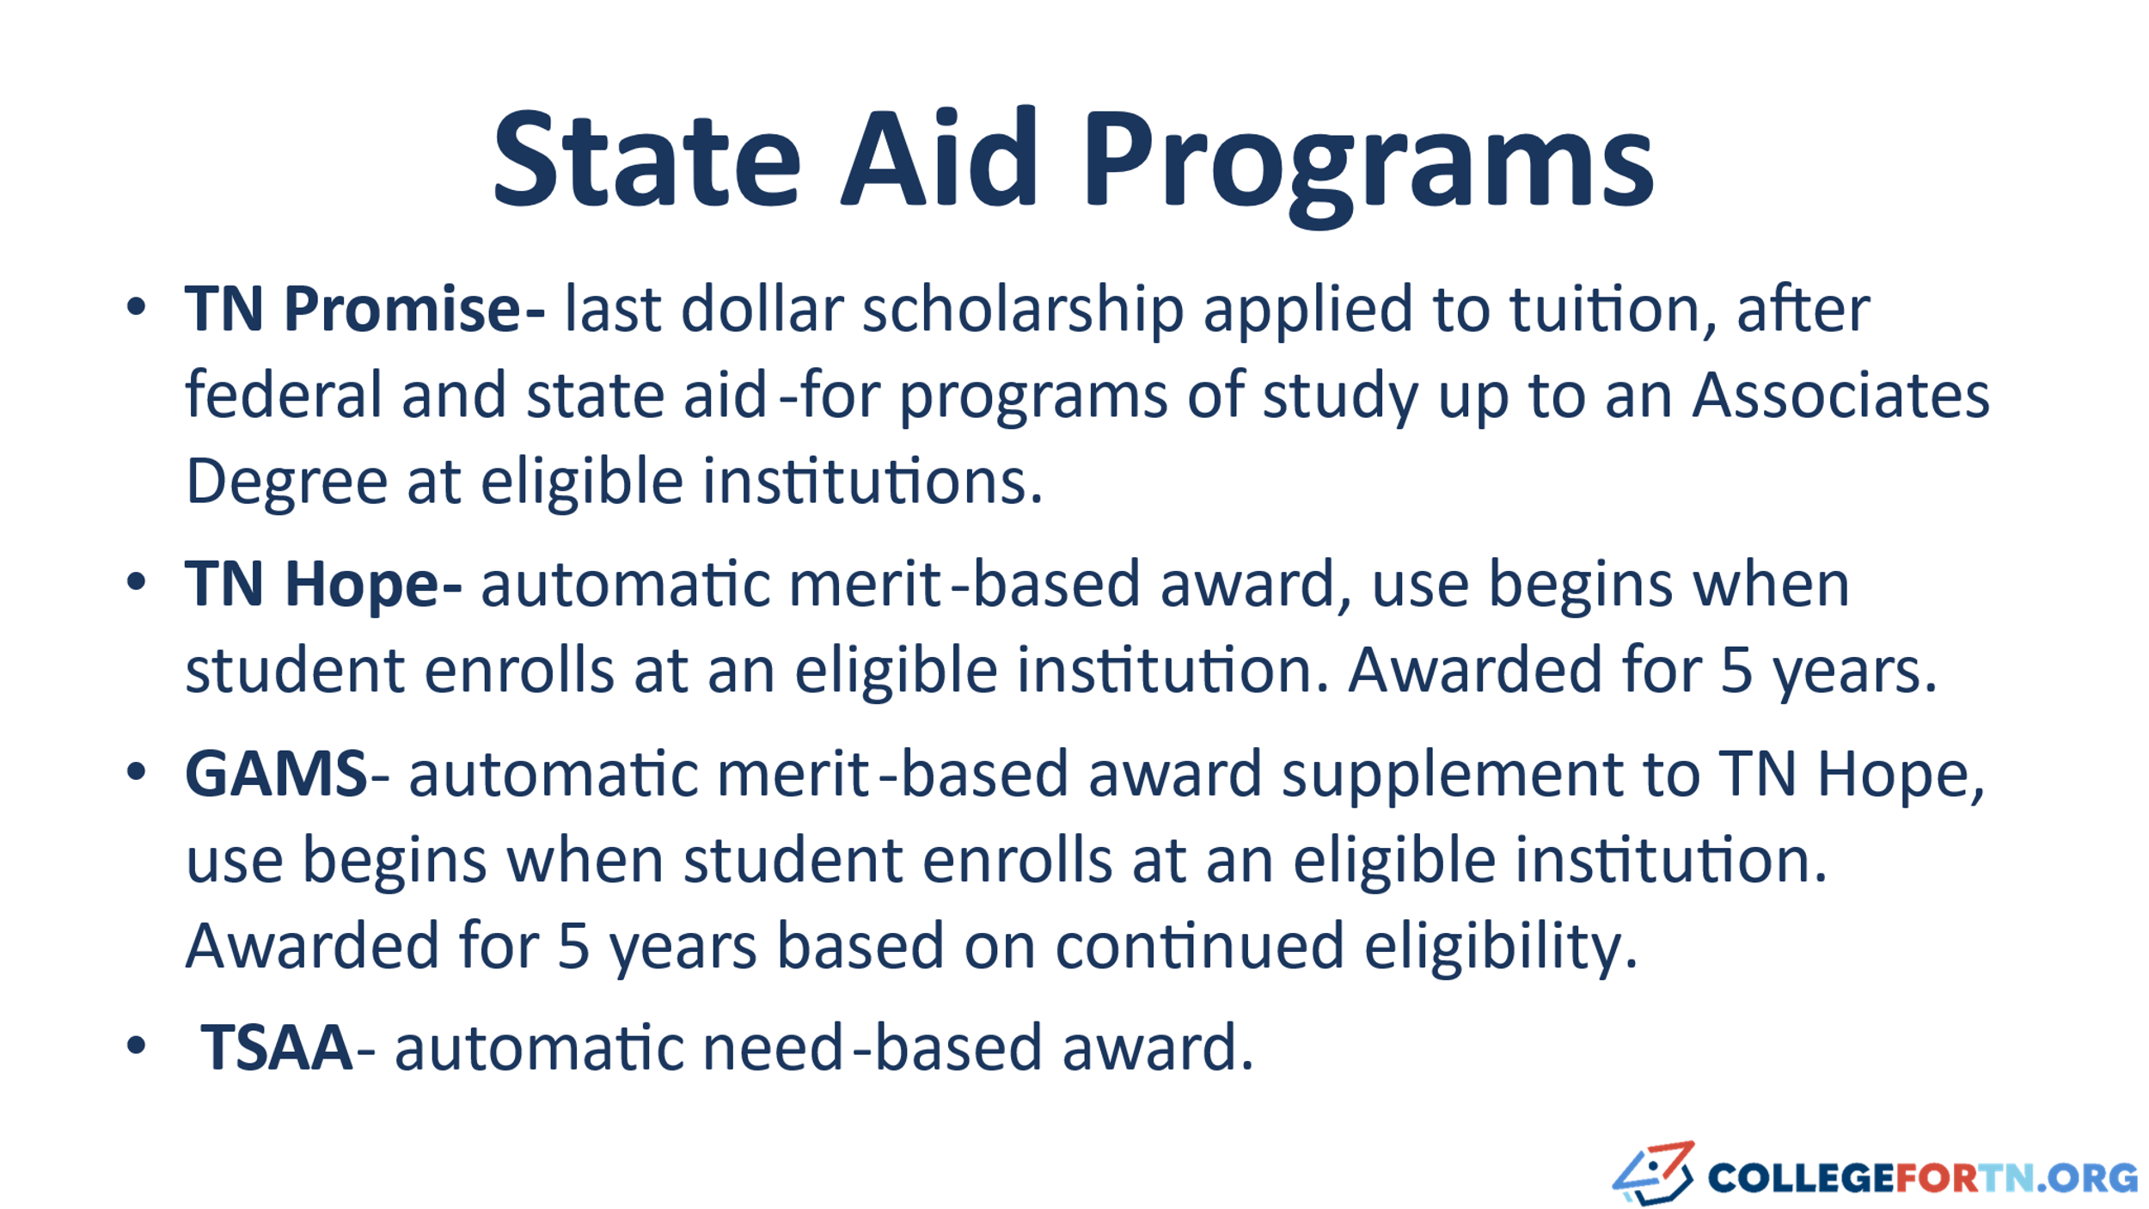

Slide 20
HOPE Renewal
Student MUST maintain continuous enrollment
  Fall, spring, fall, spring
Student MUST maintain enrollment status within a semester
  If you begin a semester full-time (e.g. 12+ hours), you must finish semester full-time
  Never drop a course without speaking with your financial aid
HOPE ends after 5 years or attainment of an advanced degree

Slide 21
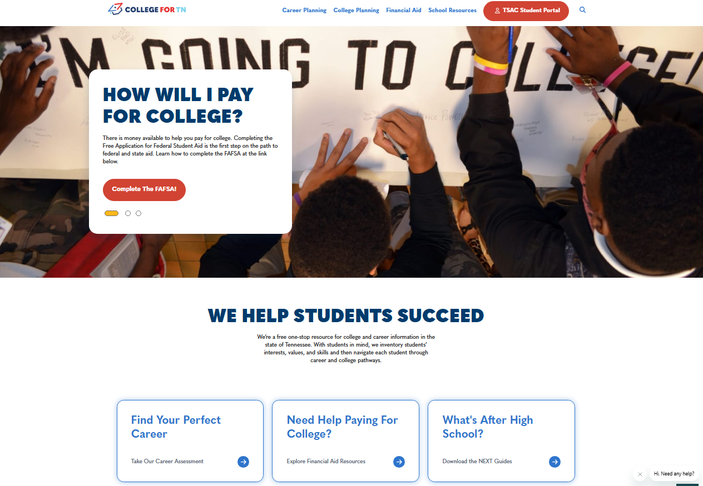
Resources on CollegeforTn.org
Career Exploration
College Exploration
TN Financial Aid by school type
FAFSA help

Slide 22

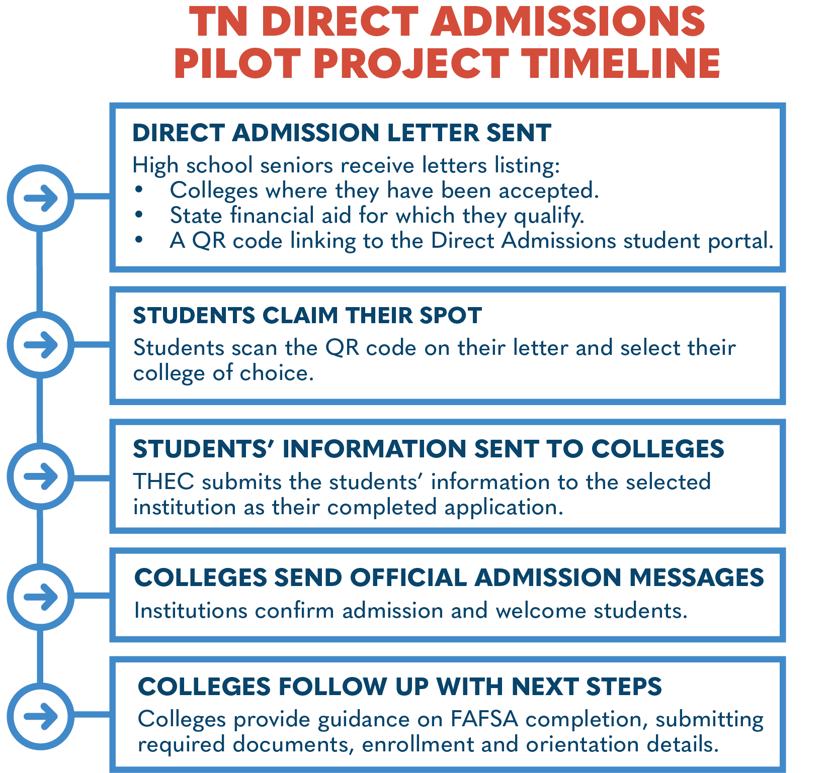
Leveraging data from the TN Promise application, ACT records, the Electronic Transcript Exchange, and existing FAST accounts, roughly two thirds of high school seniors (approx. 40,000) will receive a Direct Admissions letter in the mail from Governor Lee in November.

Slide 23
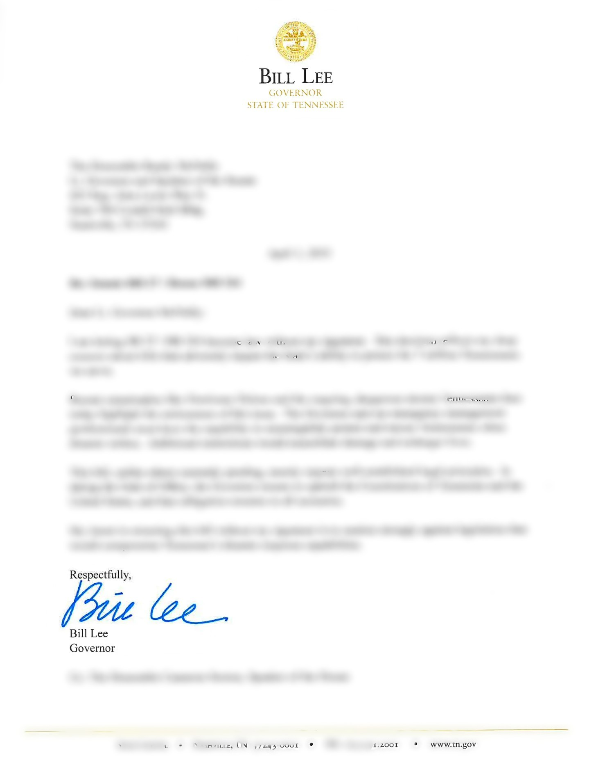
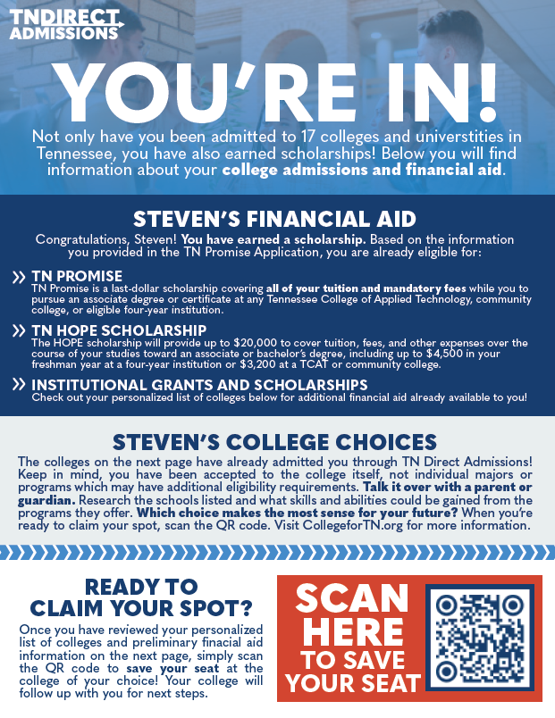
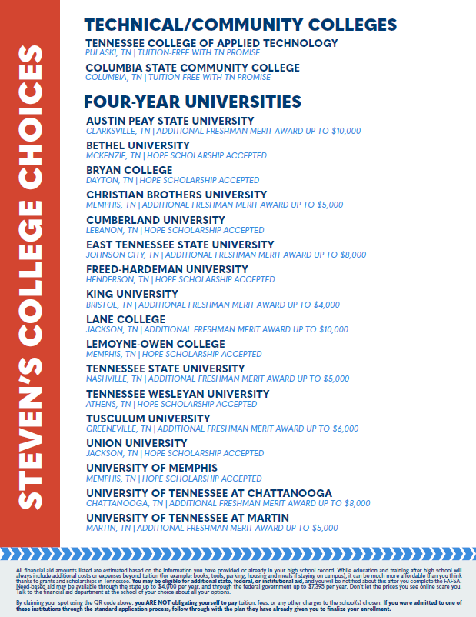

Slide 24


TN Direct Admissions Website –
www.collegefortn.org/direct-admissions/
- or scan the QR code on the left
Have questions about Direct Admissions?
Email us at direct.admissions@tn.gov

