Slide 1
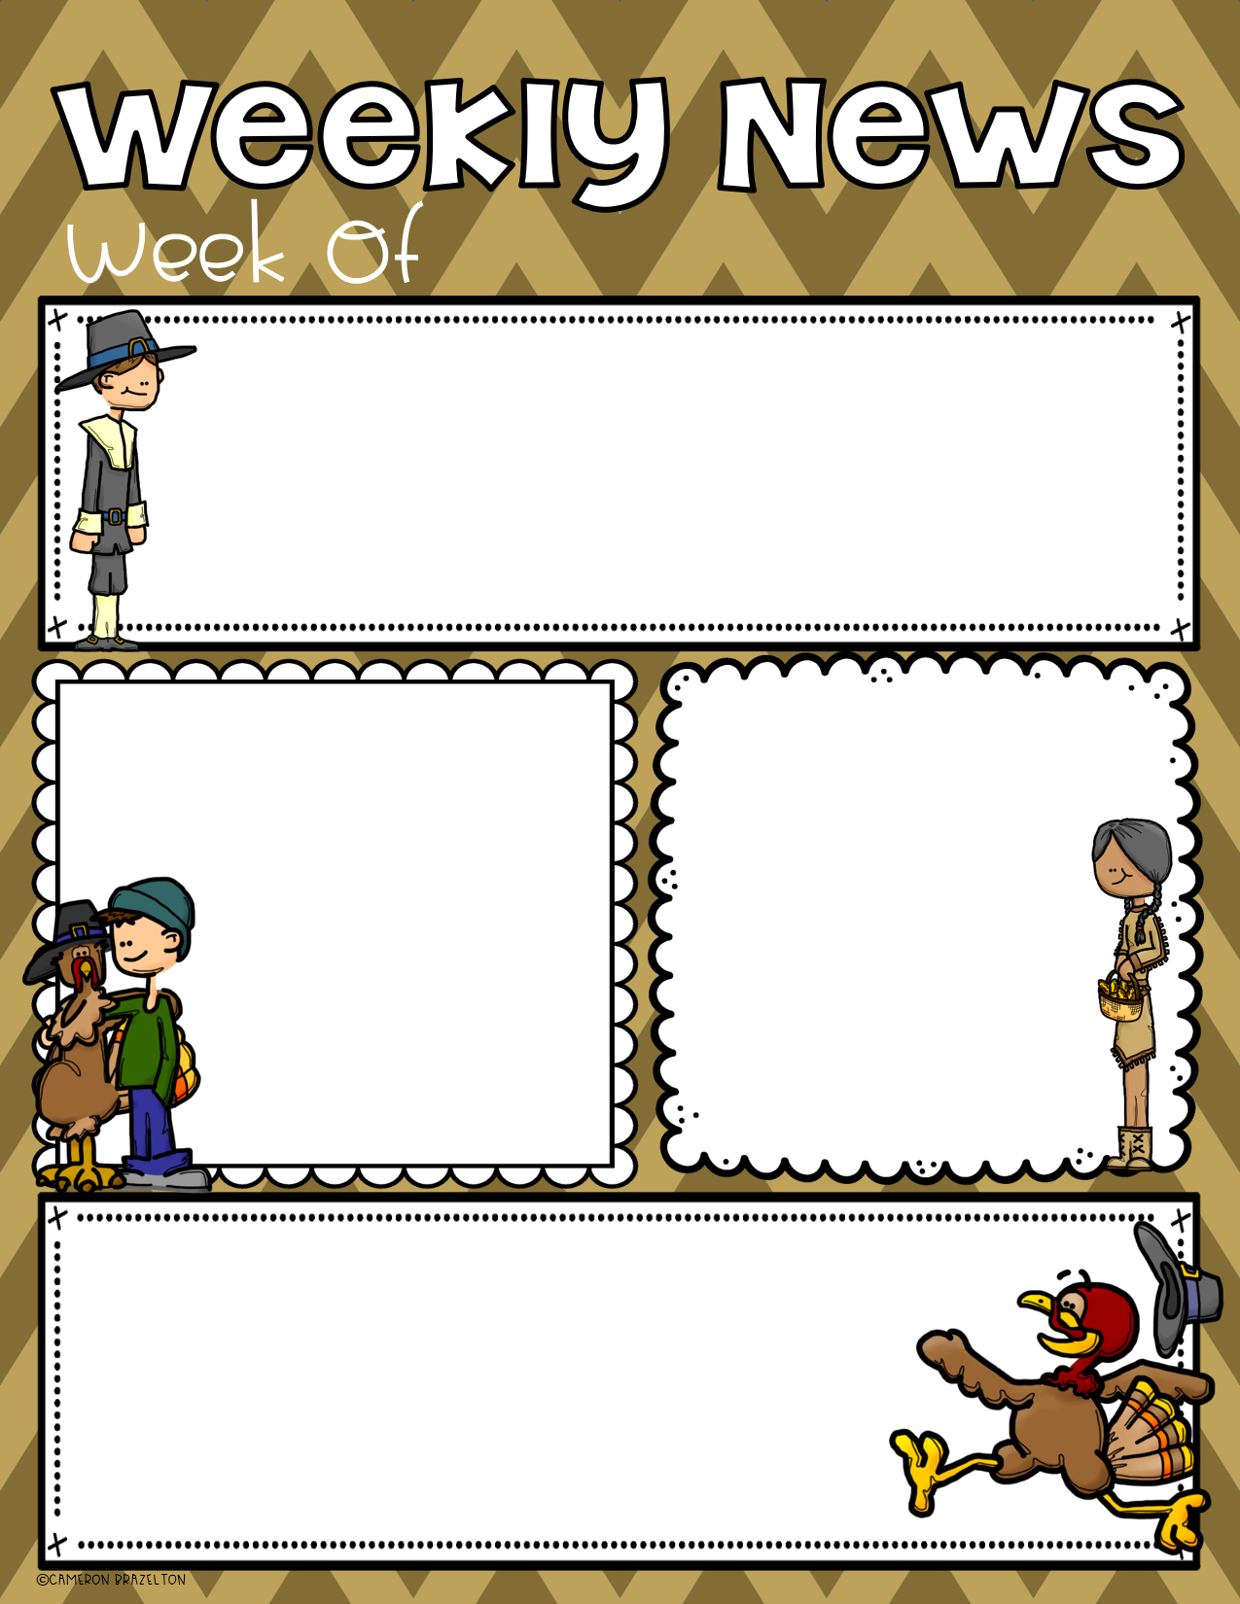
November 10
what we are learning:
We are learning about nonfiction turkeys!
*key details *main topic
Math: addition 0-10
Please remember:
Don’t forget:
*remove daily work
from BEE Binder
*send water
bottle
*check/initial
daily calendar
No School
11/10 &
11/11
Please review:
*letters and sounds
*sight words
*counting to 100 by 1s, 5s and 10s

